Slide 1
Welcome to
District 7750
Secretary’s Workshop

Slide 2
Secretary’s Role
As Secretary, you are the link between your club
and the rest of the Rotary world. You perform
many vital functions for your Club, the District and Rotary International. It is critical that these functions are both accurate and timely.

Slide 3
Learning Resources
You have several resources available to assist you in learning about your role and duties:
my.rotary.org => Learning & Reference =>
Learn by Topic => Club Roles => Secretary

Slide 4
Learning Resources
my.rotary.org => Learning & Reference =>
Learning Center =>
Get Ready: Club Secretary
Club Administration: Club Secretary

Slide 5
Learning Resources
DACdb.com => Support/Training
Attendance
Club
Officer Fundamentals
Pmail

Slide 6
Learning Resources
Rotary7750.org => Club Leader =>
Officers, Board & Committee Chairs =>
Secretary

Slide 7
Secretary’s Duties
From Rotary’s Recommended Club Bylaws:
Article 4 Duties of Officers
Section 4 – Secretary
“It shall be the duty of the secretary to:

Slide 8
Secretary’s Duties
Keep membership records
Record the attendance at meetings
Send out notices of club, board and committee meetings

Slide 9
Secretary’s Duties
Report as required to RI, including the semi-annual reporting of membership on or before 1 January and 1 July of each year
Report changes in membership
Perform other duties as usually pertain to the office of secretary.”

Slide 10
Secretary’s Best Resources
www.dacdb.com
www.my.rotary.org
You can access either from:
www.Rotary7750.org

Slide 11
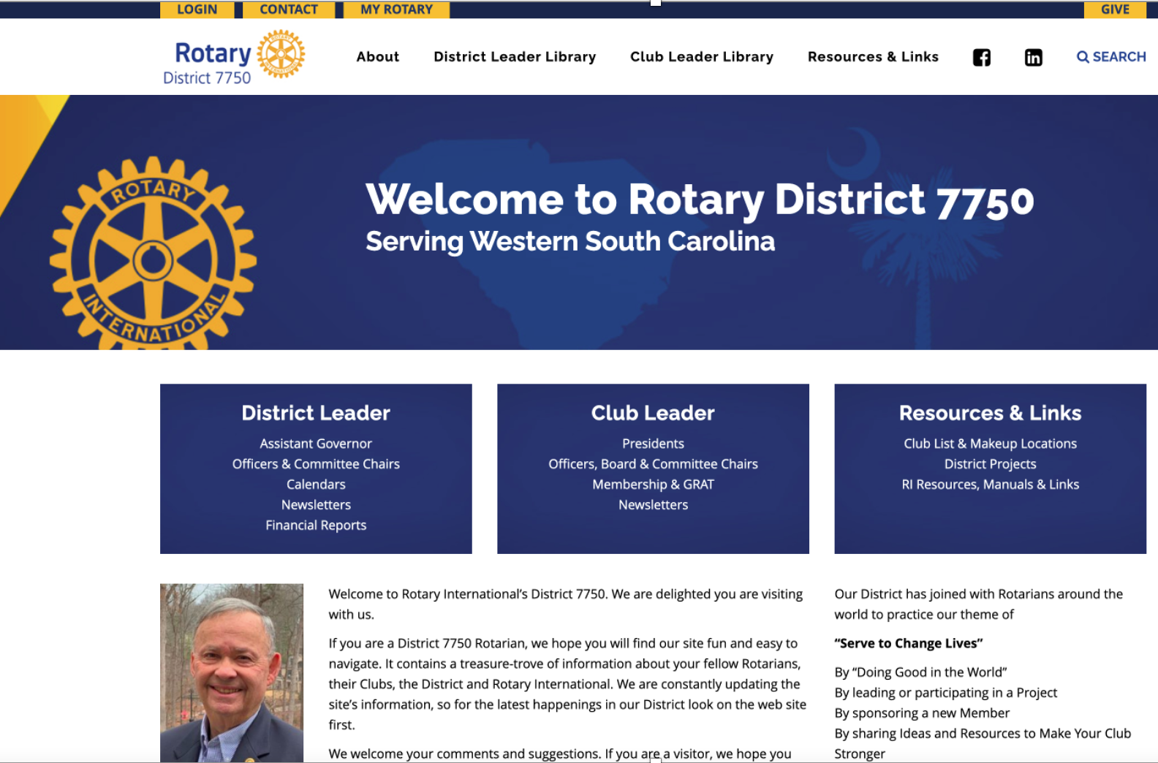

Slide 12
Keeping Membership Records / Reporting Changes in Membership

Slide 13
Adding New Members
to RI and DACdb
Adhering to these “best practices” in adding members to both RI (my.rotary.org) and the District (dacdb.com) databases will result in better data, less confusion, and easily accessible contact information for members and prospects.

Slide 14
Adding a New Member
to Your Club
ALWAYS, ALWAYS, ALWAYS begin in my.rotary.org!

Slide 15
Adding a New Member
to Your Club
Step 1: Add new Member to RI Database
Sign into www.my.rotary.org
Mouse over MANAGE
Mouse over Club & District Administration
Click on Club Administration
These steps are illustrated on the next slide

Slide 16
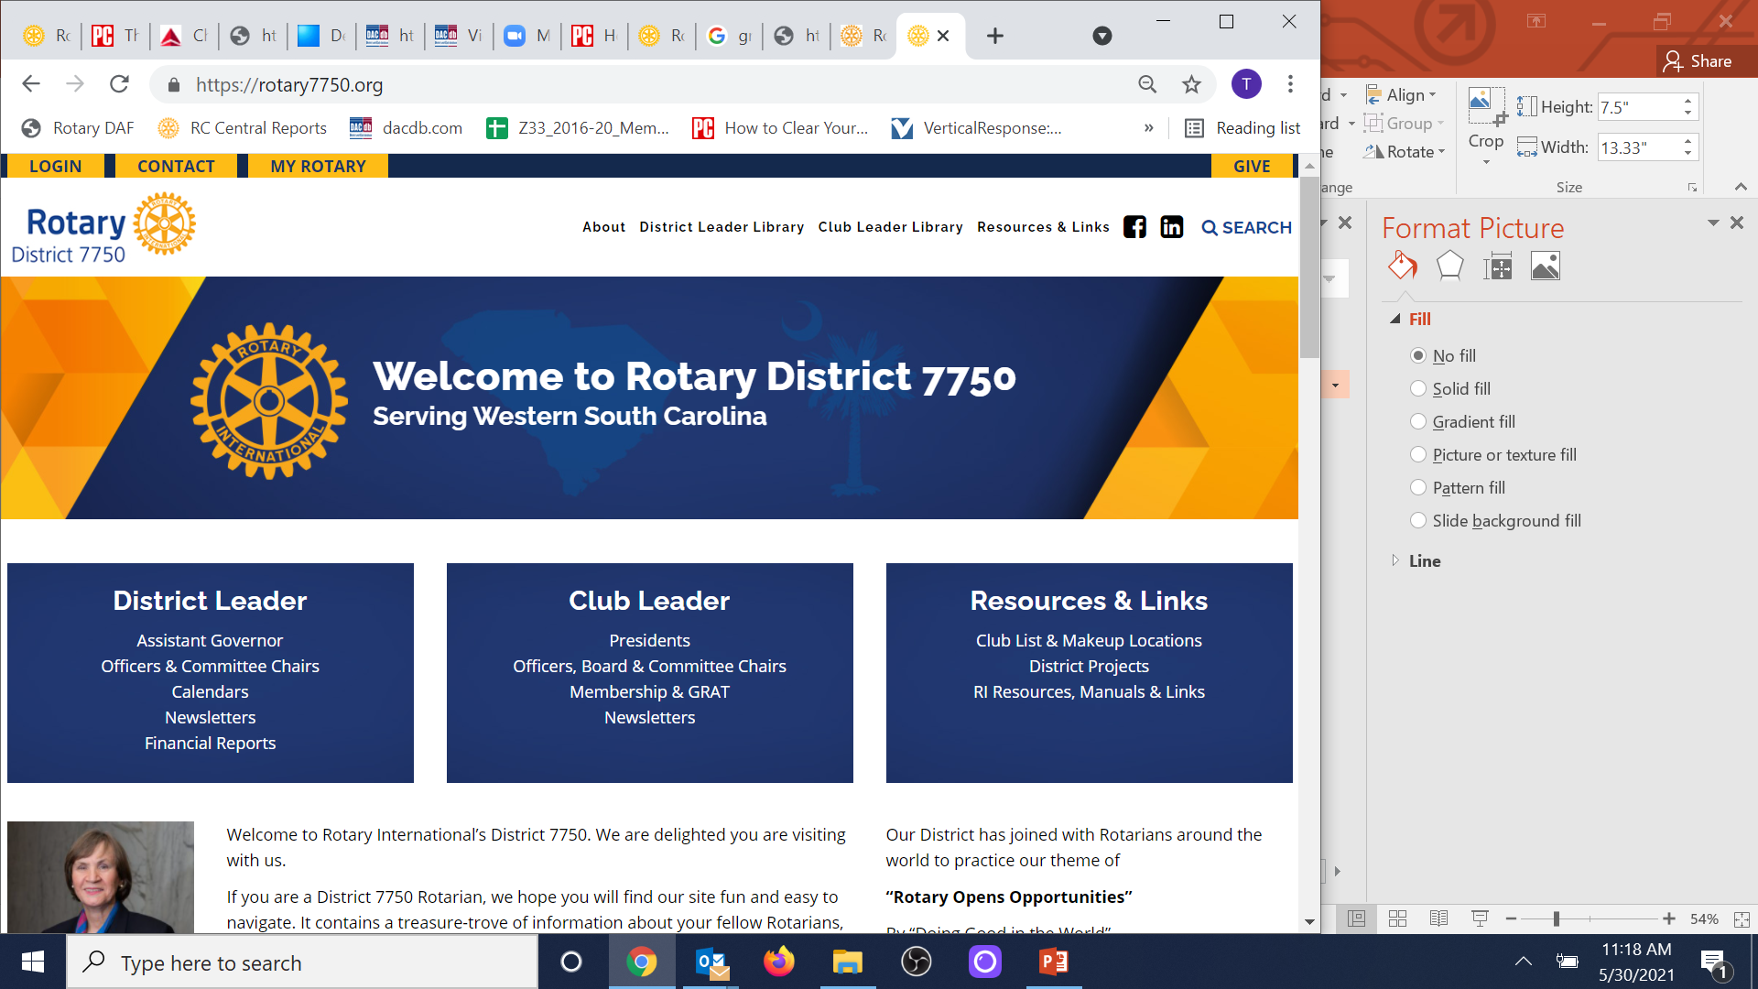
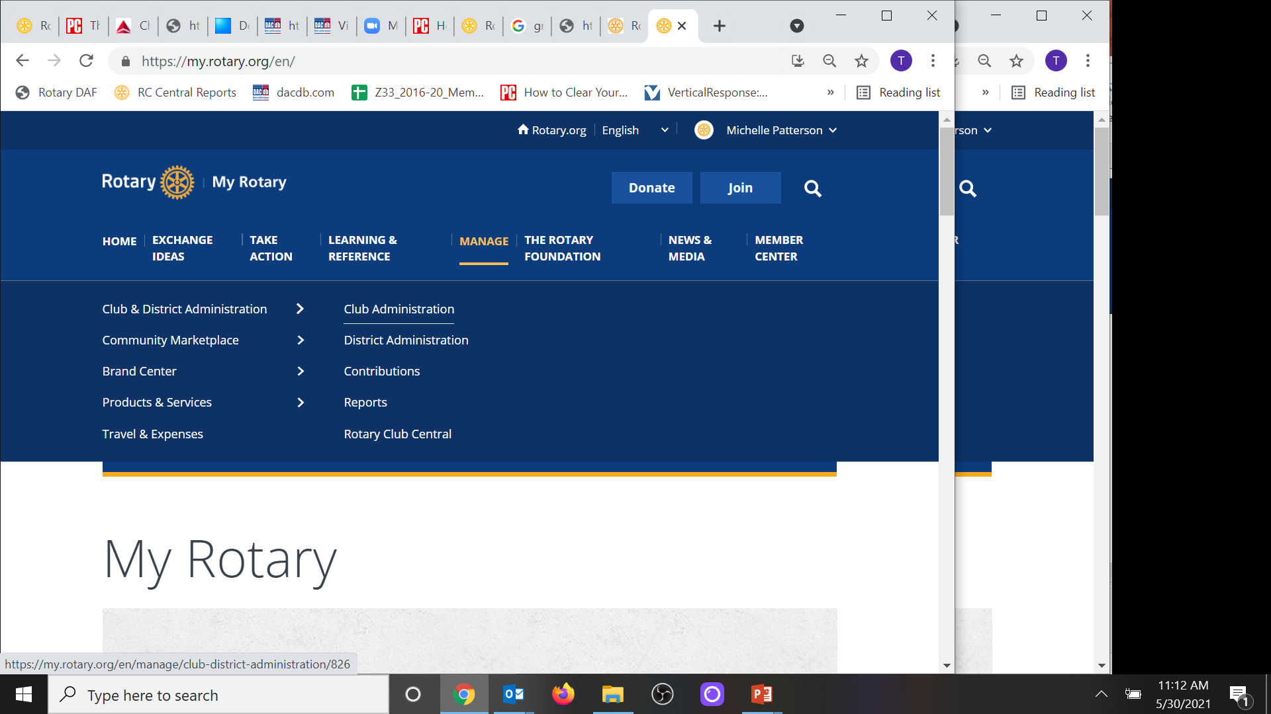
Start at: www.Rotary7750.org

Slide 17
Adding a New Member
to Your Club
Click on Add, edit, or remove members
This step is illustrated on the next slide

Slide 18
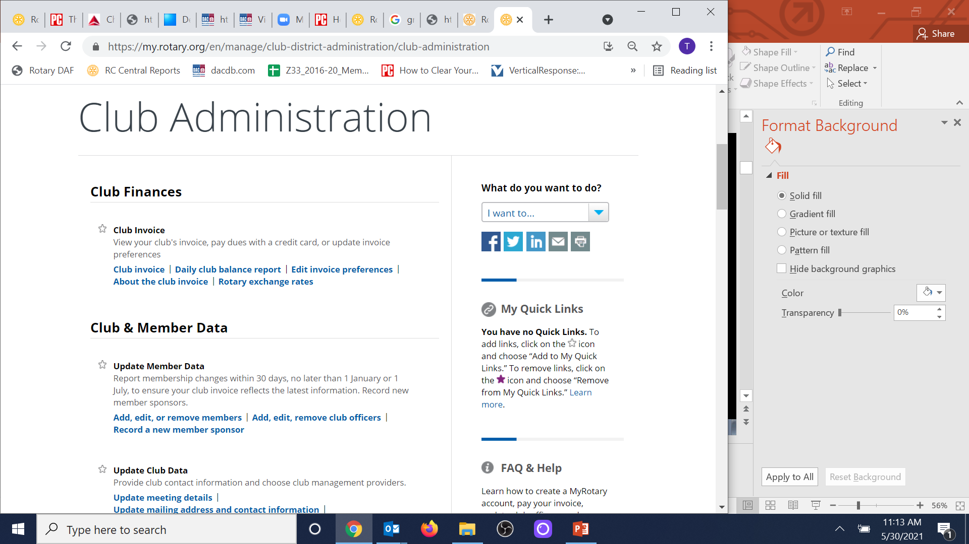
Notes:
18

Slide 19
Adding a New Member
to Your Club
Click on ADD A MEMBER
This step is illustrated on the next slide

Slide 20
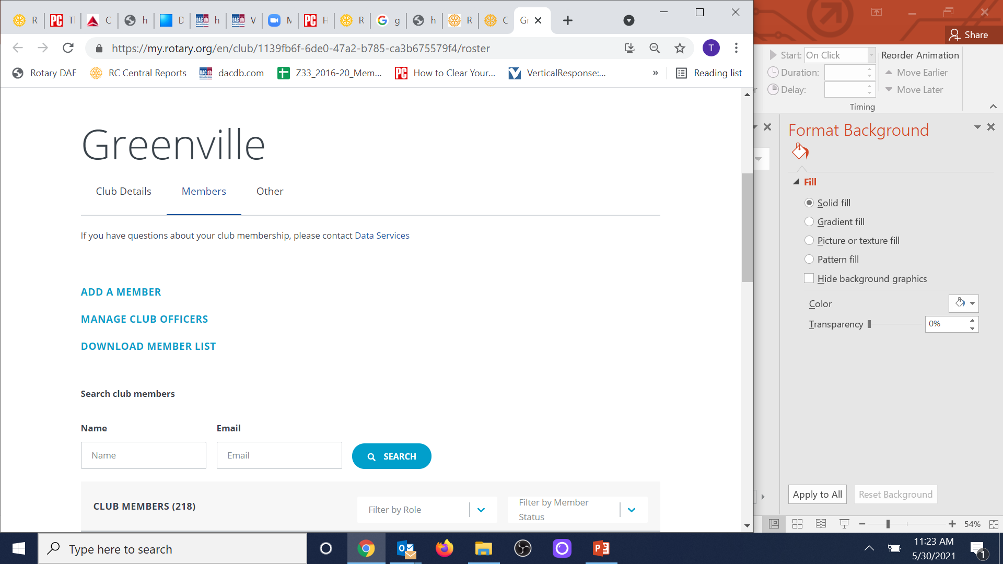
Notes:
20

Slide 21
Adding a New Member
to Your Club
Identify Member
Search by last name
Further narrow the search by entering an email address if you have it
These steps are illustrated on the next slide

Slide 22
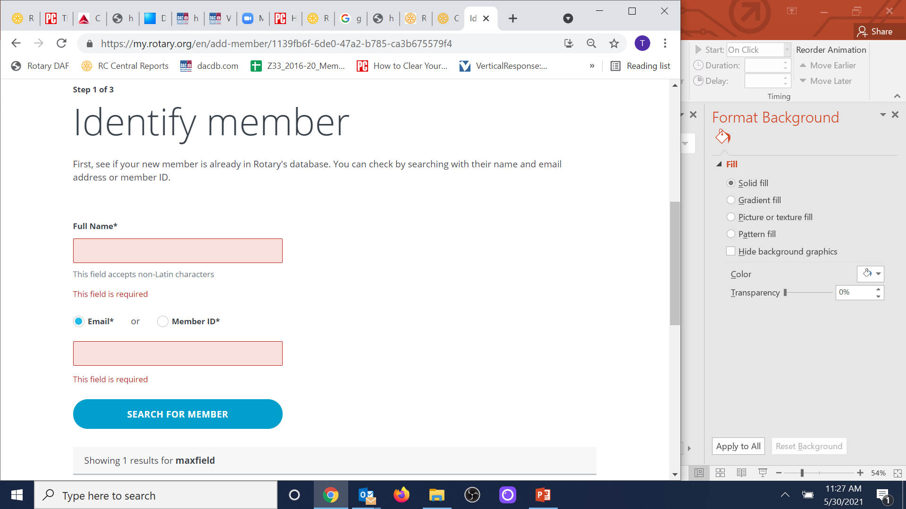
Weaver
terry@tweaver.com
Notes:
22

Slide 23
Adding a New Member
to Your Club
If the search does not find your new member, click ADD AS A NEW MEMBER and follow the prompts to enter the minimal required fields.

Slide 24
Adding a New Member
to Your Club
You have successfully added your new member to RI, when you receive the following message:
Successfully added (Name) to club with
member ID #######.

Slide 25
When Your New Member
is a Prior Rotarian
If the search finds that your new member has been a member of another Rotary club, do NOT create another record.

Slide 26
When Your New Member
is a Prior Rotarian
Look at the information provided for OTHER CLUB AFFILIATION
If (Terminated) appears beside the club name, you may click CONTINUE WITH THIS PERSON to add this person to your club in RI.

Slide 27
When Your New Member
is a Prior Rotarian
If (Member) appears beside the club name, you will need to contact that club secretary to have your new member terminated from that club before you can add this Rotarian to your club.
This scenario is illustrated on the next slide

Slide 28
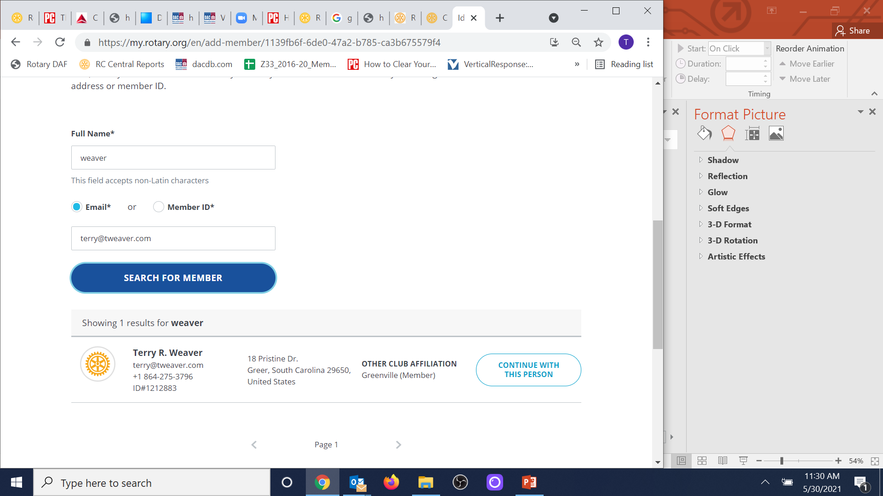
If (Member) appears beside the club name, you must contact that club secretary and have your new member terminated from that club before you can add to your club
Click this button only if OTHER CLUB AFFILIATION has (Terminated) beside the club name.
Notes:
28

Slide 29
Adding a New Member
to Your Club
Step 2: Add new Member to DACdb
Sign into dacdb.com
Click the My CLUB tab
Click Club Members icon
Click RI Integration in left panel
Click Member Compare
These steps are illustrated on the next slide

Slide 30
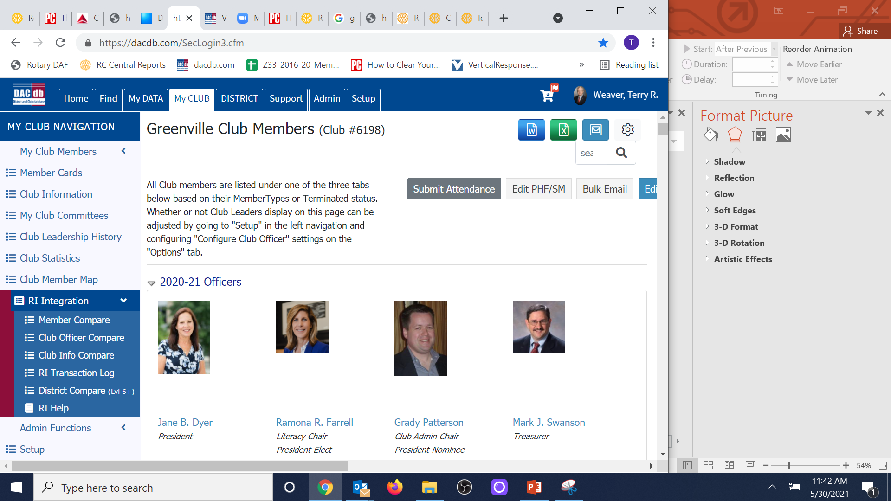

Slide 31
Adding a New Member
to Your Club
NOTE: If you have been tracking this new member in DACdb, first as a potential member, then as a proposed member, do NOT follow these instructions to officially add this person as a new member in DACdb. Refer to the slides “When a Proposed Member Becomes a New Member” for those instructions.

Slide 32
Adding a New Member
to Your Club
Club members who have records in the RI database will be displayed on the left; members with records in the DACdb database will be displayed on the right.

Slide 33
Adding a New Member
to Your Club
Locate your new member alphabetically in the Members in Rotary list on the left
Click Add to DACdb
These steps are illustrated on the next slide

Slide 34
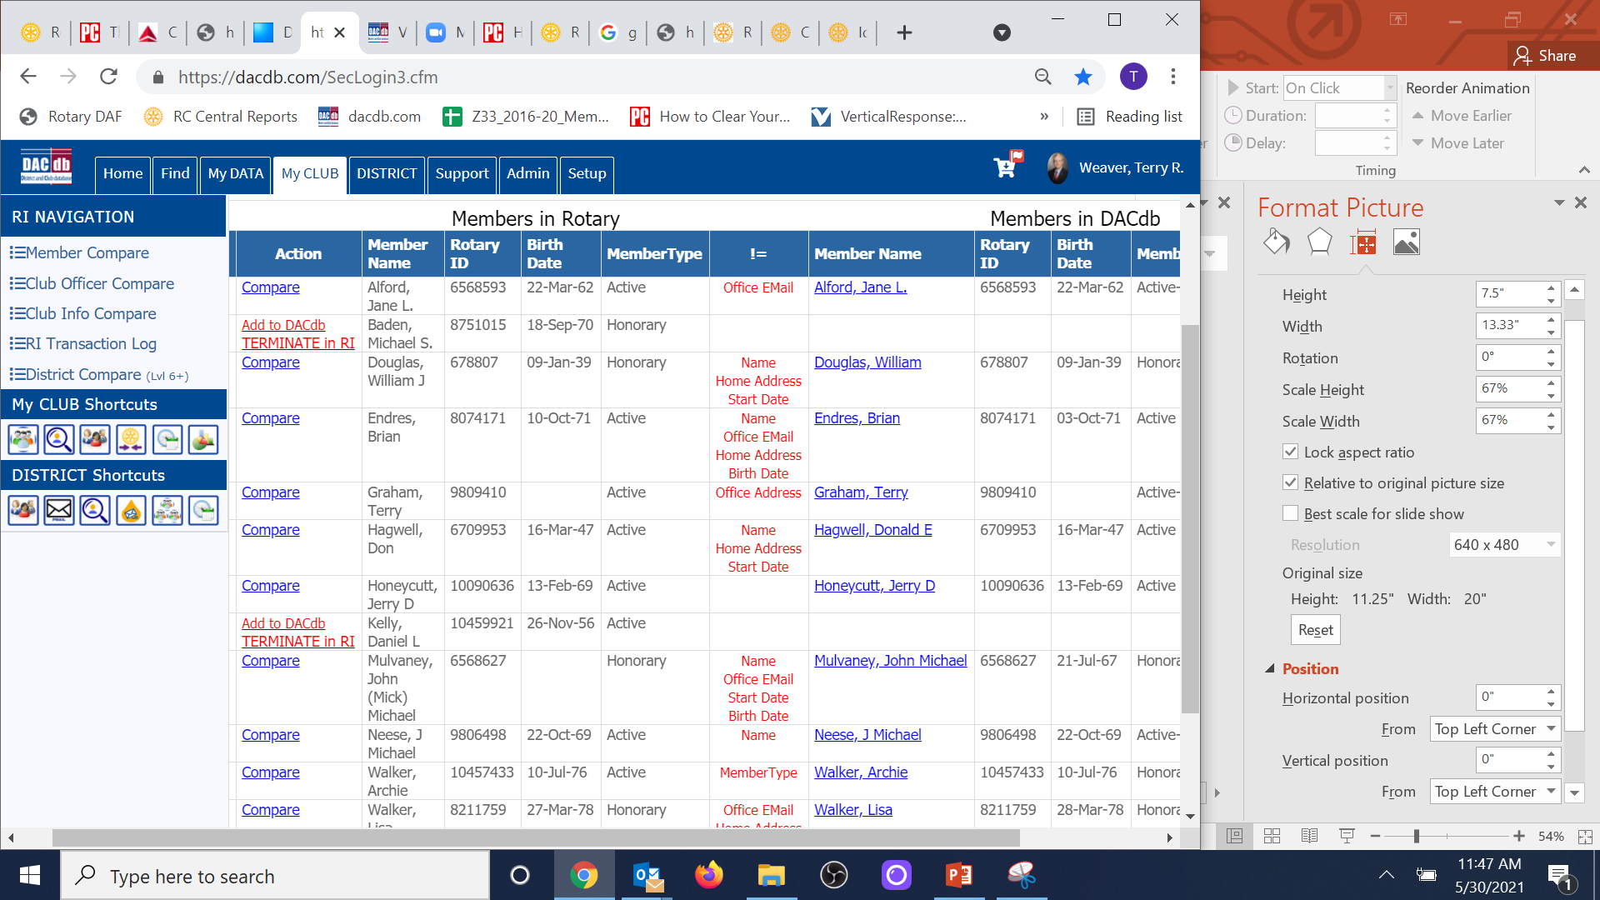

Slide 35
Adding a New Member
to Your Club
You have now successfully added the new member to your club!!

Slide 36
Adding a New Member
to Your Club
All future updates to the member’s record (e.g. address change/termination of membership) should be made in DACdb as these changes are automatically sent to RI.
You never need to open the member’s record in RI again.

Slide 37
As an Aside: Member Compare
You should routinely use this feature to identify discrepancies in member records between the two databases.
The != column in the middle identifies data fields that do not match.

Slide 38
Using DACdb to Track &
Market to Potential Members
Anytime a non-member visits your club, attends a Discover Rotary event, participates in a service project, attends a fundraiser, etc., collect his/her contact information on a form similar to the one illustrated on the next slide.

Slide 39
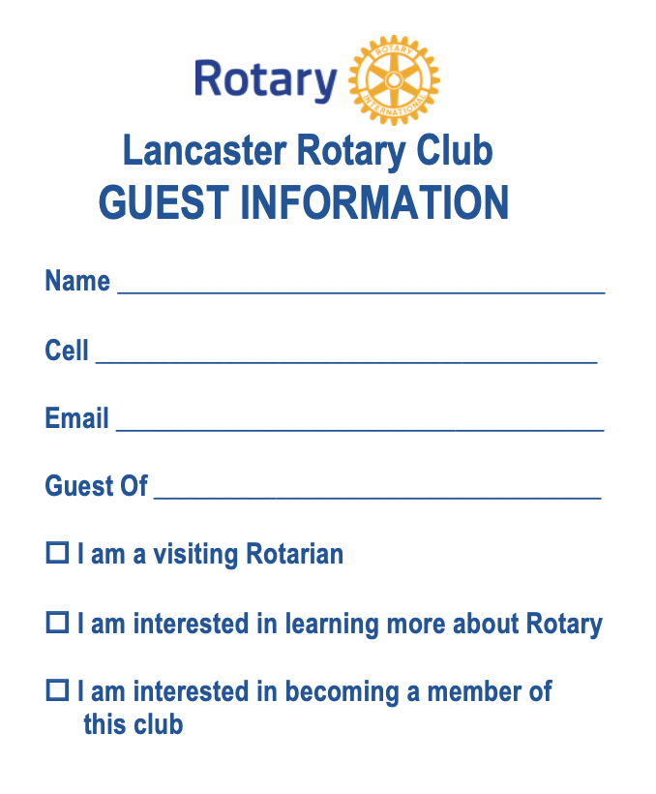
Using DACdb to Track &
Market to Potential Members

Slide 40
Using DACdb to Track &
Market to Potential Members
Add the Potential Member to DACdb:
Sign into dacdb.com
Click the My CLUB tab
Click Club Members icon
Click on Add New Member tab
These steps are illustrated on slide #29

Slide 41
Using DACdb to Track &
Market to Potential Members
Add the Potential Member to DACdb:
Do NOT enter a number in the Rotary ID field
Select Potential Member as the Member Type
These steps are illustrated on the next slide

Slide 42
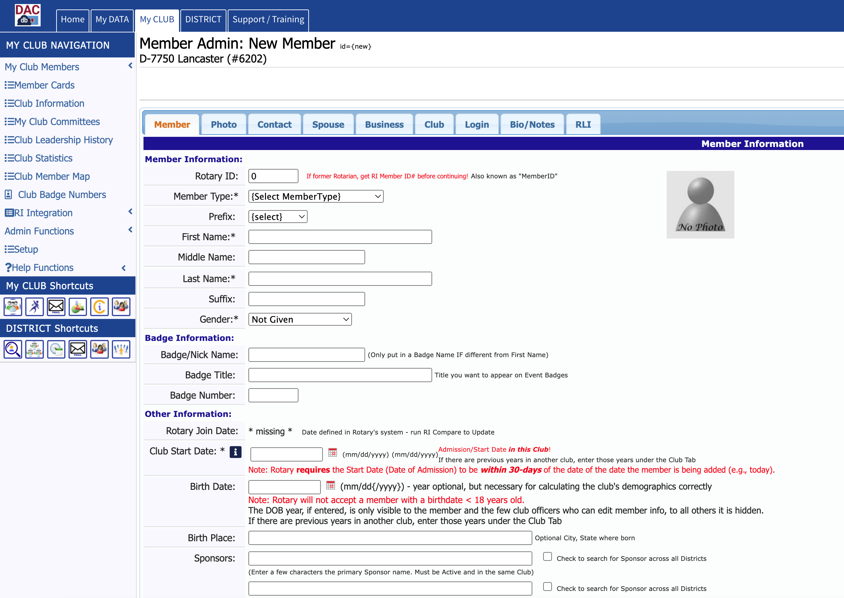

Slide 43
Using DACdb to Track &
Market to Potential Members
Add the Potential Member to DACdb:
Complete the required fields for the Member Tab:
First Name
Last Name
Gender
Club Start Date
These steps are illustrated on the next slide

Slide 44
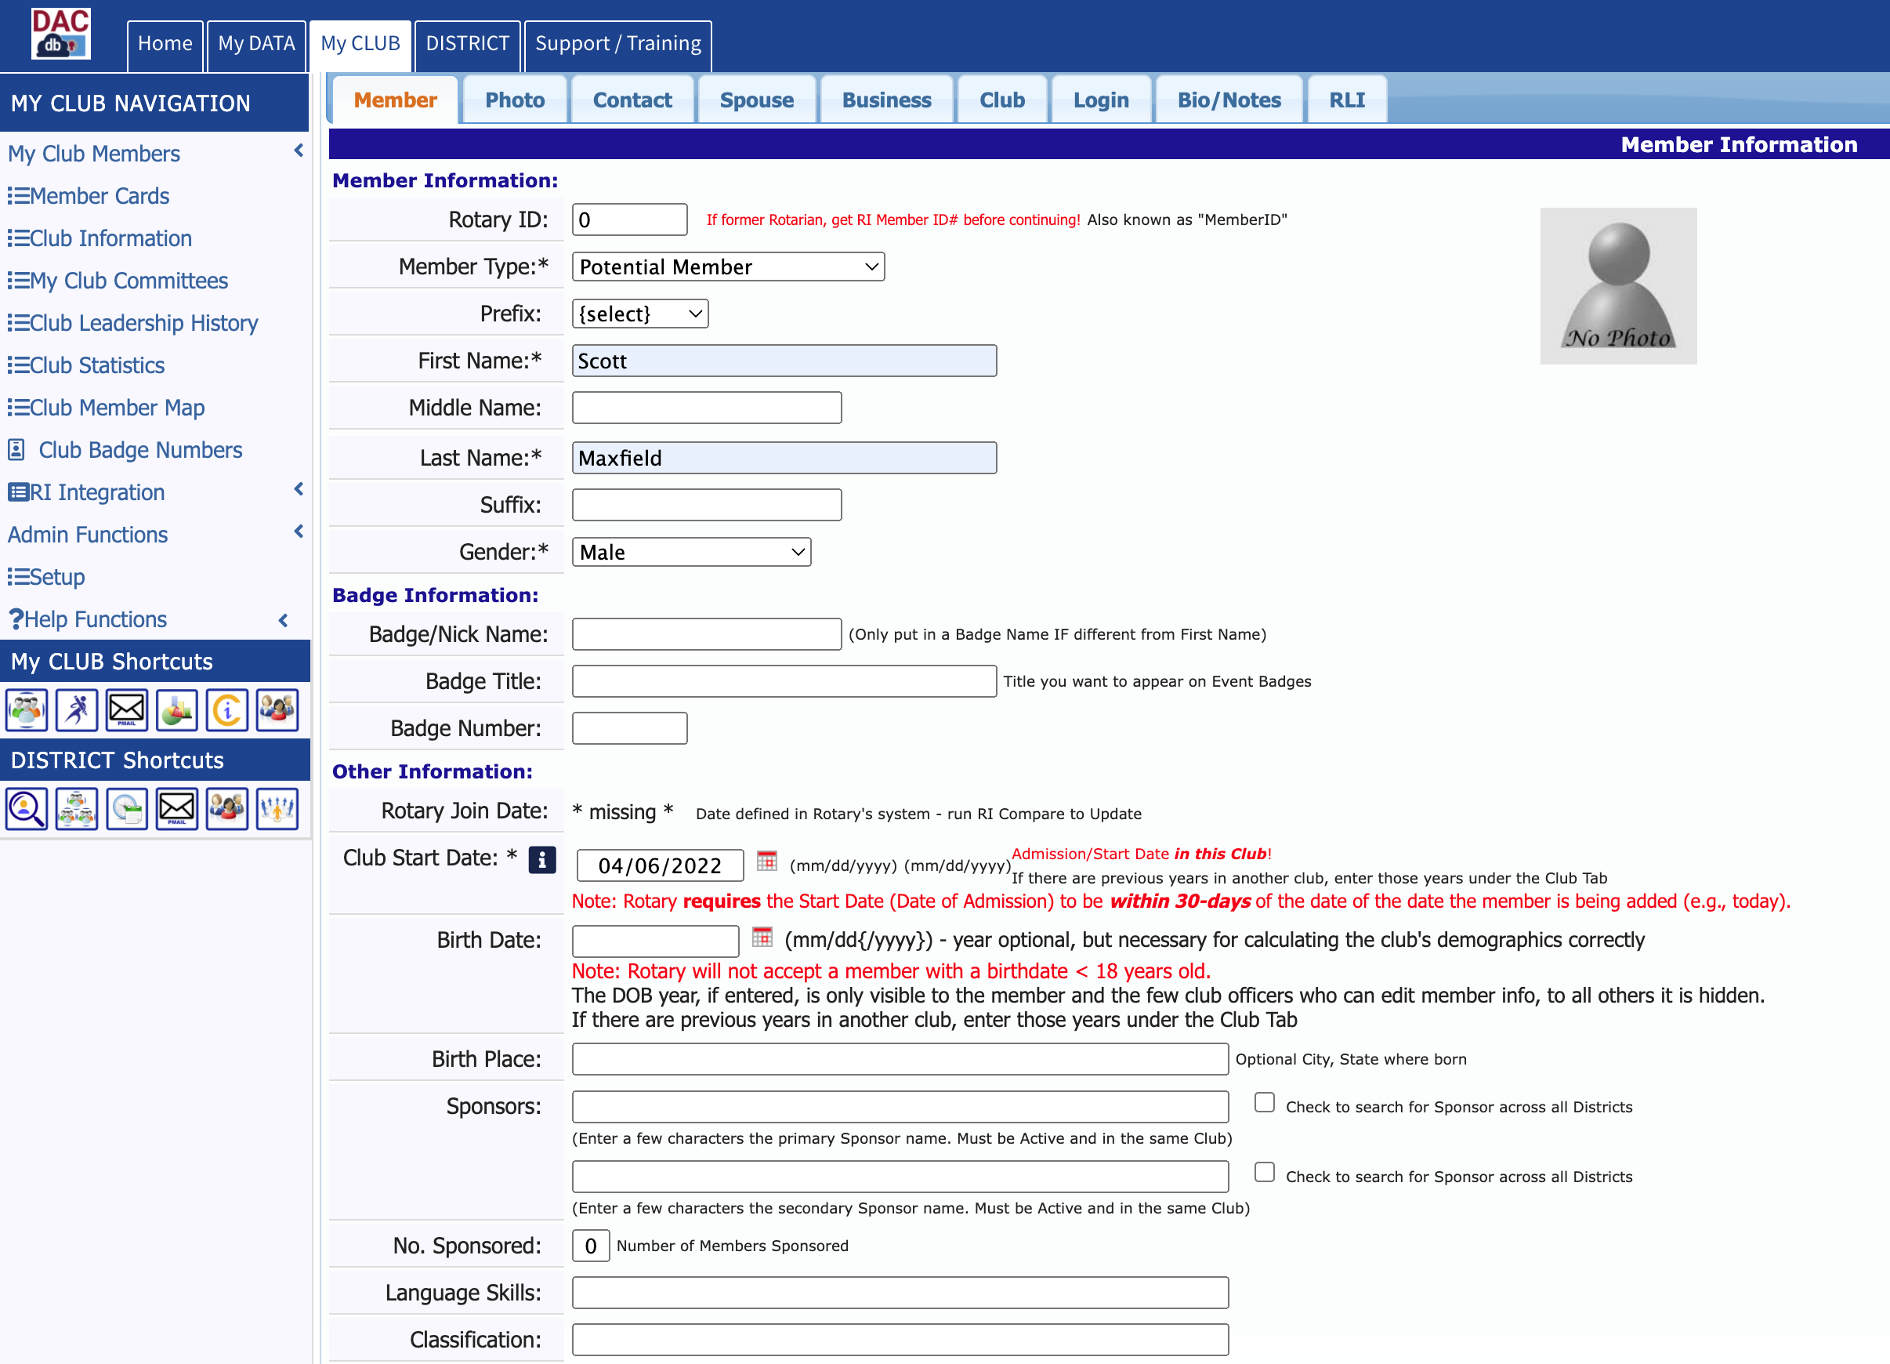

Slide 45
Using DACdb to Track &
Market to Potential Members
Add the Potential Member to DACdb:
Complete the fields for which you have data on the Contact Tab:
Email
Cell Phone
Click the Add button in the upper right corner
These steps are illustrated on the next slide

Slide 46
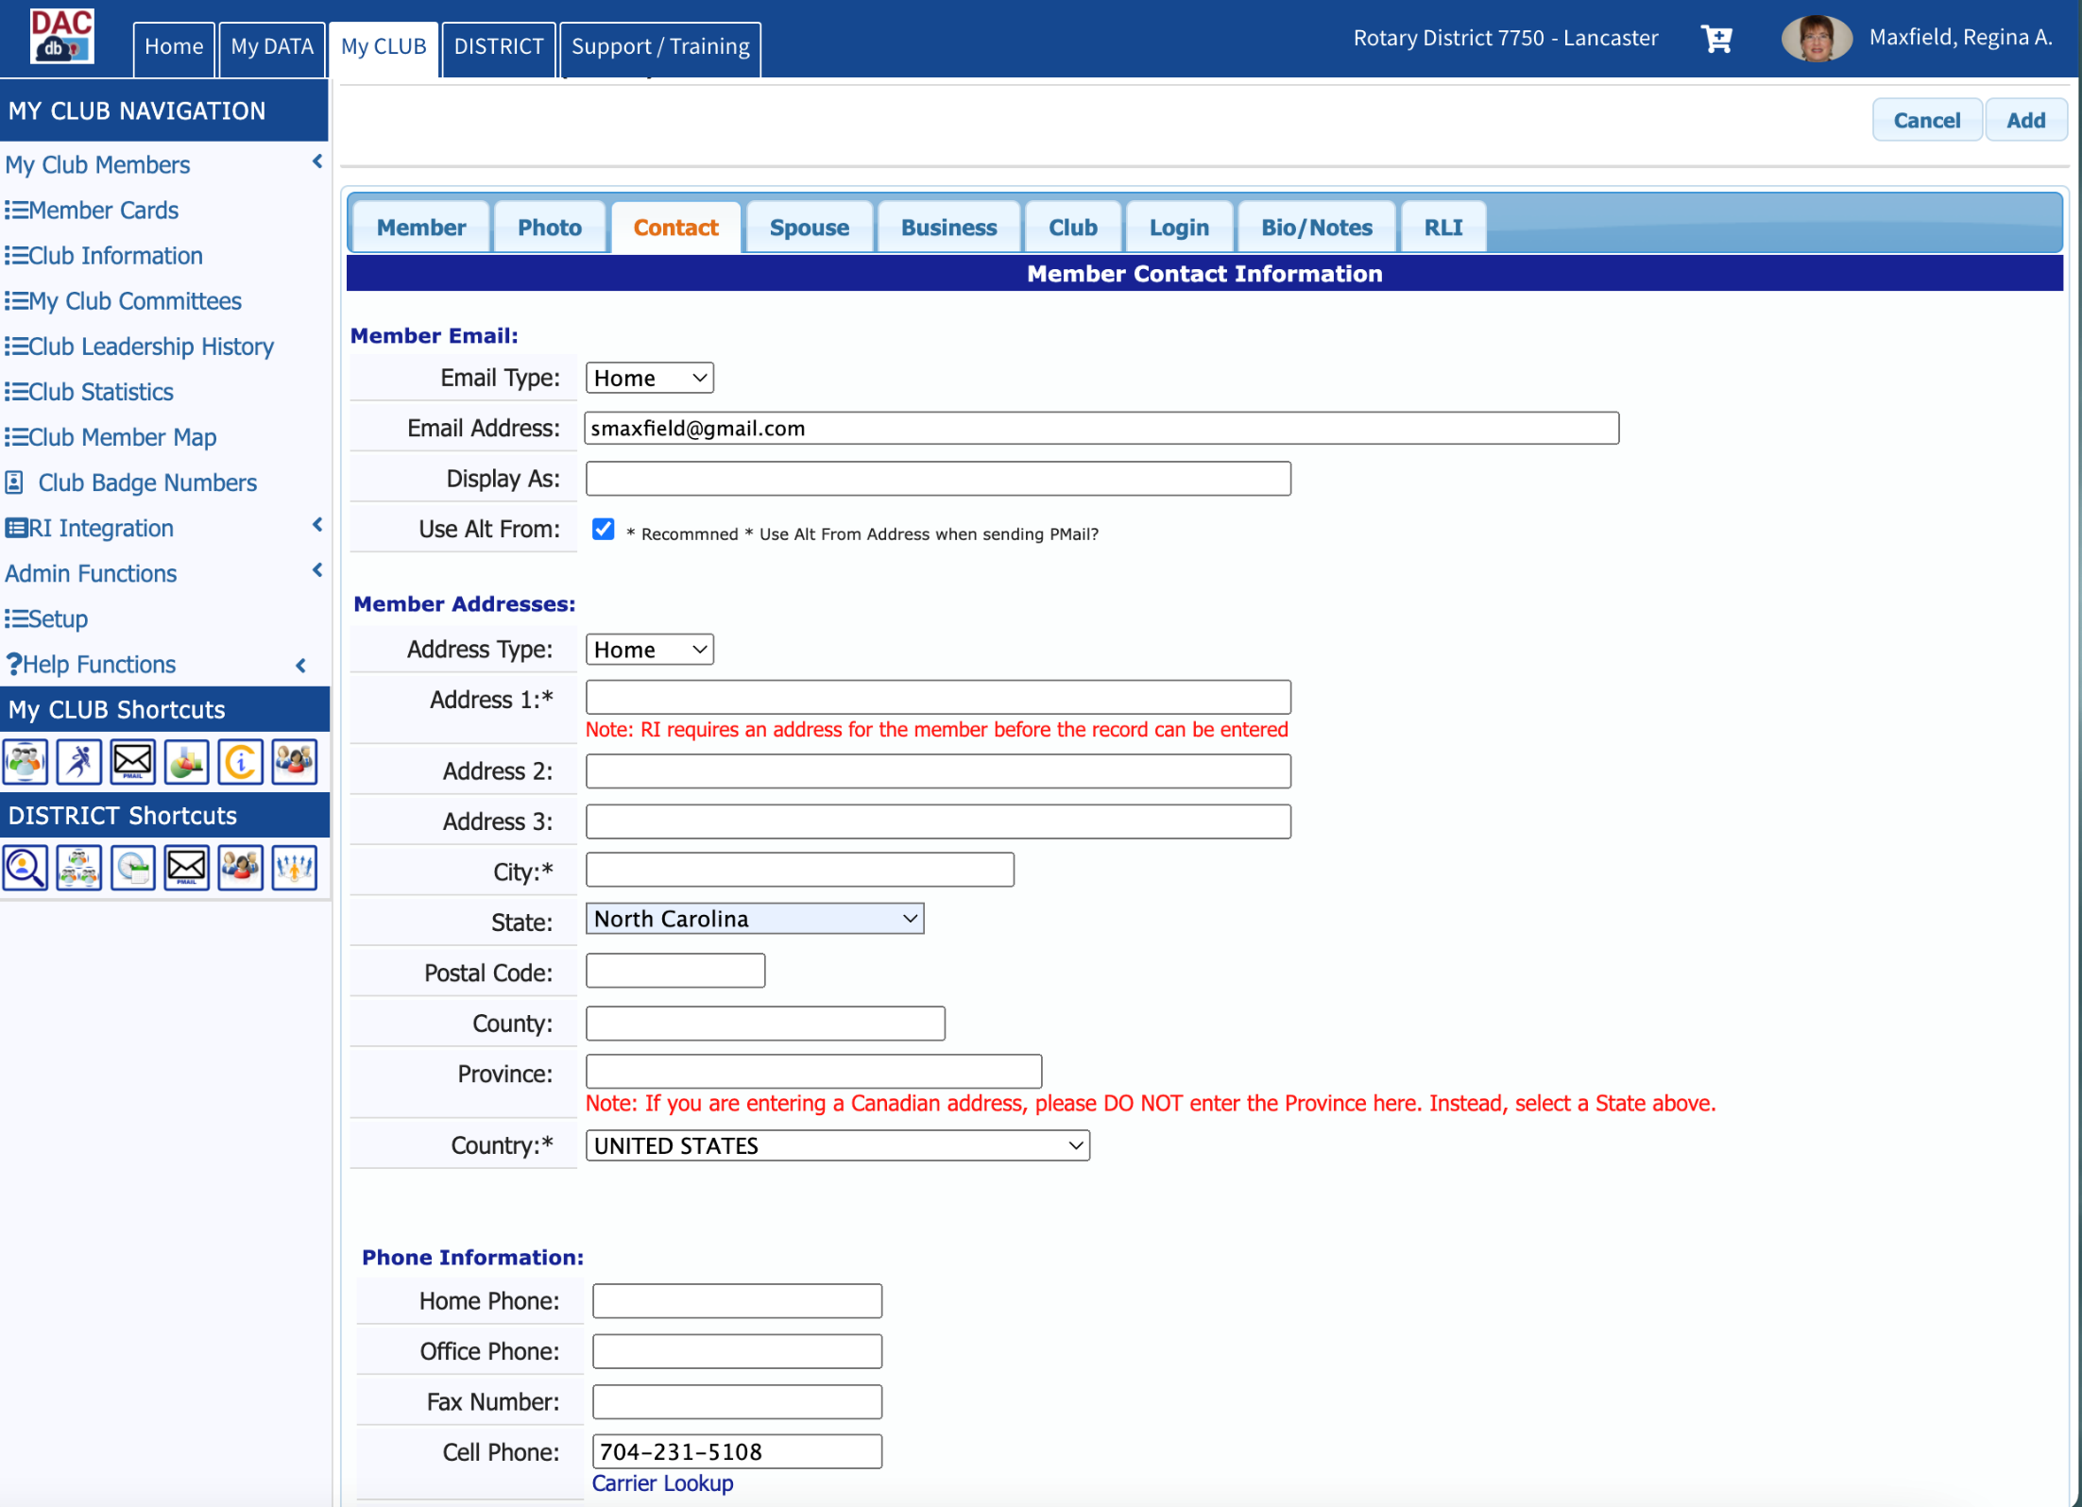

Slide 47
Using DACdb to Track &
Market to Potential Members
You may now include Potential Members in Pmail communications.
Attend the Advanced DACdb session to learn more about Pmail.

Slide 48
When a Potential Member
Becomes a Proposed Member
When a potential member becomes a proposed member, i.e. an application has been completed and signed by both the proposed member and his/her sponsor, simply change the Member Type in the member’s DACdb record.
This step is illustrated on the next slides

Slide 49
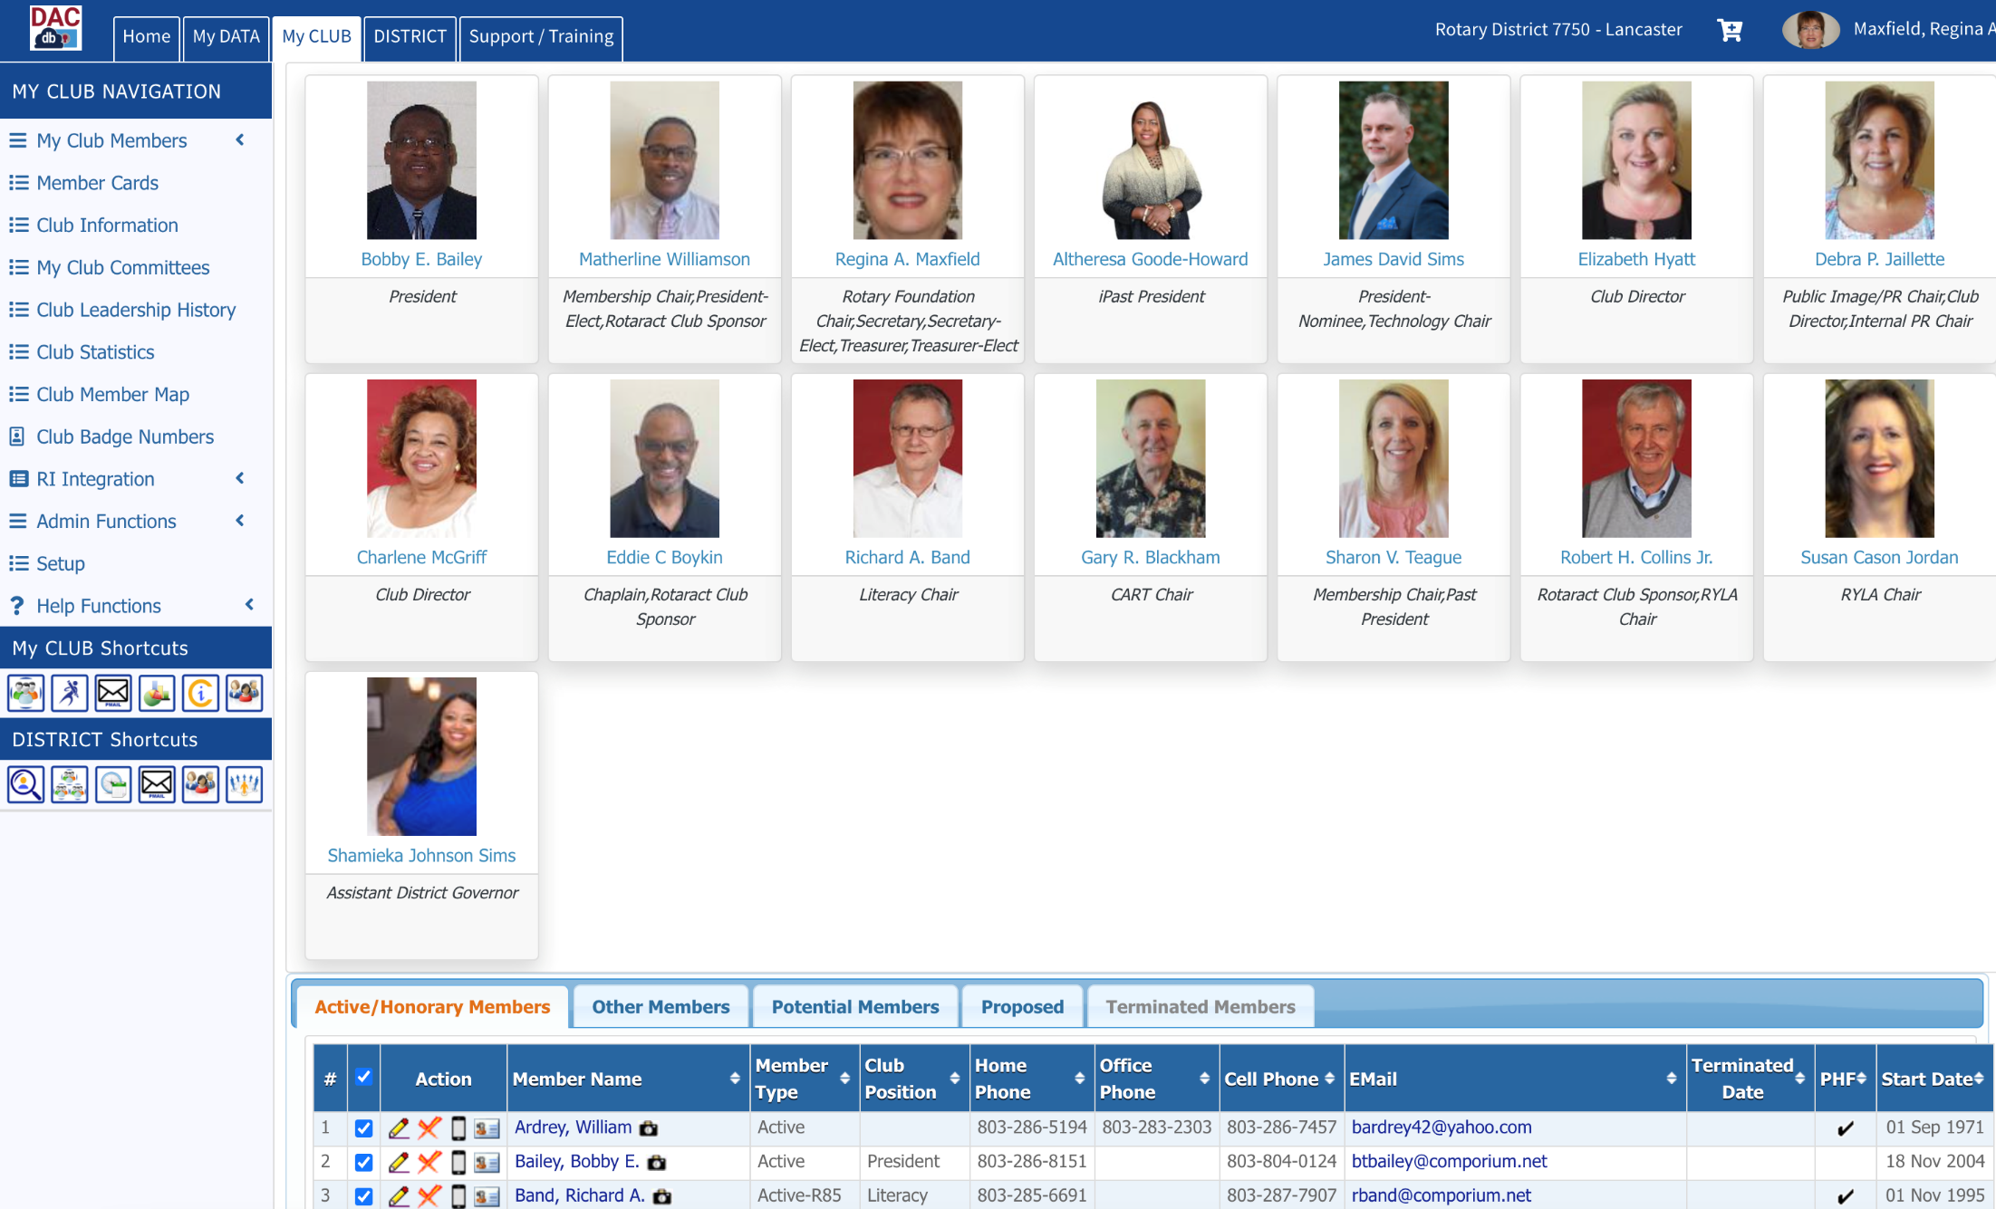

Slide 50
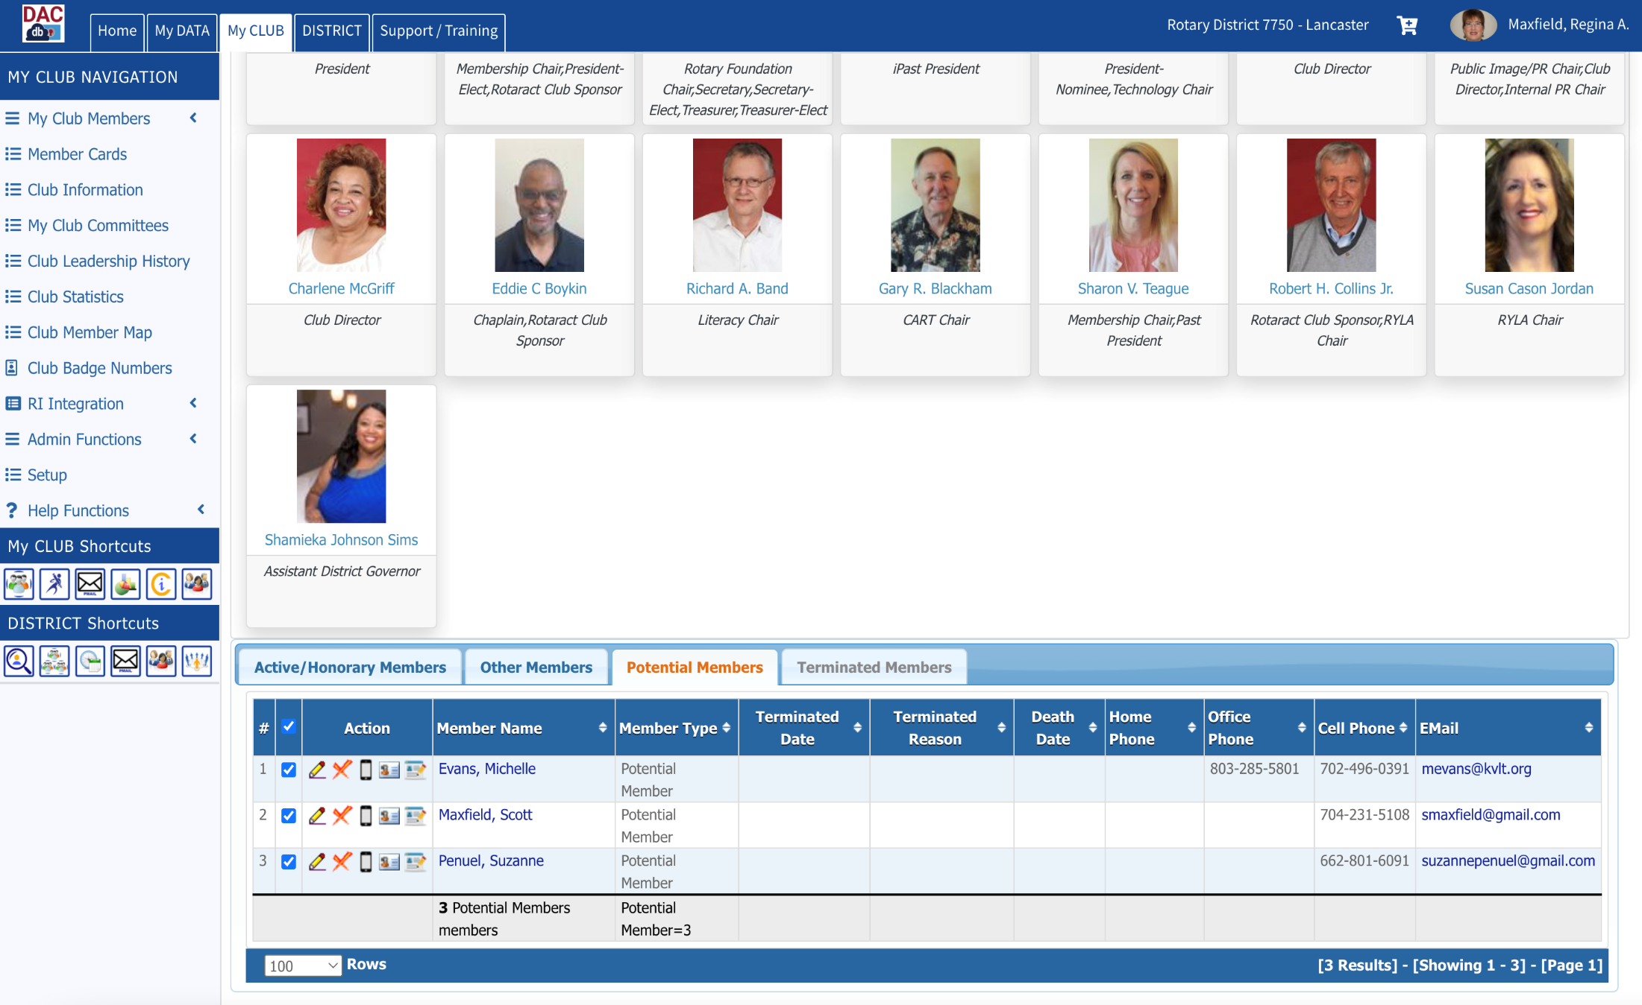
Clicking on the
pencil icon puts the record in Edit Mode

Slide 51
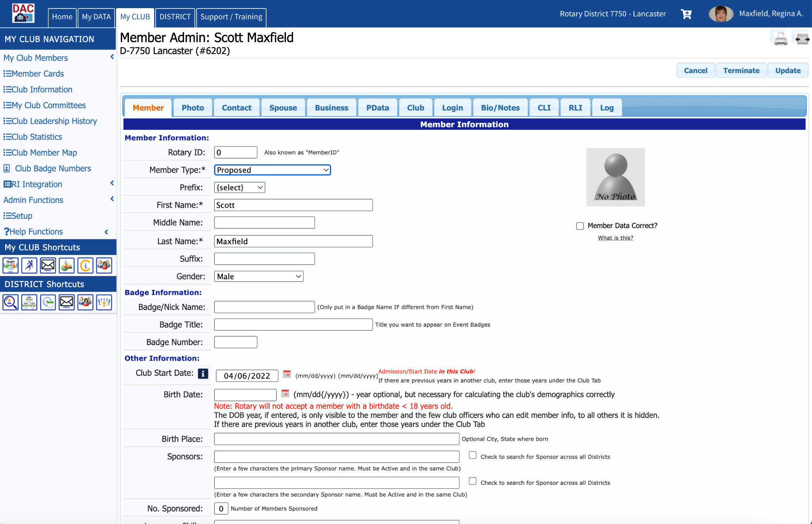

Slide 52
When a Potential Member
Becomes a Proposed Member
Once the proposed member has been approved by the board and club members have had an opportunity to voice any concerns/objections, do NOT yet add the new member to the RI database.

Slide 53
When a Potential Member
Becomes a Proposed Member
A recommended “best practice” is to invoice the new member for dues, meals, etc. per your club’s practice. Only when the new member’s payment has arrived, is it time to induct the member and add him/her to the RI database.

Slide 54
When a Proposed Member
Becomes a New Member
Add the new member to the RI Database as described beginning on Slide #14.
Remember to search to see if your new member is a Prior Rotarian.
When you get to Step 2: Add new Member to DACdb, STOP and follow the instructions on the next slide.

Slide 55
When a Proposed Member
Becomes a New Member
To make a member you have been tracking thru DACdb (first as a Potential Member and then as a Proposed Member) an Active member in your club, simply edit the following fields in the member’s DACdb record:

Slide 56
When a Proposed Member
Becomes a New Member
Enter the Rotary ID assigned when you entered the member in my.rotary.org
Change the Member Type to Active
Change the Start Date to the date you entered the member in my.rotary.org.
This step is illustrated on the next slides

Slide 58
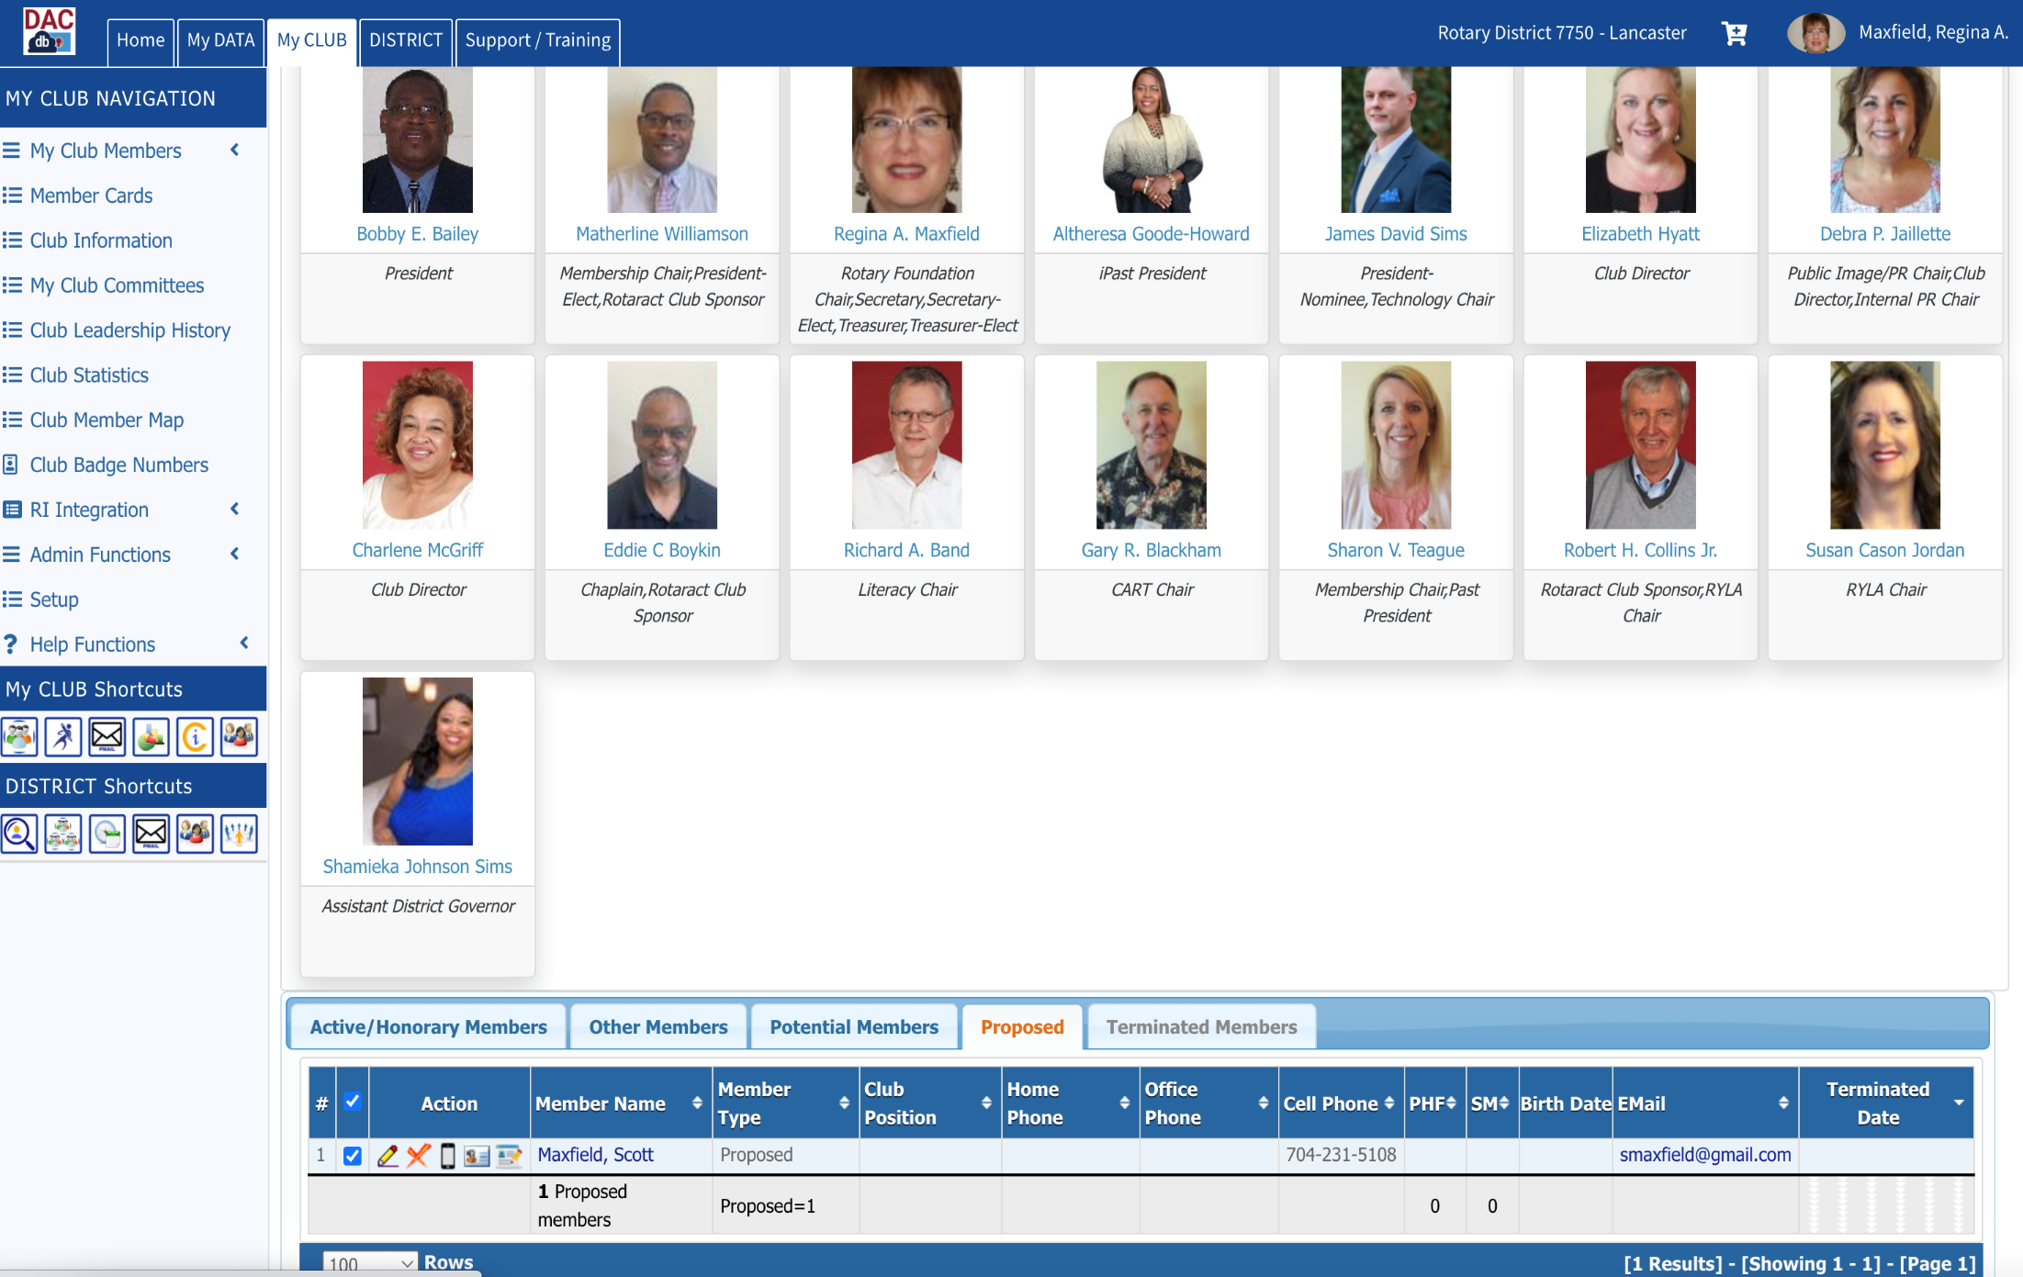
Click the pencil to put the record into Edit Mode

Slide 59
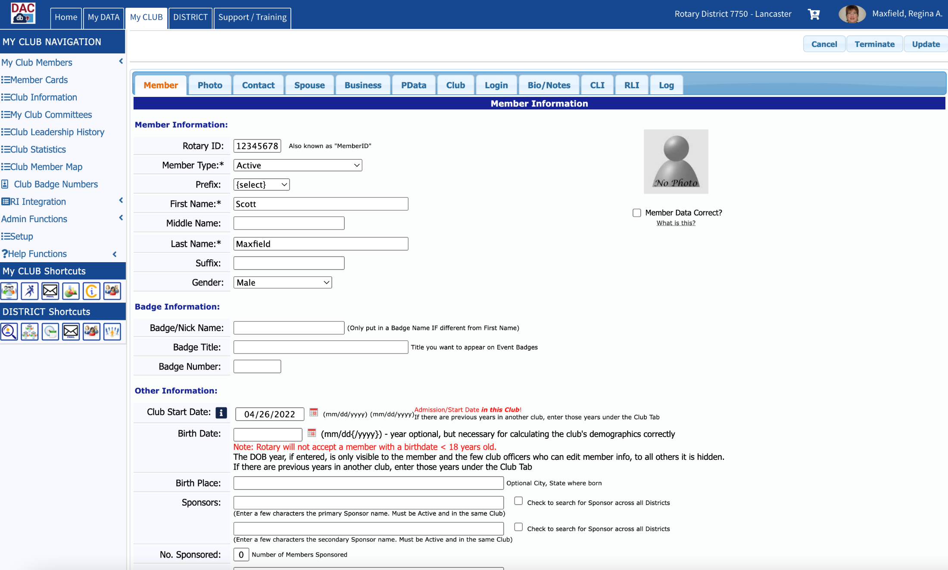

Slide 60
Terminating Members
To terminate a member in compliance with your club’s bylaws:
Access My Club in DACdb
Click on the X beside the member’s name
These steps are illustrated on the next slide.

Slide 61
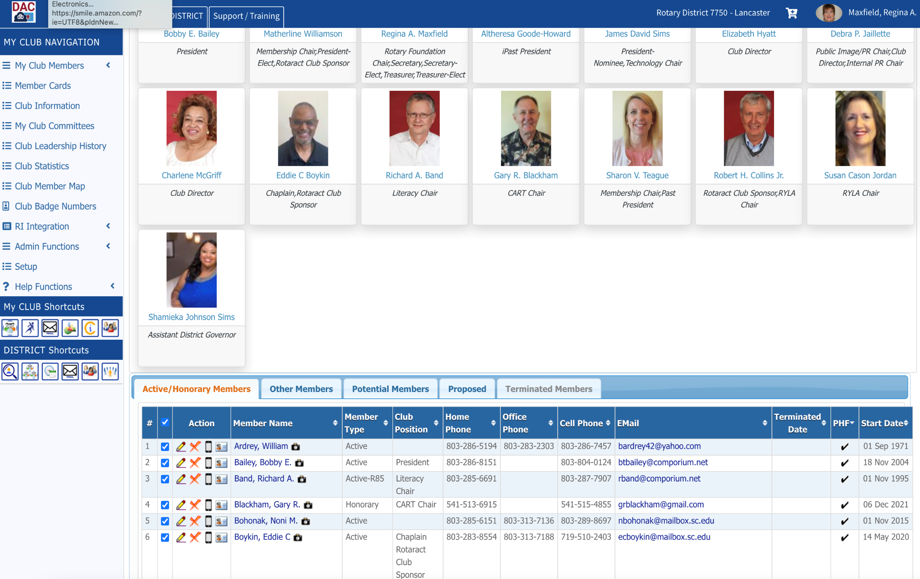
Click on the X to
Terminate
a member

Slide 62
Terminating Members
Enter the Date of Termination (date cannot be older than 30 days in the past)
Identify the Reason for Termination
Click Term
These steps are illustrated on the next slide.

Slide 63
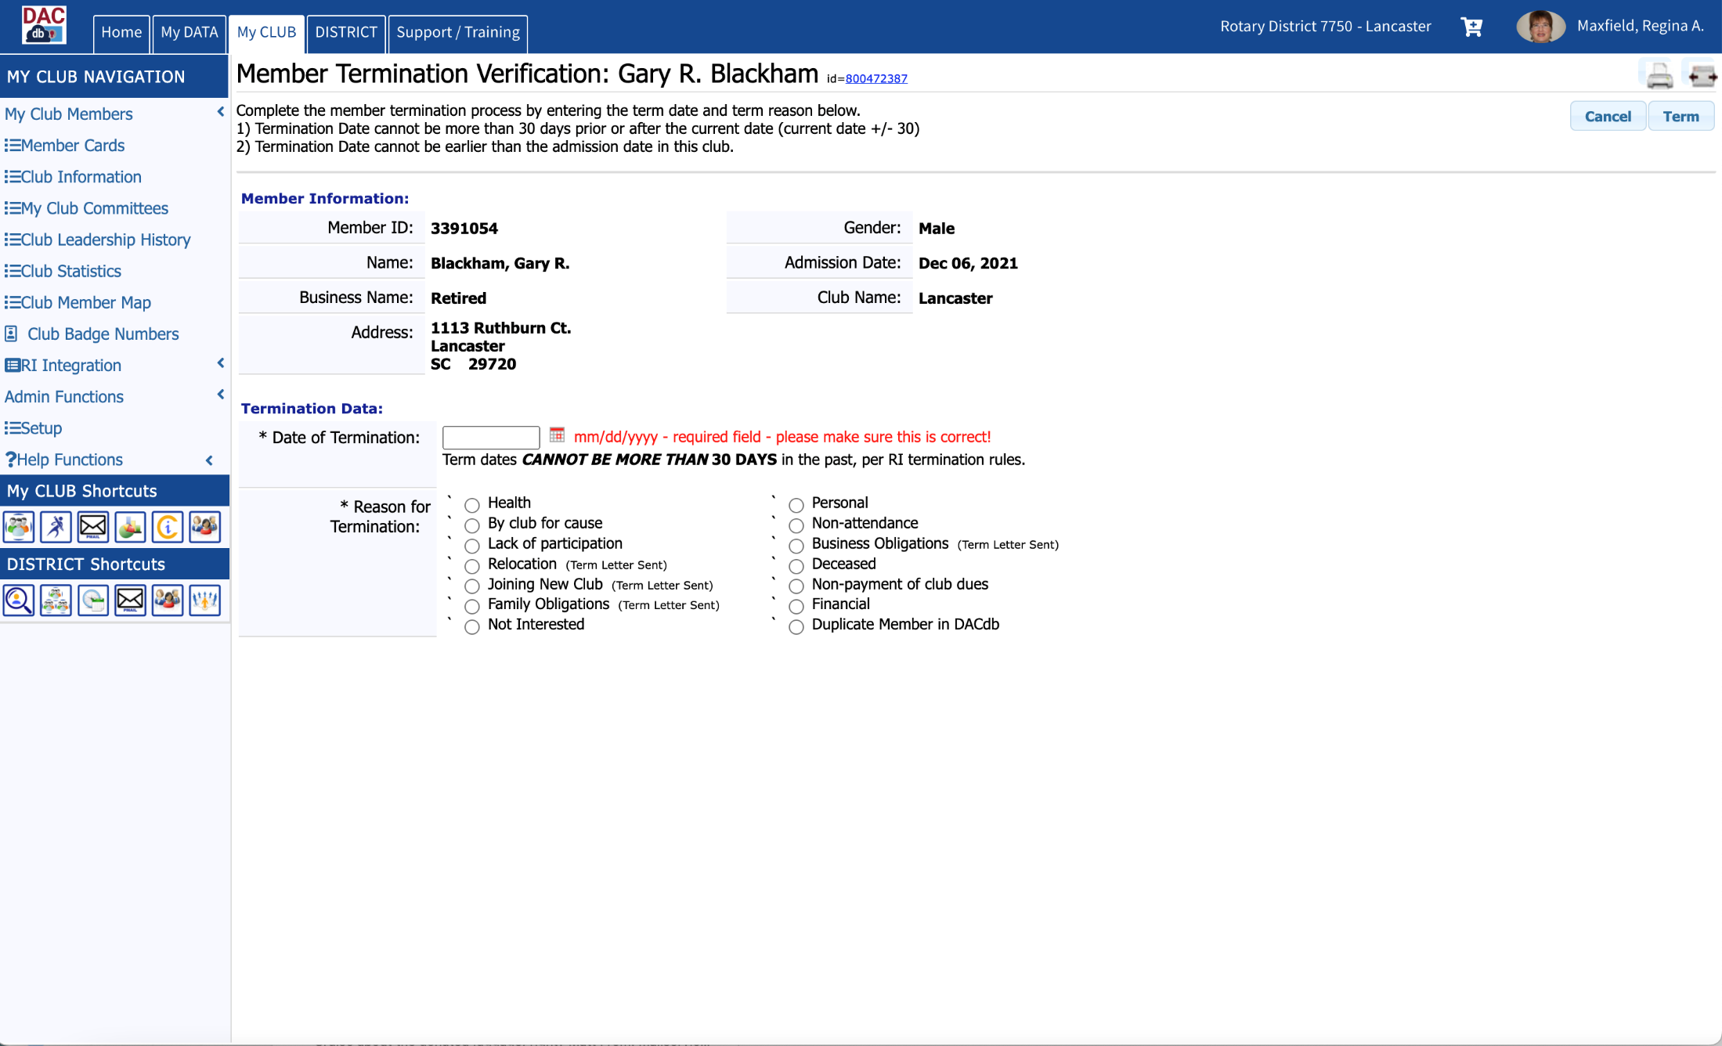

Slide 64
Maintain Member Records
Use DACdb to maintain as much information as you like about each member, including:
Photo
Contact Information
Spouse’s name, birthday & anniversary
Employer and job position
Rotary participation data
Member’s club information
Login credentials
Bio/Resume information
Other community involvement
RLI participation

Slide 65
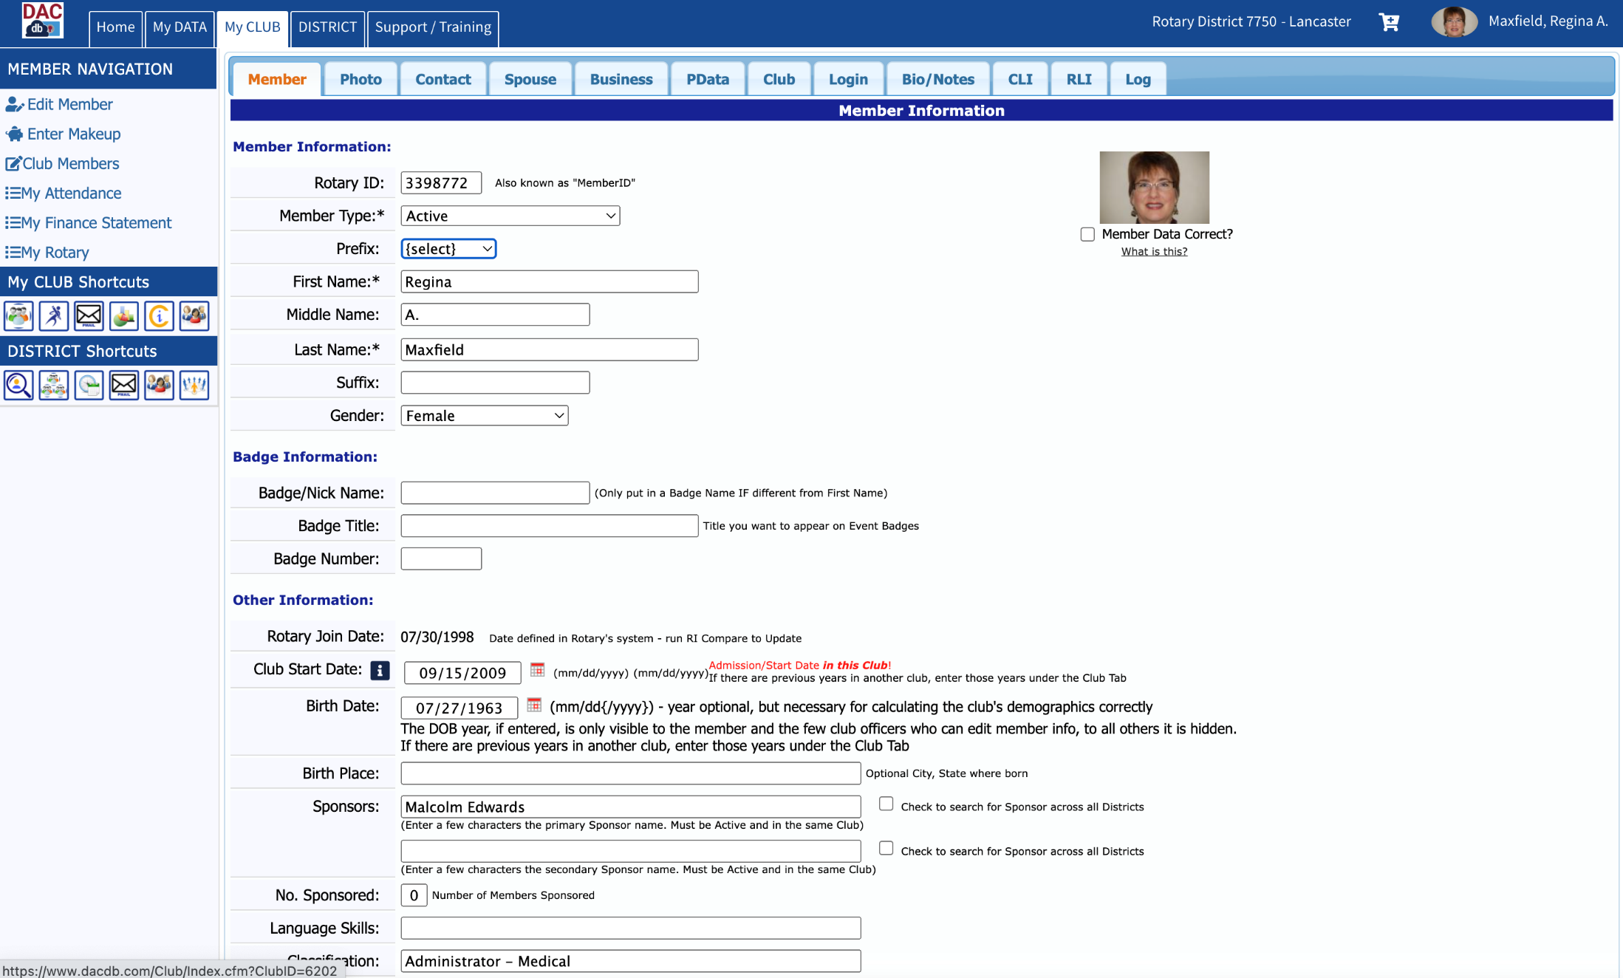
Use these tabs to access/
enter additional data for
each member

Slide 66
Maintain Member Records
Some data are more important than others for Rotary statistics/purposes:
Gender
Birthdate (including year!)
Email
Phone
Opt out of communications
These fields are identified on the next slides.

Slide 67
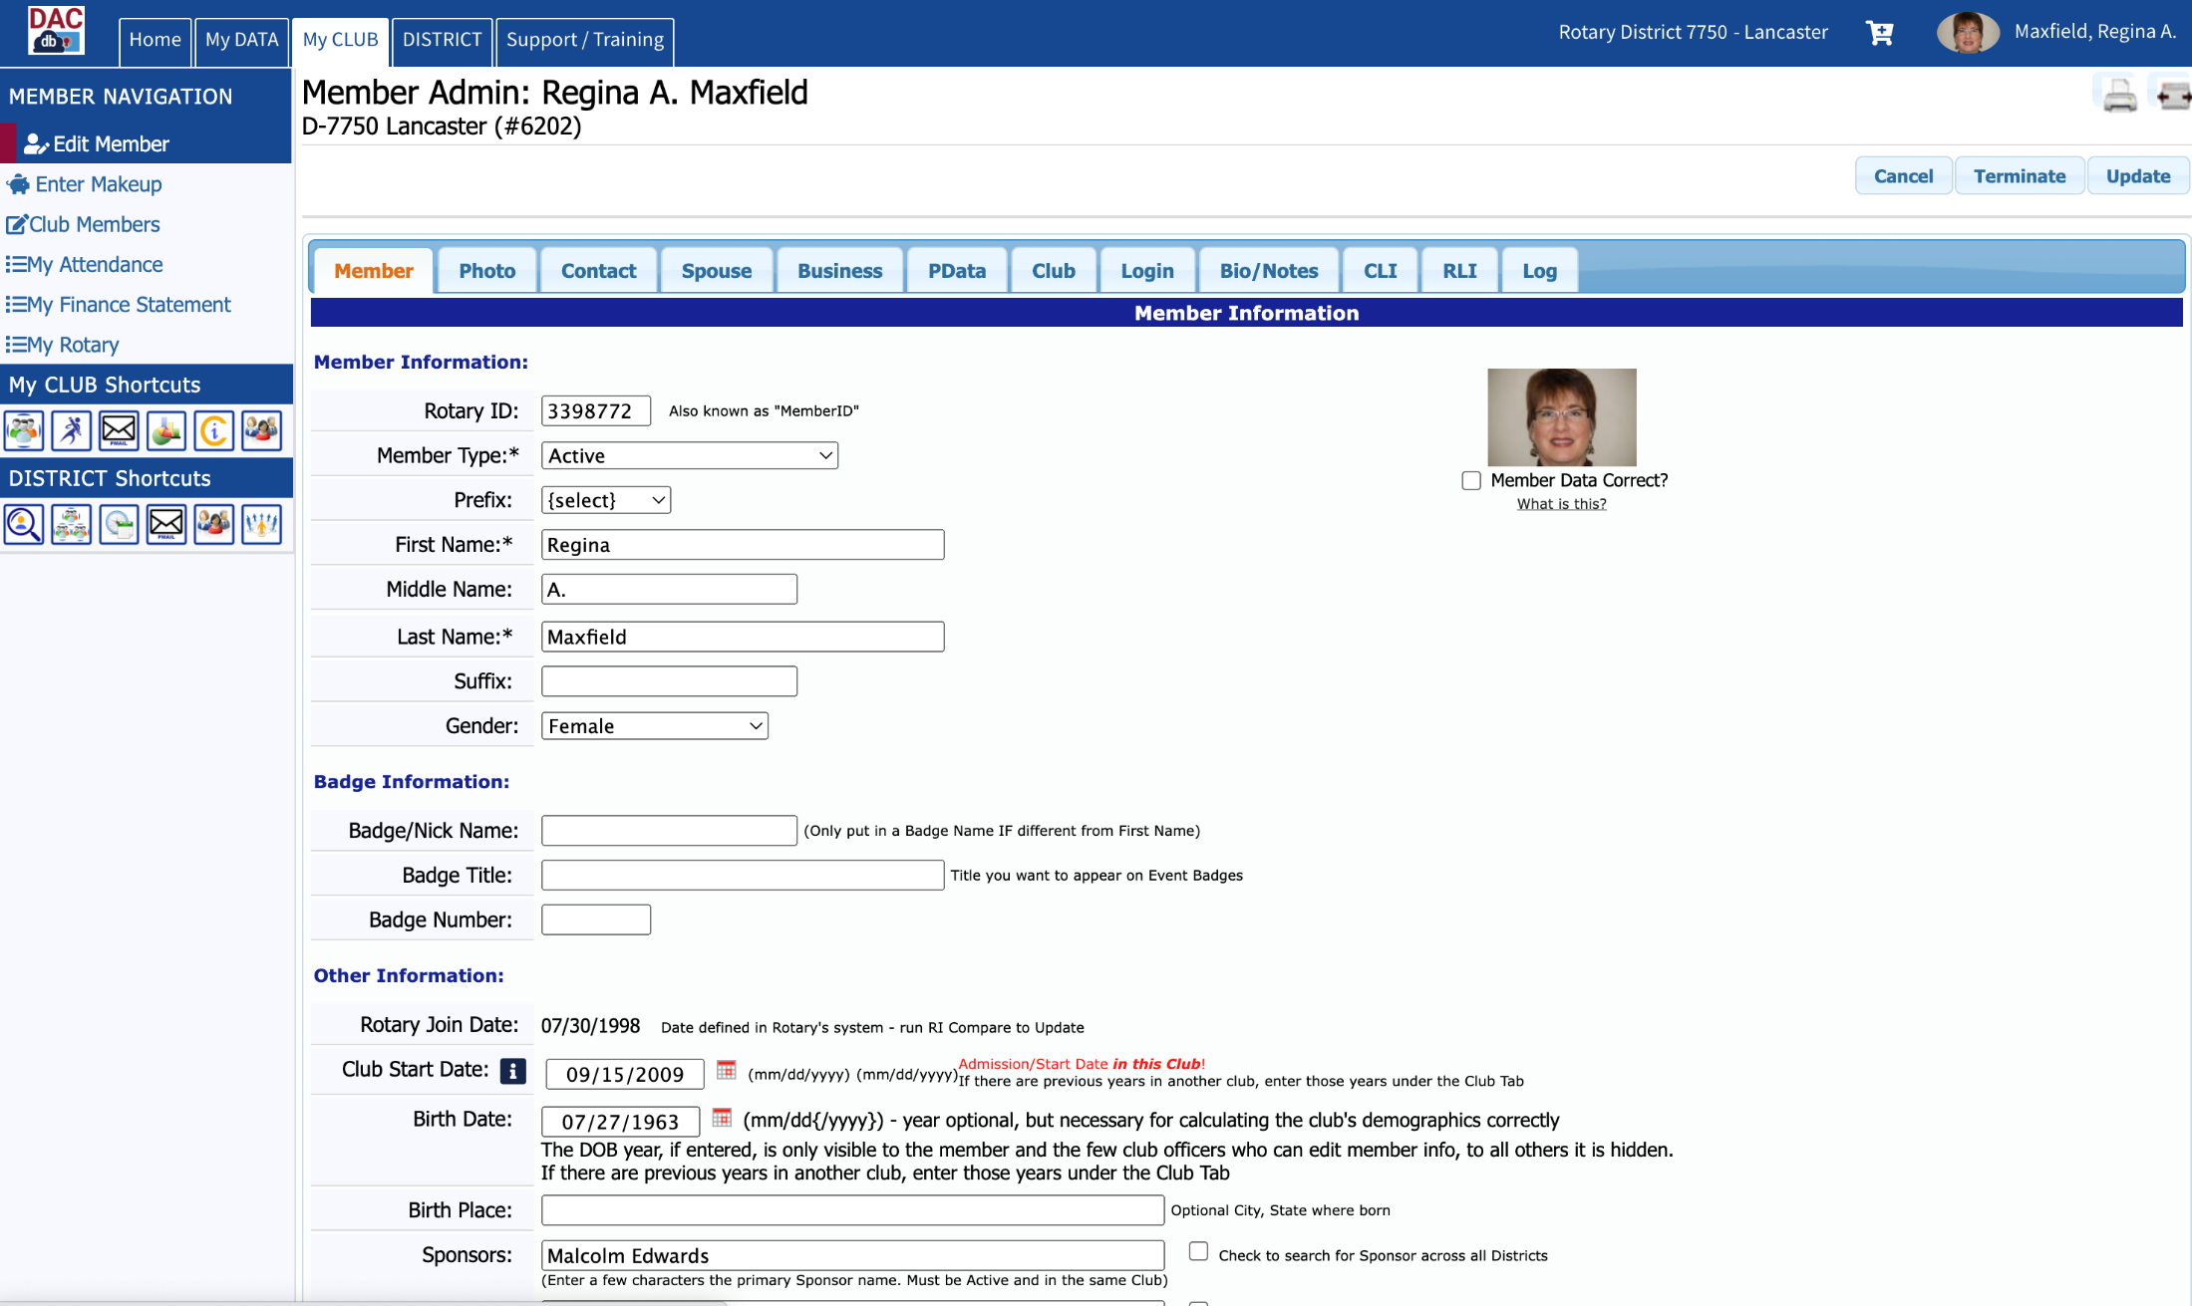

Slide 68
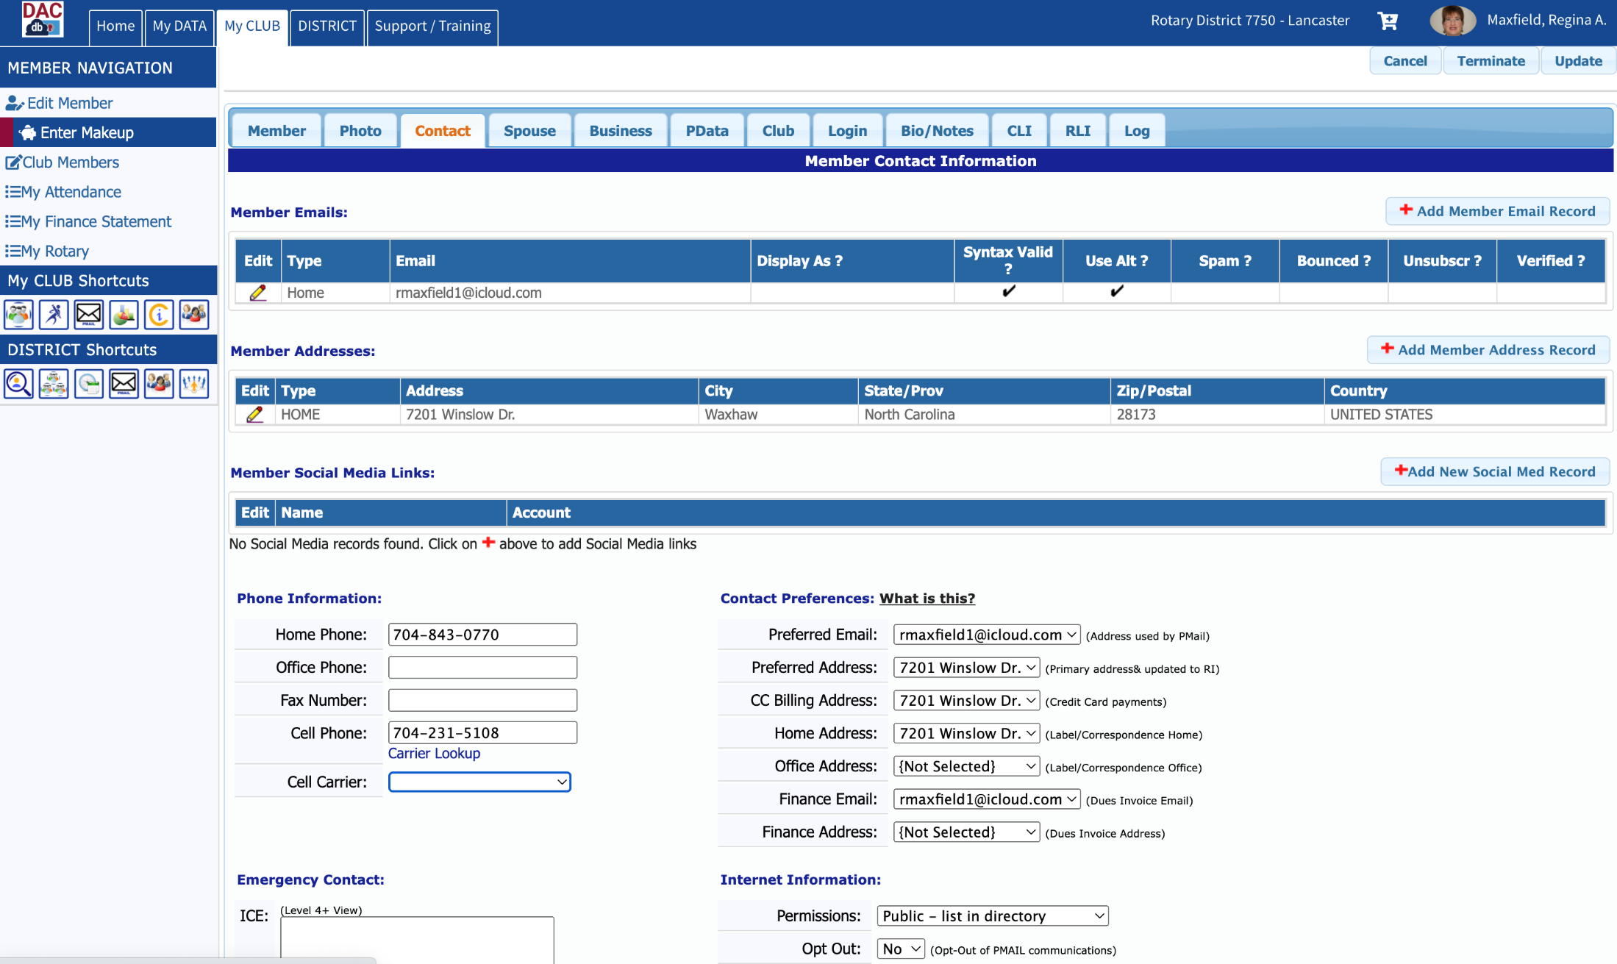

Slide 69
Semi-Annual Reporting of Membership
RI has simplified the semi-annual reporting process. Clubs no longer have to submit a SAR form. RI bills clubs based on member- ship records on July 1 and January 1. The best way to ensure your club is billed properly is to keep your membership records current.

Slide 70
Keeping & Reporting Attendance

Slide 71
Attendance Member Types
Active – attendance required
Rule of 85 – attendance NOT required but absences affect member’s Perfect Attendance Record

Slide 72
Attendance Member Types
Leave of Absence – attendance excused but must be included in club’s attendance calculations and affects Perfect Attendance Record for the member
Honorary – attendance not required and NOT included in club’s attendance

Slide 73
Attendance Rule of 85
Rule of 85 – From Club Secretary’s Manual:
“count them as present if they attend a club meeting but do not count them as absent if they do not attend”

Slide 74
Attendance Rule of 85
Prerequisites for Rule of 85 Eligibility:
Must be an Active Member
Must have been a Rotarian for minimum of 20 years
Member’s age plus number of years in Rotary must equal or exceed 85

Slide 75
Attendance Rule of 85
Once the Rule of 85 prerequisites are met, the member must submit, in writing, a request to be considered an Active - Rule of 85 member.

Slide 76
Attendance Rule of 85
DACdb offers a report to identify club members
eligible for Rule of 85:
Log into DACdb
Click on My CLUB
Click on Reports Icon
Scroll down to Report #15.30 Rule of 85 Eligibility Report

Slide 77
Attendance Make-Ups
An Attendance Make-Up counts as if the member was present at a meeting.
The Make-Up activity must occur within 14 days (before or after) the missed meeting to which it is applied.

Slide 78
Attendance Make-Ups
Activities that qualify as Meeting Make-Ups:
Visit another club’s meeting
Attend an online club meeting (E-Club)
View another club meeting online
Attend a club board or committee meeting (1 hr minimum)
Attend a District or RI event
Participate in a Rotary Service Project (1 hr minimum)

Slide 79
As an Aside: Locating a Club for a Make-Up Visit
Log into DACdb
Click on DISTRICT
Click on Clubs icon
Click on Where Clubs Meet in the left panel
These steps are illustrated on the next slides.

Slide 80
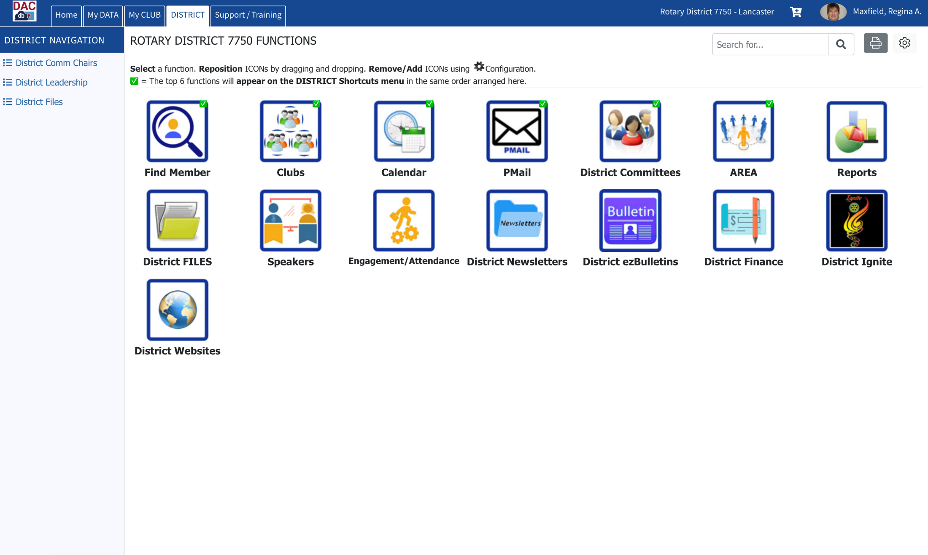
Note: You can customize the icons you wish displayed when you access DACdb, and you can position them as you wish. Your screen, therefore, will not look exactly as mine.

Slide 81
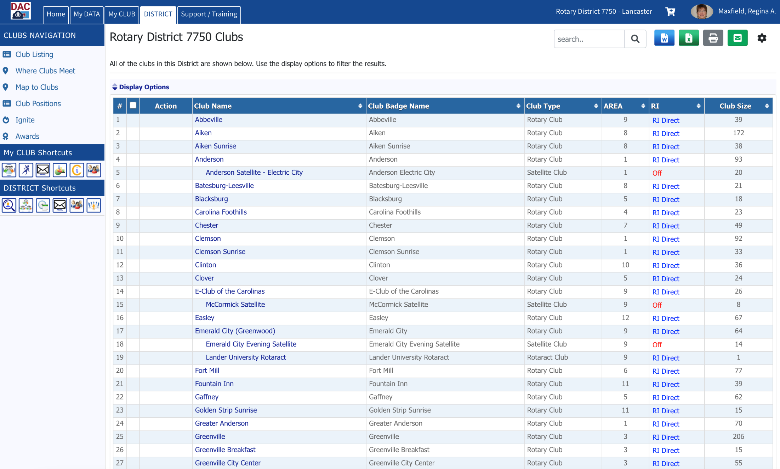

Slide 82
Record Attendance at Meetings
Use a form similar to the one illustrated on the next slide, or use the Attendance Module offered through DACdb, to document attendance at each club meeting.
Note: If you use a form, create it using Excel as it is much easier to edit than a Word document.

Slide 83
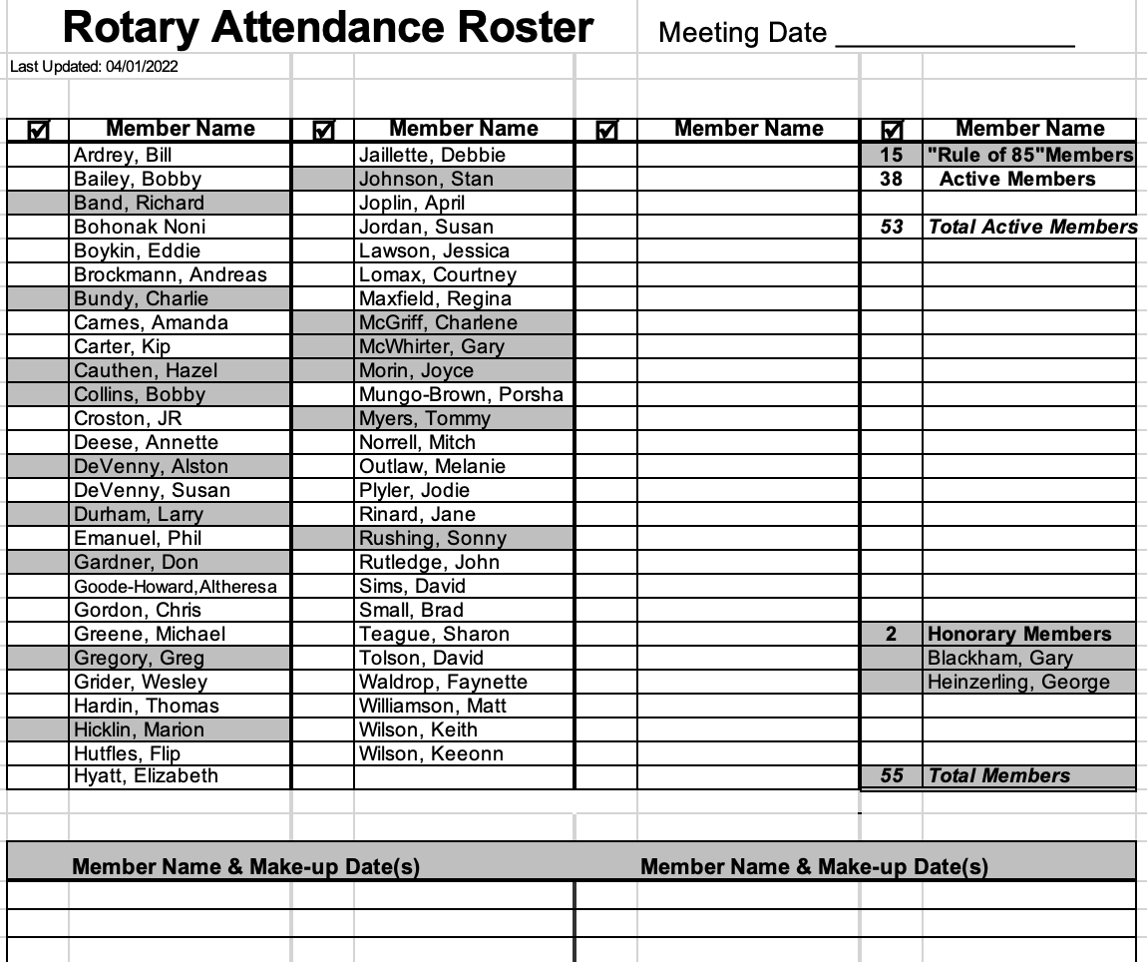

Slide 84
Attendance Calculations
Count the number of members present
Add the number of make-ups
This sum becomes your numerator
Subtract the number of Rule-of-85 members who were absent from the total number of Active members in club
This difference becomes your denominator
These calculations are illustrated on the next slide.

Slide 85
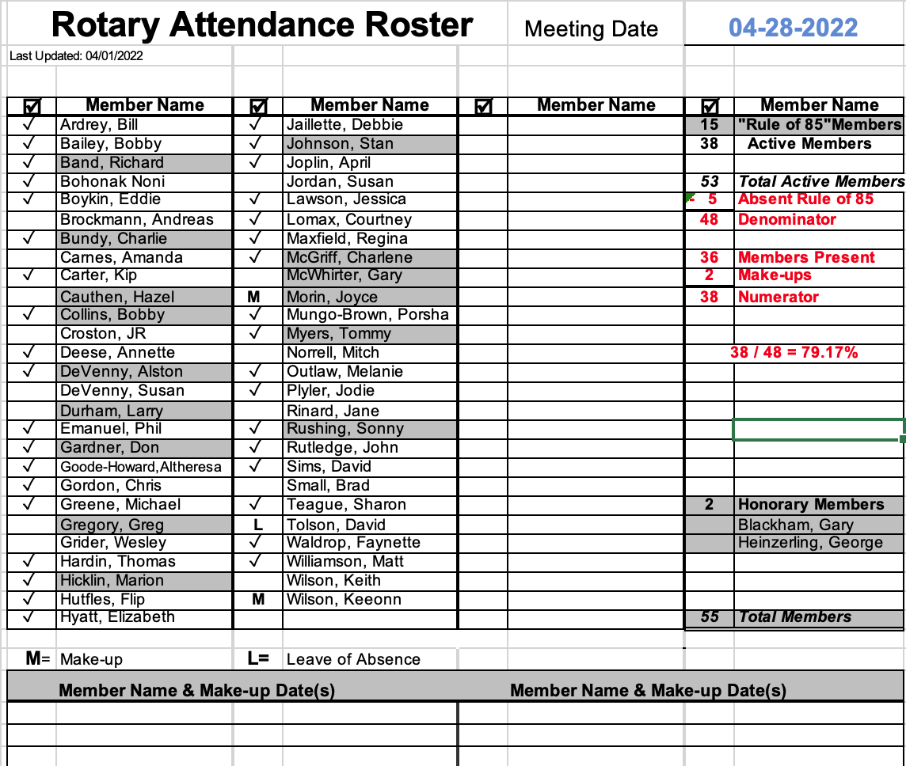

Slide 86
Report Monthly Attendance to Board of Directors
Calculating the monthly attendance average:
Add the numerators for a sum
Add the denominators for a sum
Divide the result of “a” by the result of “b”
This calculation is illustrated on the next slide.

Slide 87
Report Monthly Attendance to Board of Directors
Week #1: 38 / 48 Week #3: 32 / 47
Week #2: 36 / 47 Week #4: 36 / 48
a. Add the numerators:
38 + 36 + 32 + 36 = 142
b. Add the denominators
48 + 47 + 47 + 48 = 190
Divide result of “a” by result of “b”
142 / 190 = 76.74%

Slide 88
Updating Club Information

Slide 89
Updating Club Information
To VIEW current club information:
Log into DACdb
Click on My CLUB
Click on Club Information icon
To EDIT club information:
Log into DACdb
Click on MY CLUB
Click on Club Members
Click on Edit Club

Slide 90
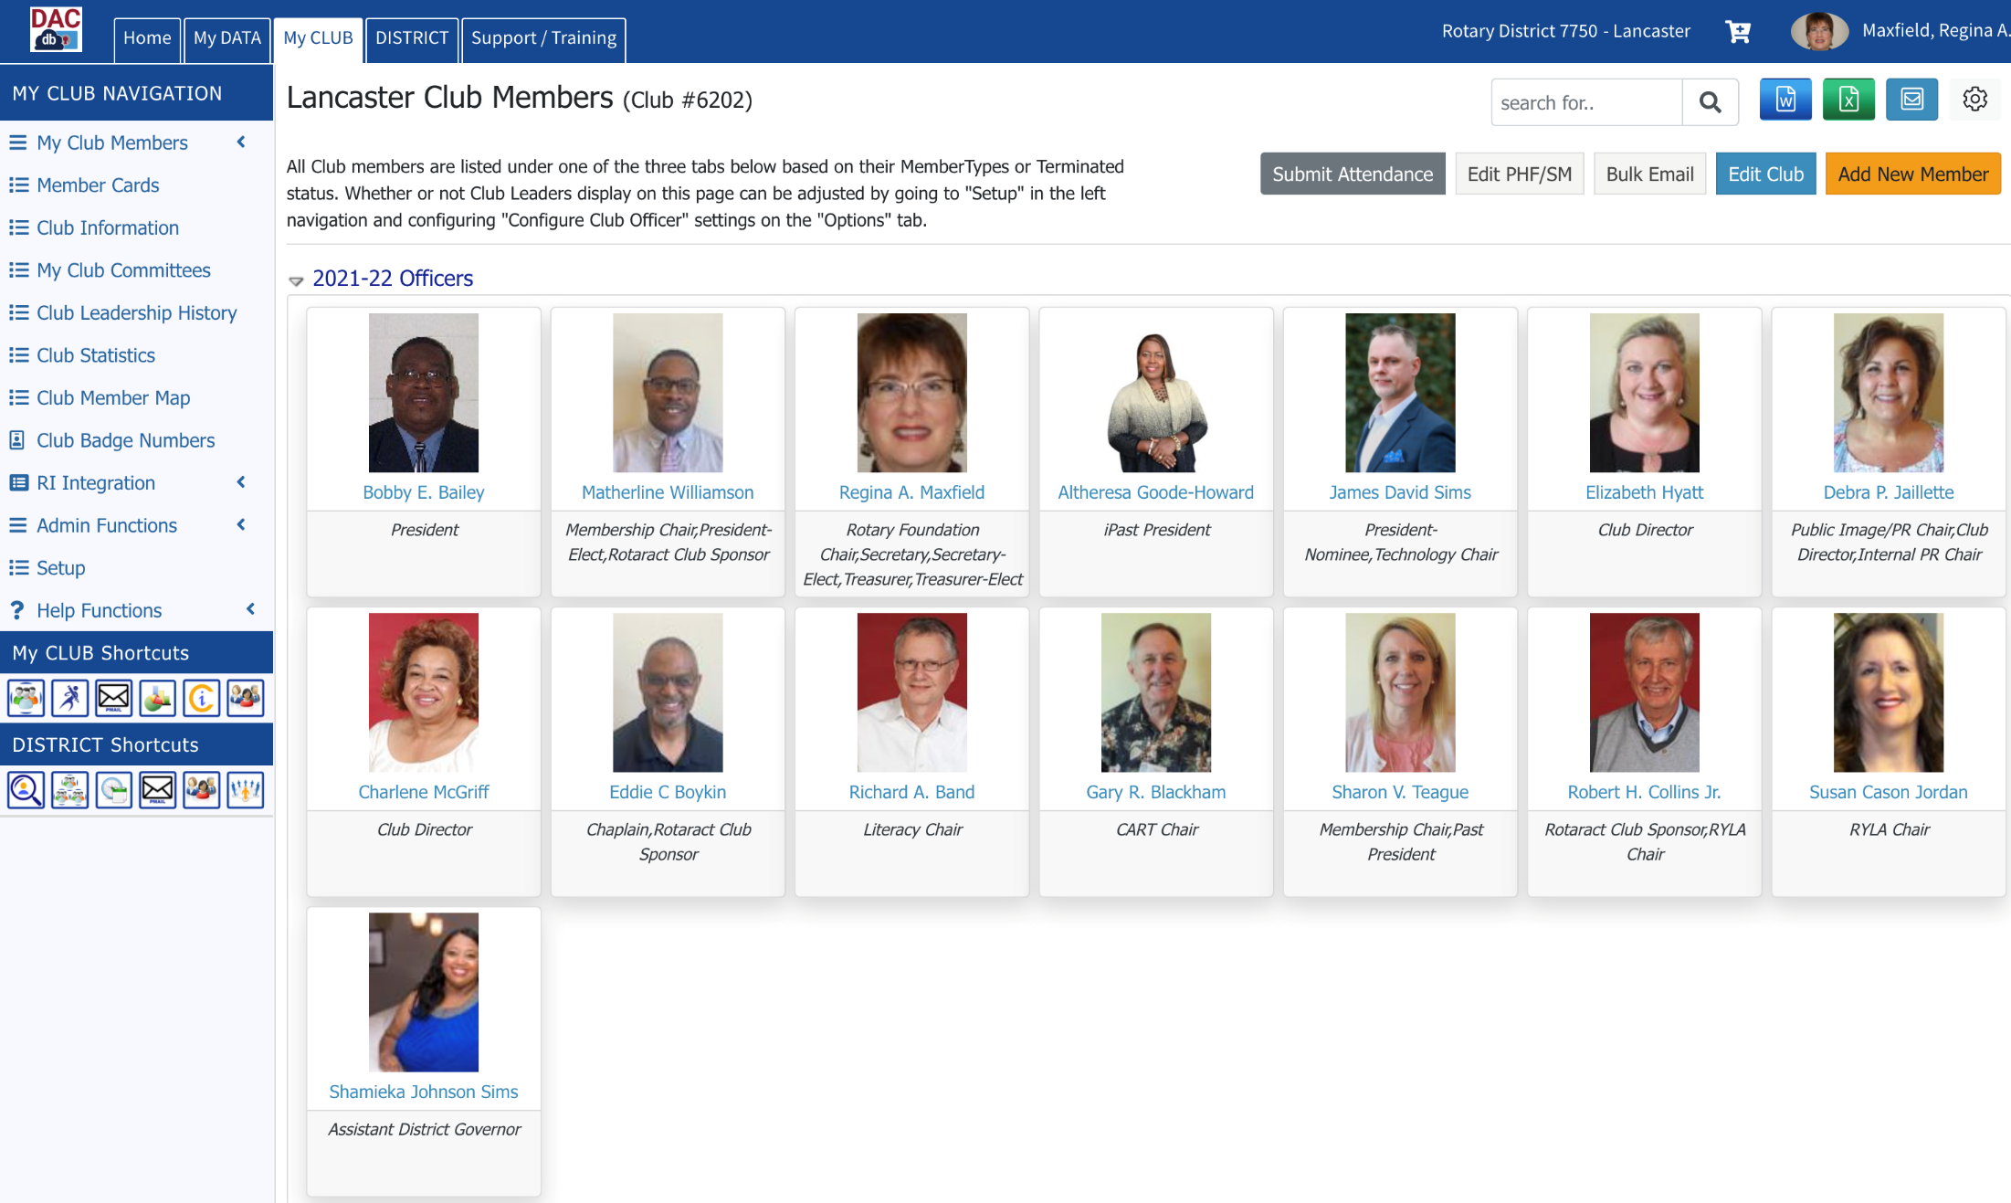

Slide 91
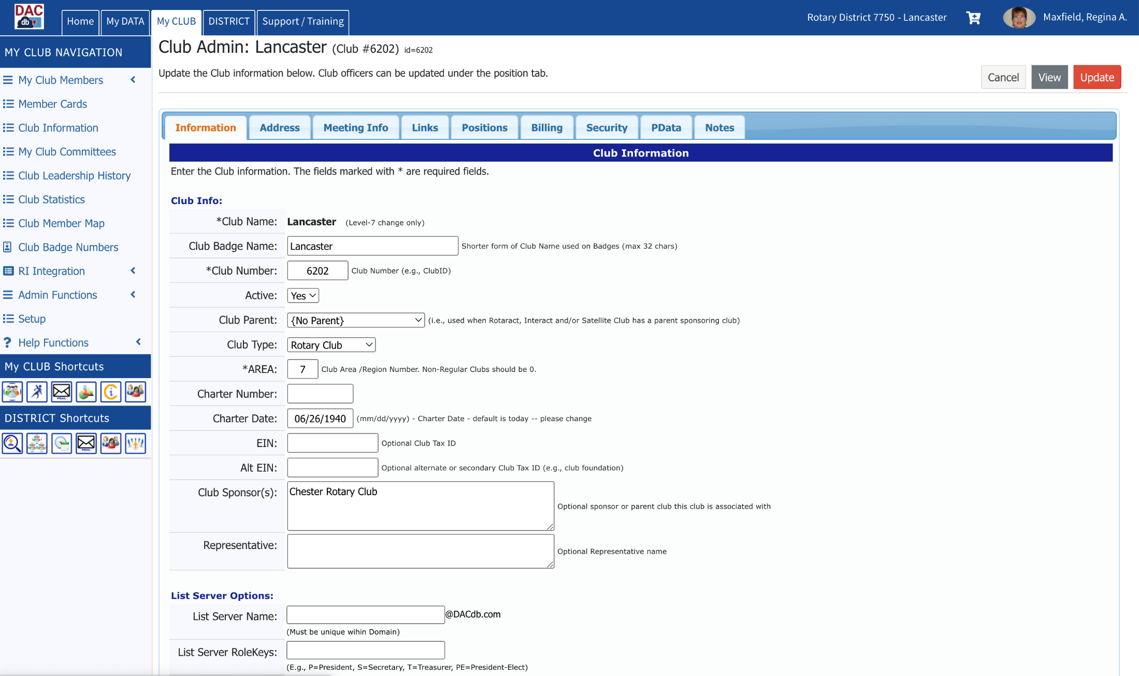
The information viewed by
clicking on Club Information
is entered on the Address and
Meeting Info screens

Slide 92
Updating Club Positions
To update club officers, board members and committee chairs from year to year:
Log into DACdb
Click on MY CLUB
Click on Club Members
Click on Edit Club
Click on Positions

Slide 93
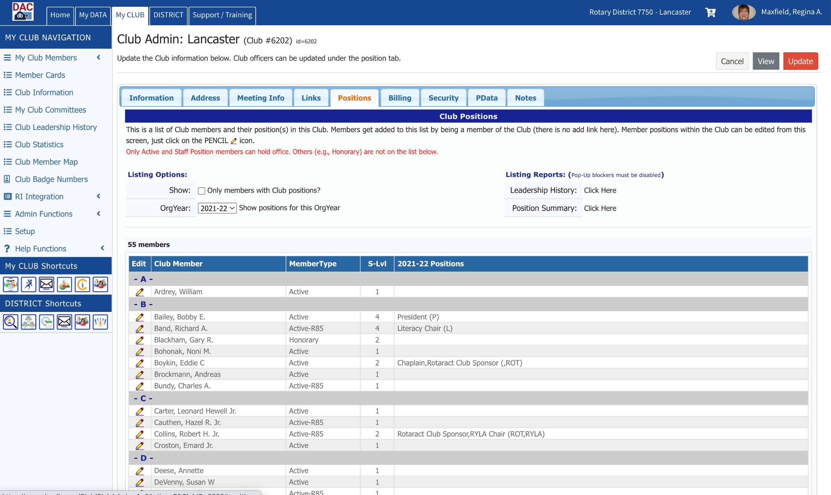
Click on the
pencil beside the member who holds a new club position

Slide 94
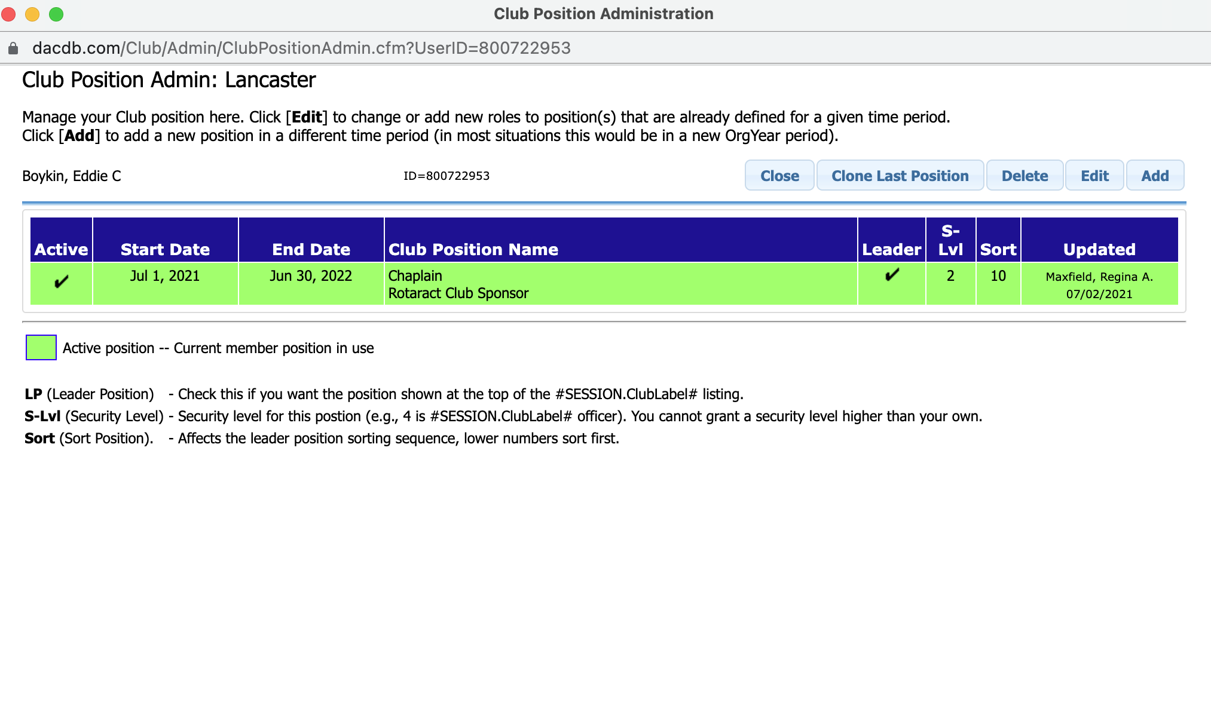
Use the blue tabs to Add, Edit or Delete a member’s positions within the club. If the member is going to hold the same position in the new year as in the last, simply click the Clone Last Position tab.
The members who hold positions are the ones whose photos are displayed above the list of members when you access Club Members. Use the Sort field to control the order in which these members/positions are displayed (e.g. the President would be assigned Sort #1; the President-Elect would be assigned Sort #2; the Immediate-Past President would be assigned Sort #3). The order is completely up to you/the club.

Slide 95
Appendices

Slide 96
Action Items for the New/First-Time Club Secretary
Prior to July 1:
Become familiar with the information in the Learning Resources (refer to slides #3 – #6)
Meet with the outgoing secretary and receive club records
Create a My Rotary account on my.rotary.org if you don’t already have one

Slide 97
Action Items for the New/First-Time Club Secretary
Prior to July 1:
Familiarize yourself with my.rotary.org
Familiarize yourself with DACdb
Meet with the incoming board of directors to determine preferred method of meeting notification, etc.

Slide 98
Secretary’s Responsibilities -
Board Meetings
Send out meeting notifications prior to meeting
Take minutes during meeting (a Smart Phone recording works wonderfully)
Report on Club Performance
Recent attendance percentages
Members who are routinely NOT attending

Slide 99
Secretary’s Responsibilities -
Board Meetings
Report on Club Performance (continued)
Membership net gain/loss
Member resignations with reasons given
New member proposals
Draft minutes of meeting to have available for ratification at next board meeting if possible, but no later than 30 days following the meeting

Slide 100
Secretary’s Responsibilities -
Club Meetings
Manage name badges (add new badges for new members and remove badges of terminated members)
Record attendance
Provide proof of make-up for visiting Rotarians

Slide 101
Secretary’s Responsibilities -
Club Meetings
If not delegated to Treasurer, collect payment for meals
If not delegated to Programs Committee or Sgt At Arms, assist speaker with set-up

Slide 102
Secretary’s Responsibilities -
Financial
If not delegated to Treasurer:
Collect for meals at each club meeting
Invoice members for dues
Follow up with members who have not paid their dues

Slide 103
Secretary’s Responsibilities -
Financial
If not delegated to Treasurer:
Notify the board of directors of extreme past-due cases
Pay RI semi-annual dues invoiced in July and January
Pay District annual dues invoiced in July

Slide 104
Secretary’s Responsibilities -
Weekly
See Secretary’s Responsibilities – Club Meetings
Email reminders of meetings to members
Assist with preparation of meeting agenda
Assist with preparation of weekly bulletin

Slide 105
Secretary’s Responsibilities -
Monthly
Prepare for and attend Board Meeting
See Secretary’s Responsibilities – Board Meetings
If not delegated to Treasurer, prepare monthly financial reports

Slide 106
Secretary’s Calendar
June
Make sure club membership is accurate in preparation for July 1 RI semi-annual invoicing:
Make sure new members are added
Make sure terminated members are terminated
Use Member Compare in DACdb to reconcile member data in the two databases

Slide 107
Secretary’s Calendar
July
Identify members who are eligible for Rule of 85; see Attendance Rule of 85 slides
Include election of Honorary members in monthly board meeting; Honorary members are NOT counted in total membership, attendance or dues calculations

Slide 108
Secretary’s Calendar
August
If not delegated to Treasurer:
Pay club’s semi –annual RI dues (usually invoiced by the end of July)
Pay club’s annual District dues (usually invoiced by the end of July)

Slide 109
Secretary’s Calendar
September
Remind President and President-Elect to begin preparing for election of officers in December (which means slate of officers needs to be presented to club members in November)

Slide 110
Secretary’s Calendar
September
Slate of Officers to be elected in December:
Next year’s President (President-Elect)
Next year’s President-Elect (President Nominee)
Next year’s Secretary
Next year’s Treasurer
Next year’s Sgt At Arms

Slide 111
Secretary’s Calendar
October
If not delegated to Treasurer and/or accountant, begin preparing the club’s
tax return (Form 990) which must be
filed no later than November 15th.

Slide 112
Secretary’s Calendar
November
If not delegated to Treasurer, ensure tax return (Form 990) is filed by the 15th.
Remind President that nominations for next year’s Club Officers and Board of Directors must be presented to the club this month (prior to a club assembly to formally elect the nominees in December)

Slide 113
Secretary’s Calendar
December
Take minutes at club assembly held to elect next year’s slate of officers.
Update newly elected officers in DACdb (refer to slides Updating Club Positions)

Slide 114
Secretary’s Calendar
December
Make sure club membership is accurate in preparation for January 1 RI semi-annual invoicing:
Make sure new members are added
Make sure terminated members are terminated
Use Member Compare in DACdb to reconcile member data in the two databases

Slide 115
Secretary’s Calendar
January/February
If not delegated to Treasurer, pay club’s semi –annual RI dues (usually invoiced by the end of January)

Slide 116
Secretary’s Calendar
March/April
If applicable, assist President in applying for District Designated Grant. Application is due April 30.

Slide 117
Secretary’s Calendar
April/May
Assist President with completion of Club Planning Guide. Guide is due May 15.
If not delegated to Treasurer, work with President and board to develop next year’s operating budget. Board needs to approve budget before it is presented to club members for approval.

Slide 118
Secretary’s Calendar
May/June
Take minutes at club assembly held to approve next year’s budget.
See earlier slide Secretary’s Calendar June

Slide 119
2022 Council on Legislation
Brand new changes affecting Secretaries as of July 1, 2022:
Club boards now must provide meeting minutes to club members within 30 days
Clubs no longer have to report monthly attendance to the District Governor

Slide 120
2022 Council on Legislation
Club boards no longer have to approve Rule of 85 attendance requests by members
For a complete set of adopted enactments:
www.rizones33-34.org/wp-content/uploads/2022/04/col22-adopted-legislation-en.pdg

Slide 121
Questions?
District Secretary – Dave Knapp Secretary@Rotary7750.org
District Administrator – Faith Line – Admin@Rotary7750.org
IT Support – Terry Weaver – ITSupport@Rotary7750.org

Slide 122
Thank You for Attending!

