Slide 1
Welcome to
Carolinas’ PETS 2018
D7750 Rotary Foundation Banquet
March 15-17, 2018
Notes:
1

Slide 2
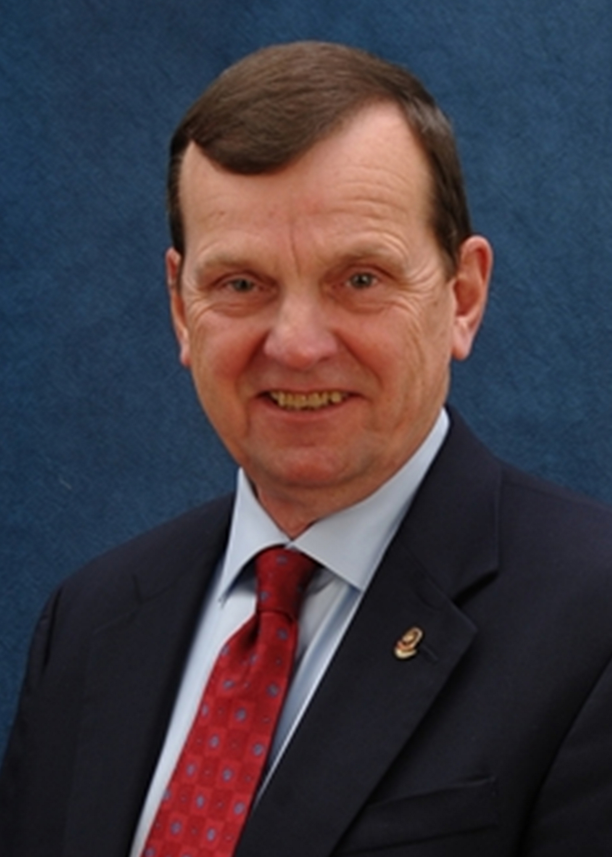
Carolinas’ PETS 2018
Ed Irick
7750 District Governor 2017-18
Rotary Club of Greenville Evening

Slide 3
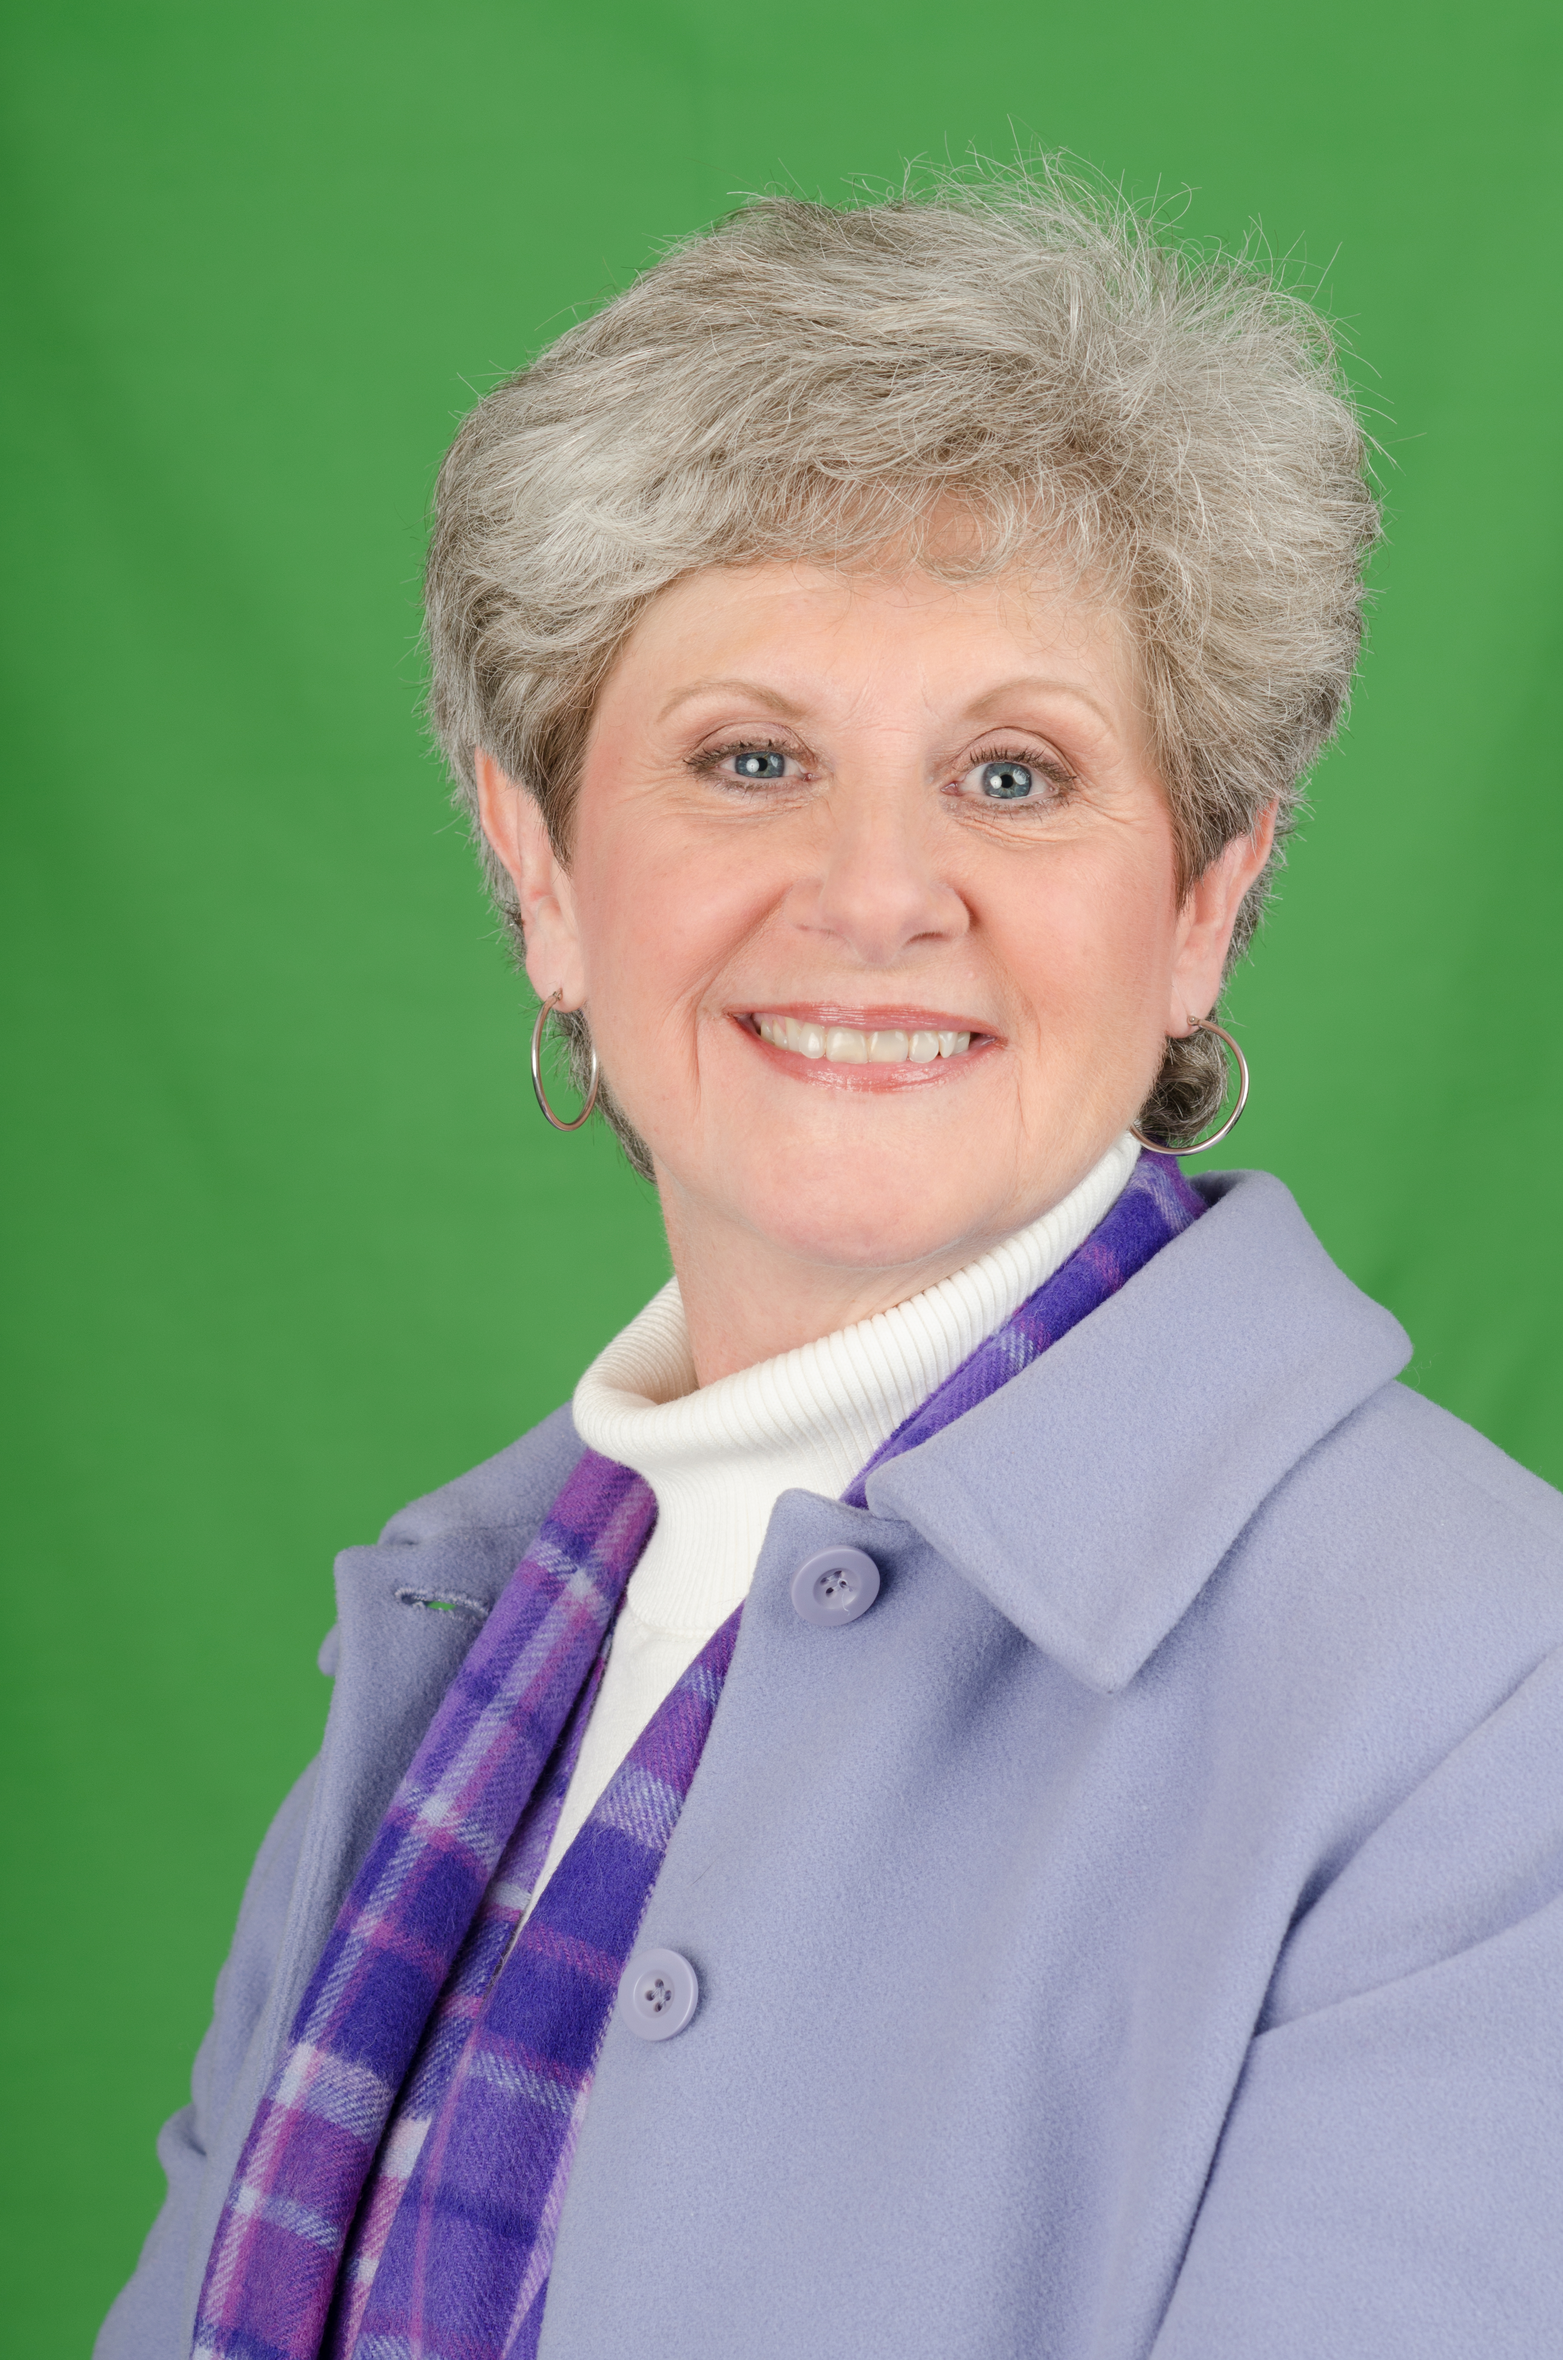
Carolinas’ PETS 2018
Carol Burdette
7750 District Governor 2018-19
Rotary Club of Anderson

Slide 4
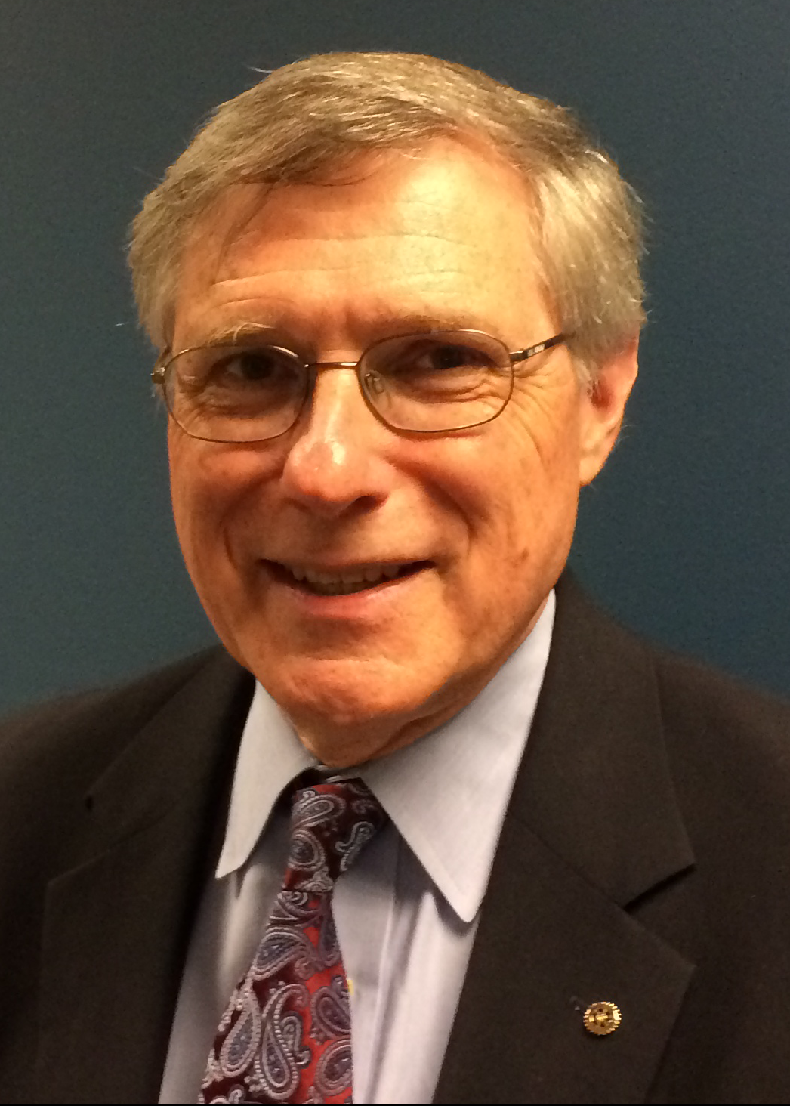
Carolinas’ PETS 2018
Rob Hanley
7750 District Governor 2019-20
Rotary Club of North Greenville

Slide 5
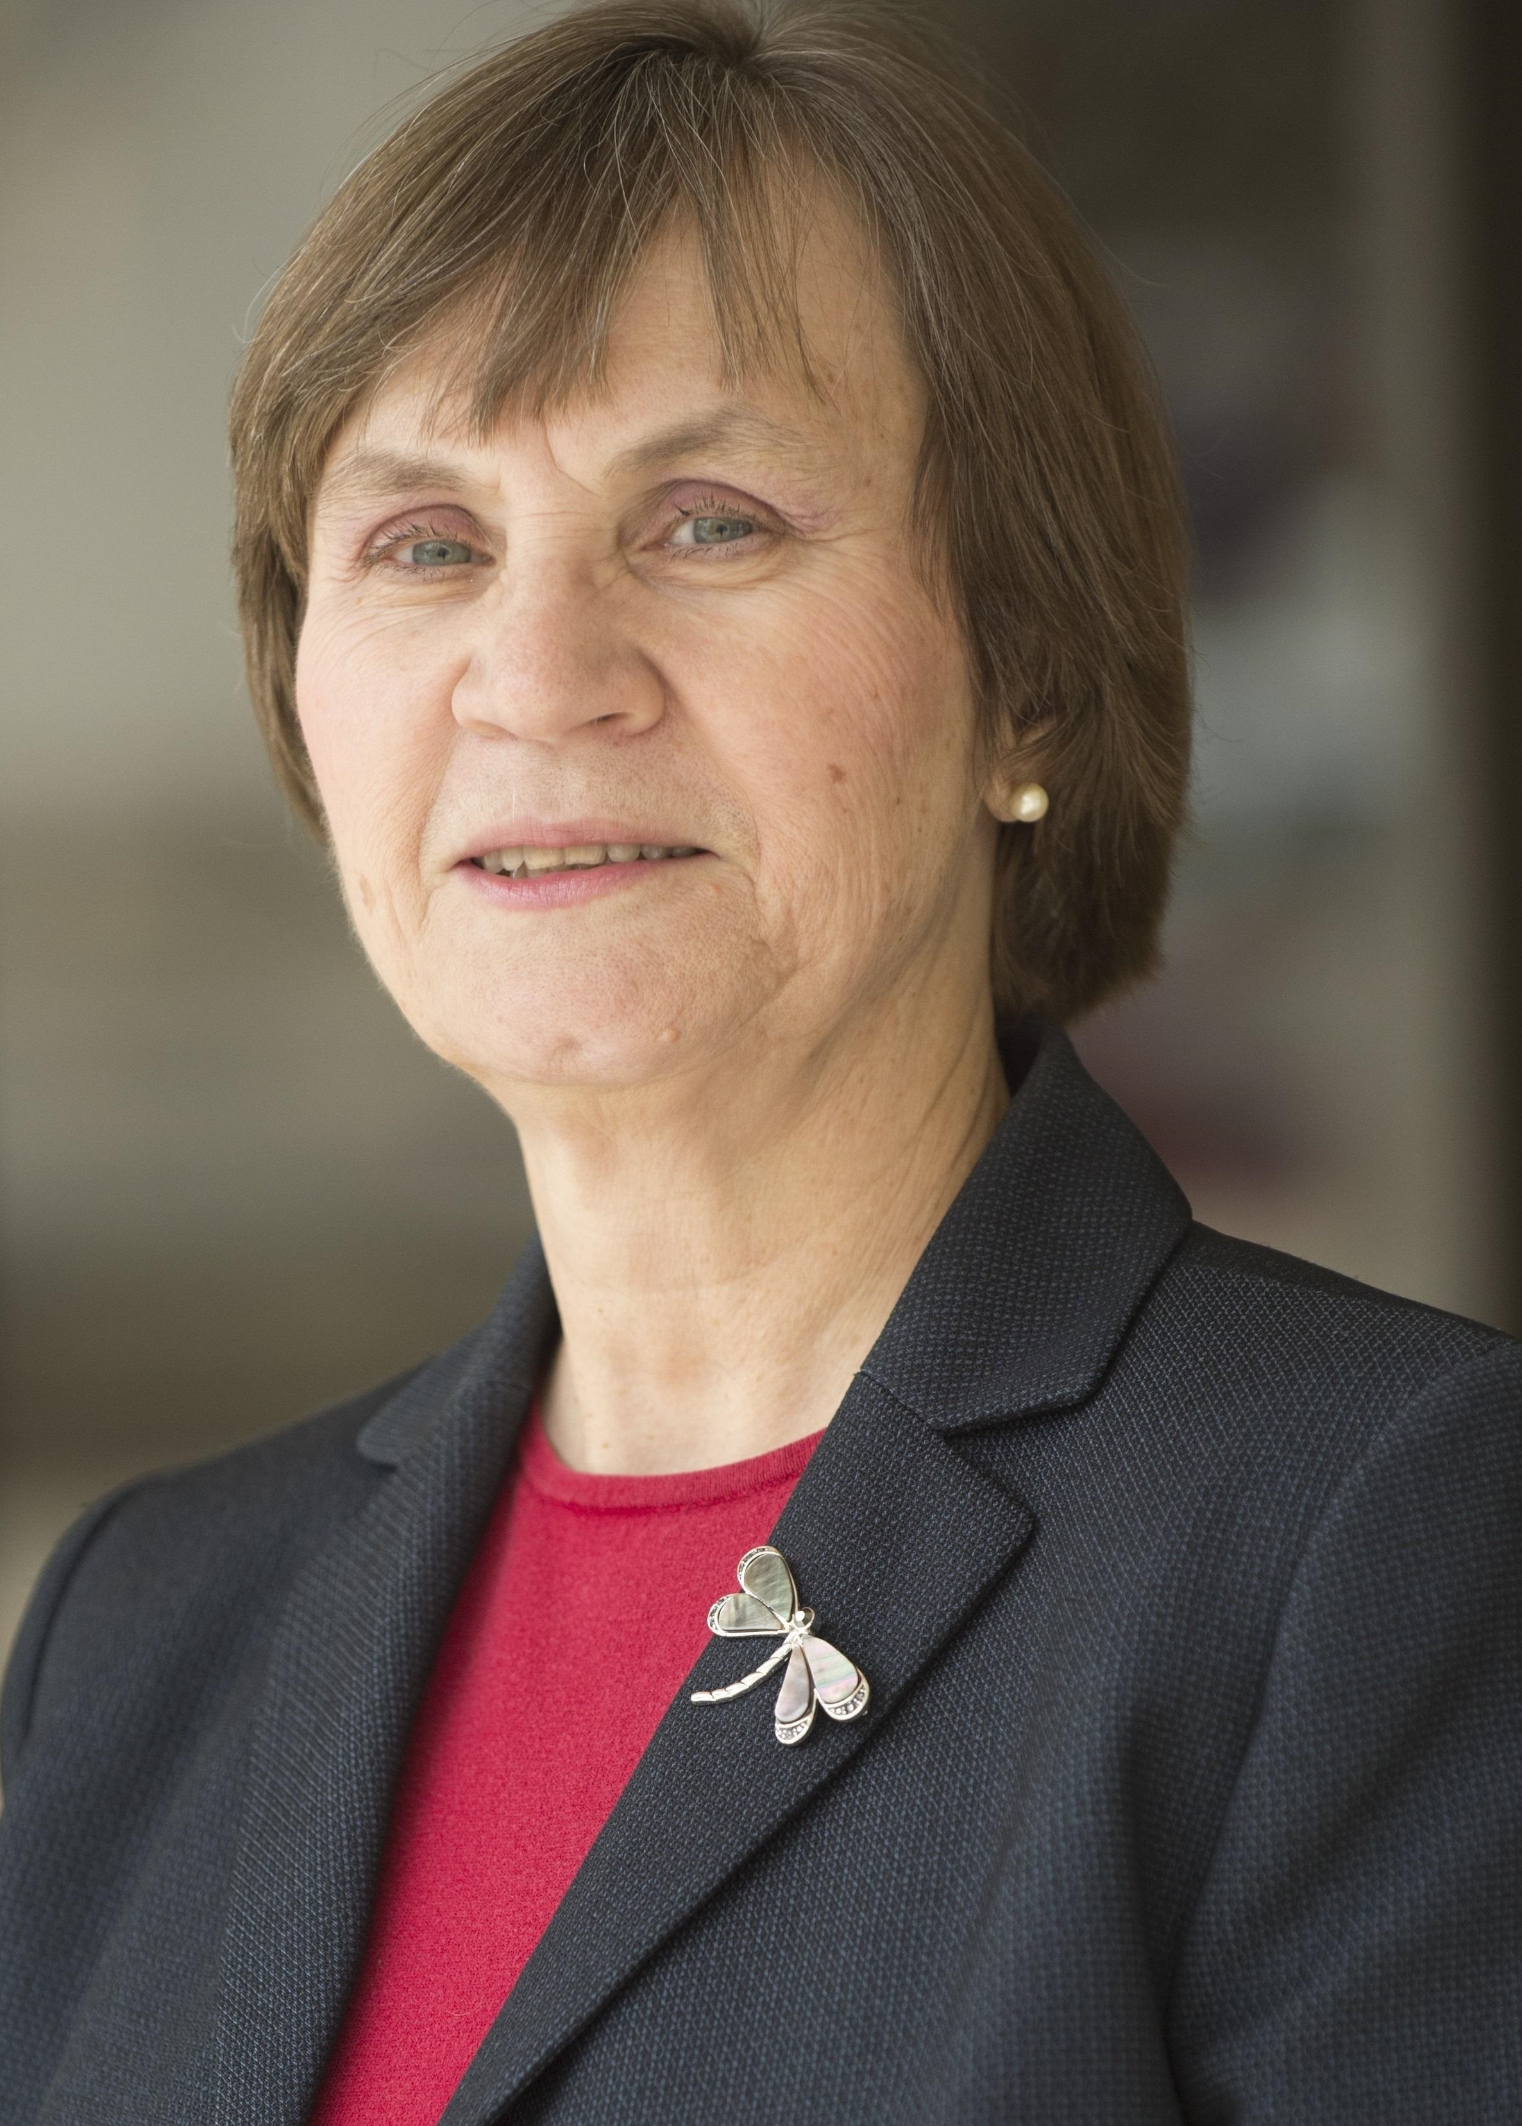
Carolinas’ PETS 2018
Beth Padgett
7750 District Governor 2020-21
Rotary Club of Greenville

Slide 6
Carolinas’ PETS 2018
Assistant Governors

Slide 7
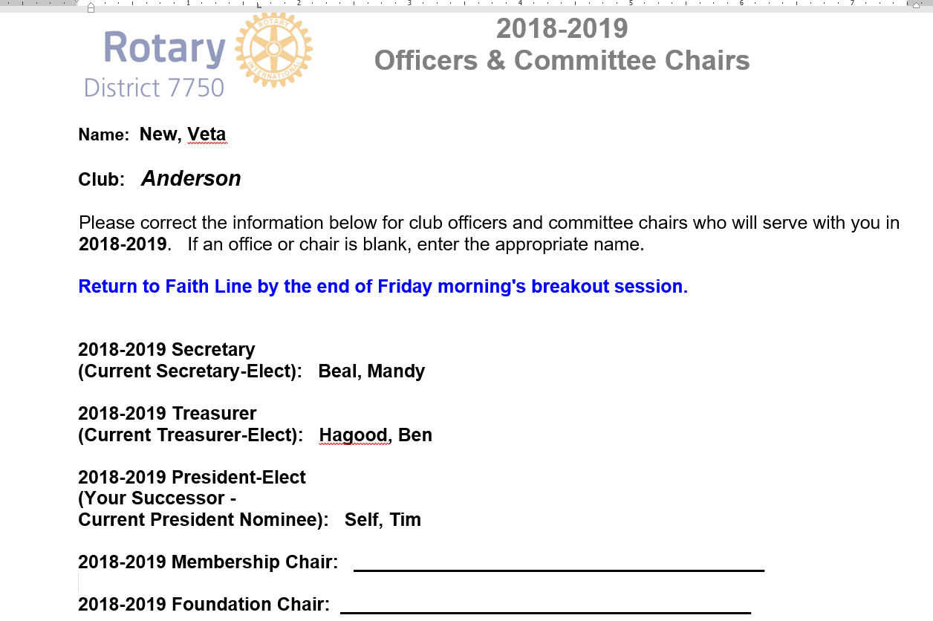
2018-2019 Officers & Committee Chairs

Slide 8
2018-2019 Overview
Notes:
8

Slide 9
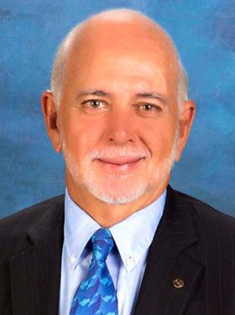
2018-2019 Rotary International President
Barry Rassin
Rotary Club of East Nassau
New Providence, Bahamas
Notes:
9

Slide 10
2018-2019 International Theme
Notes:
10

Slide 11
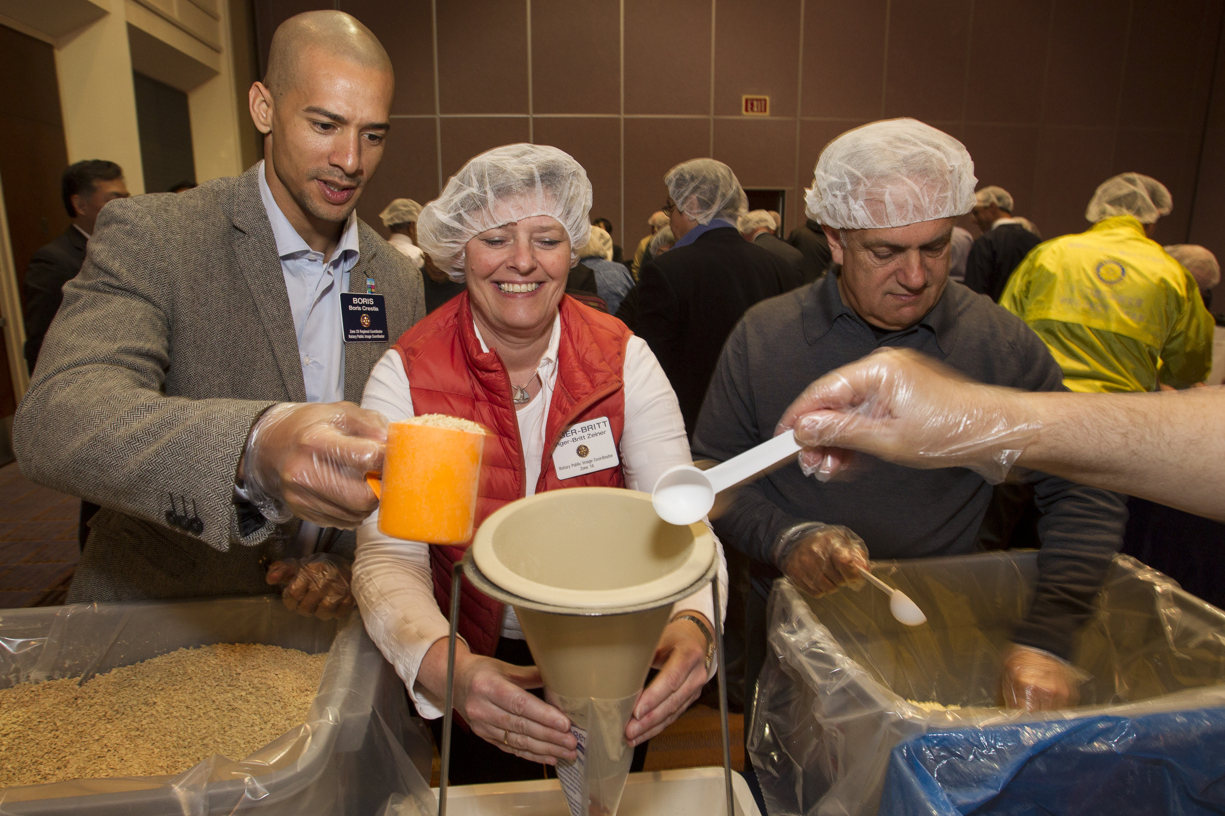
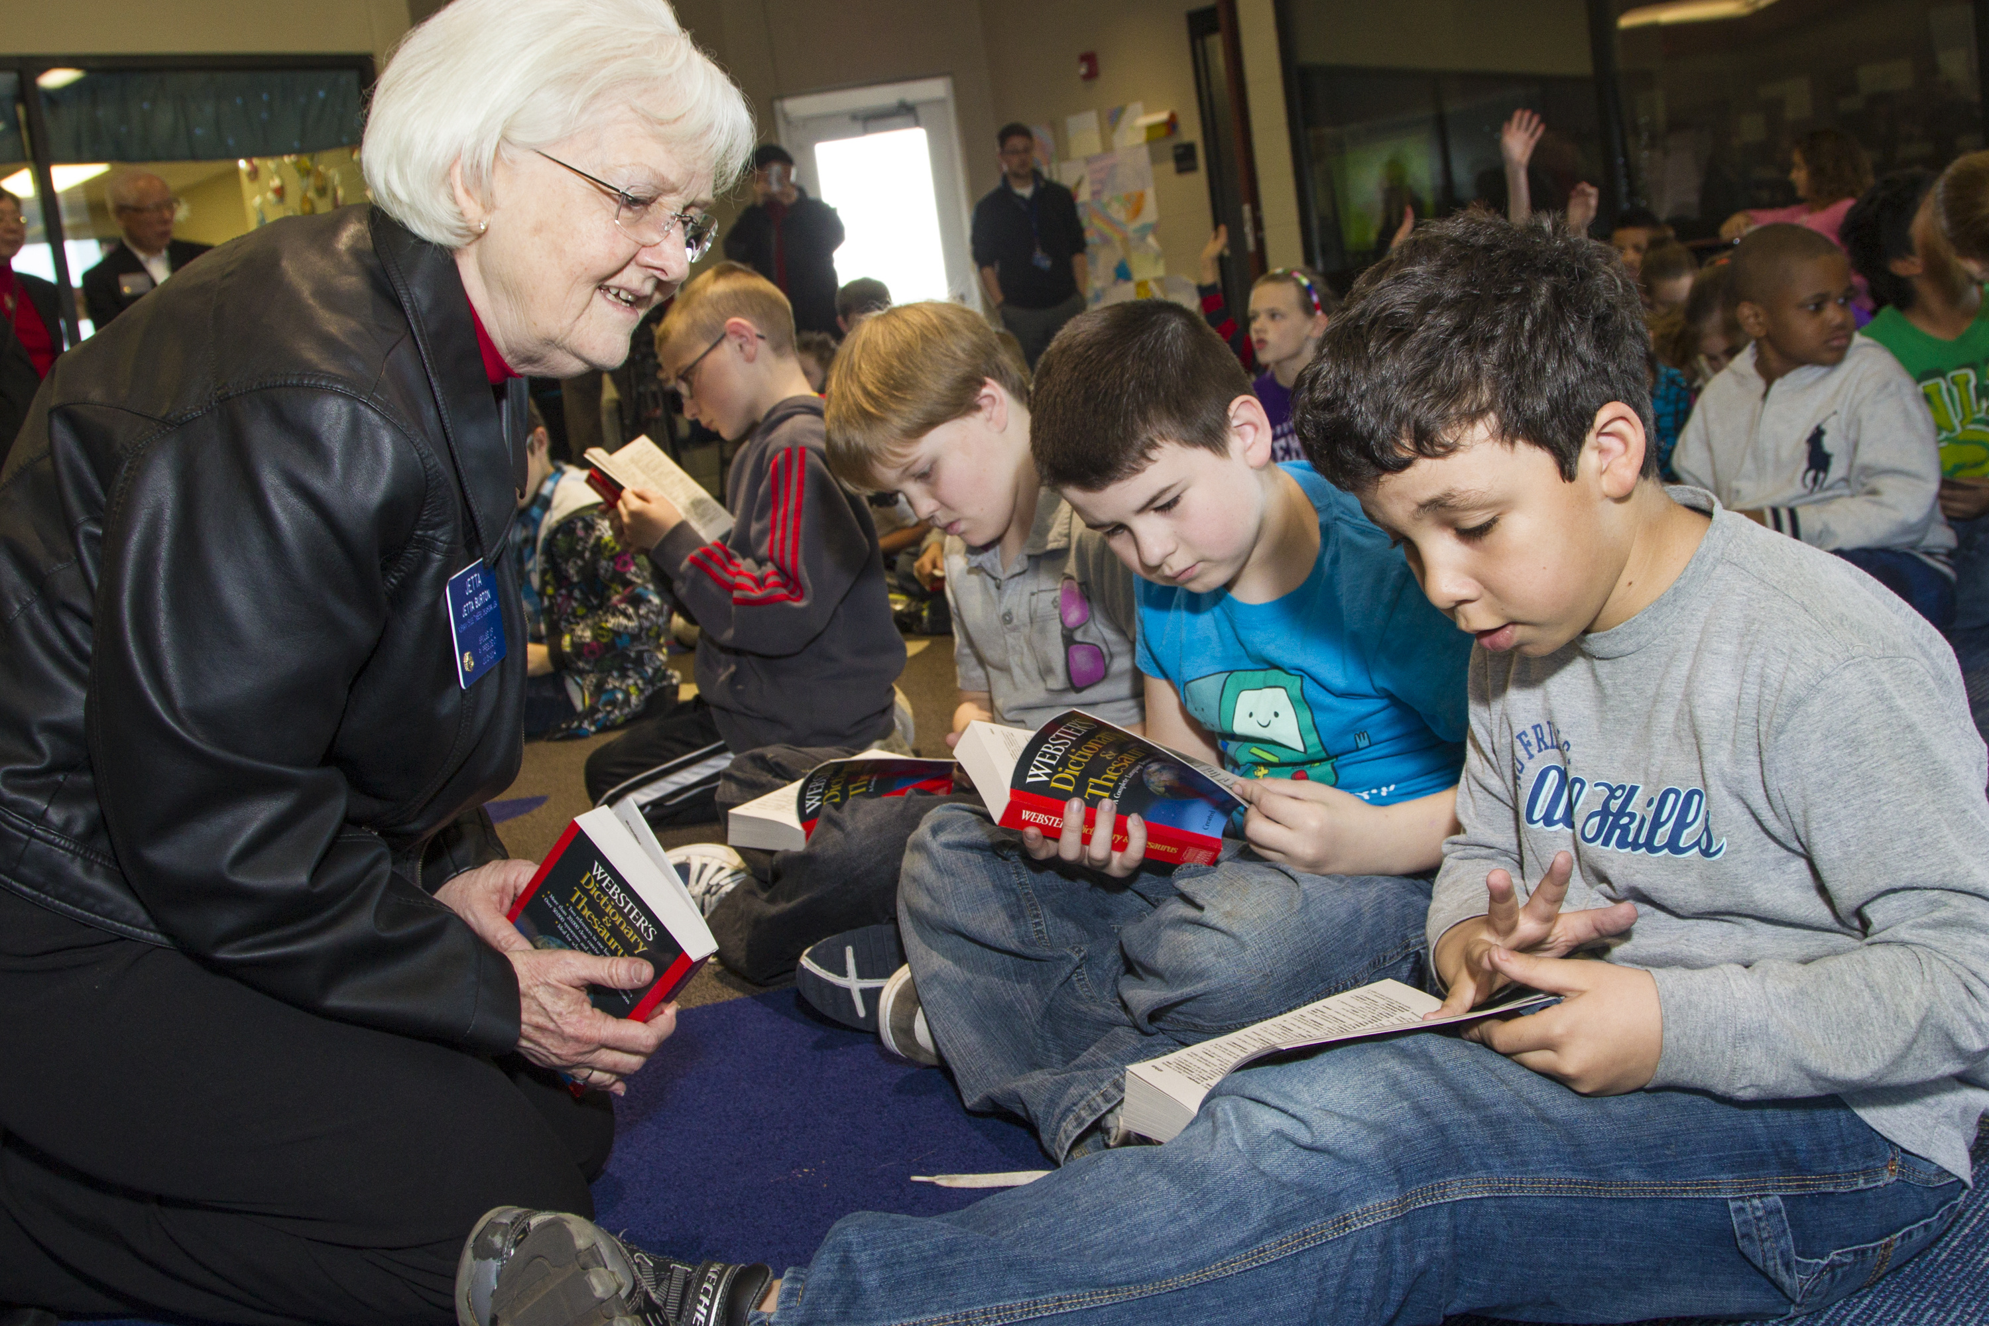
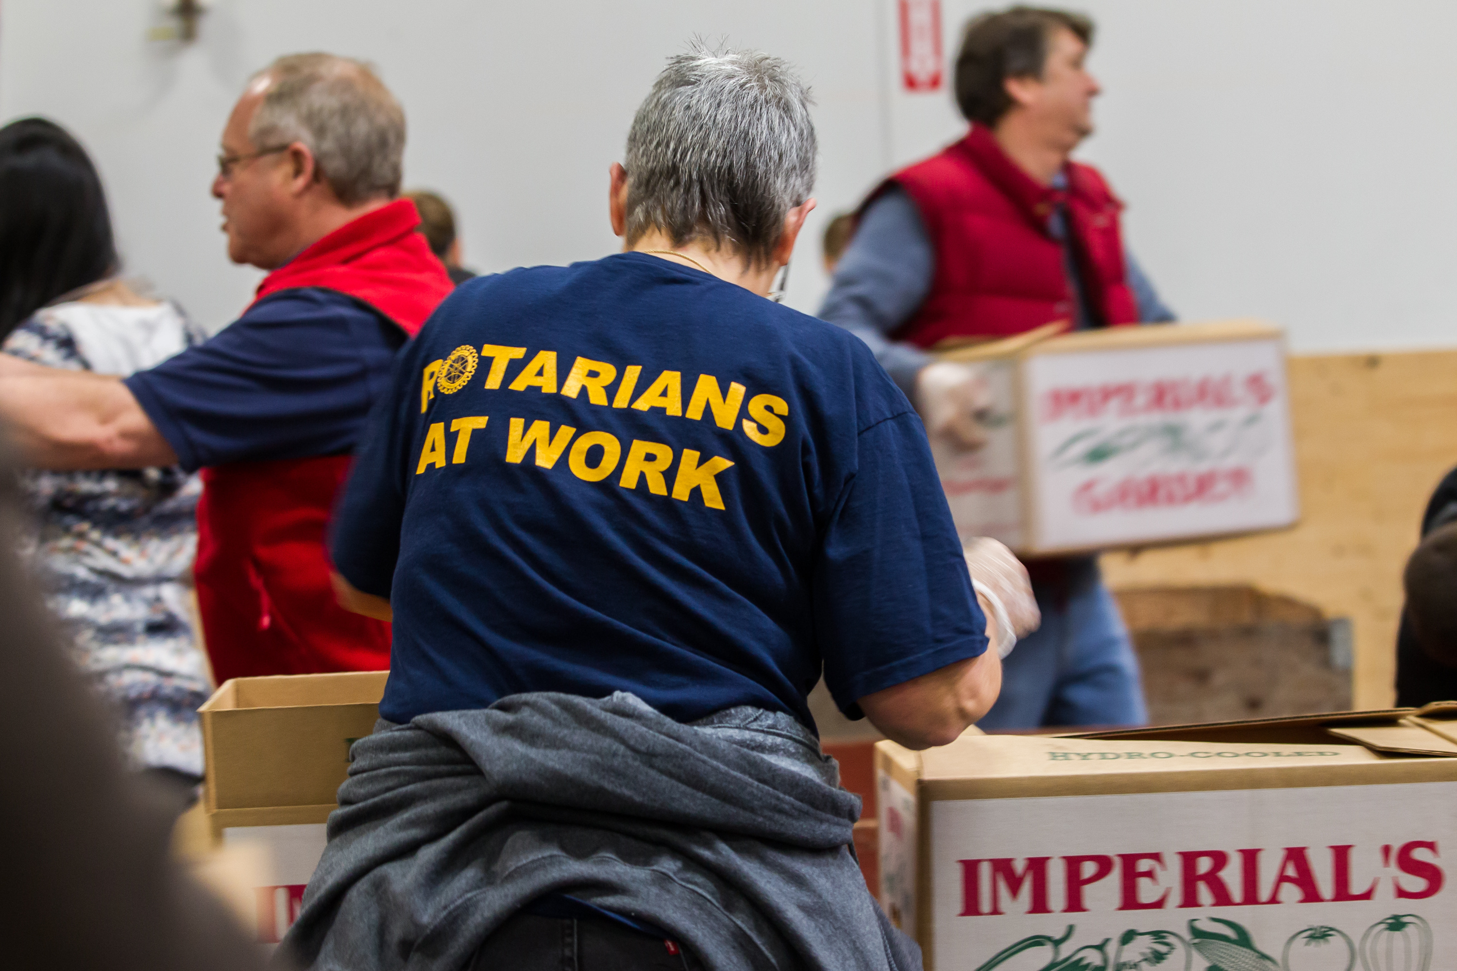
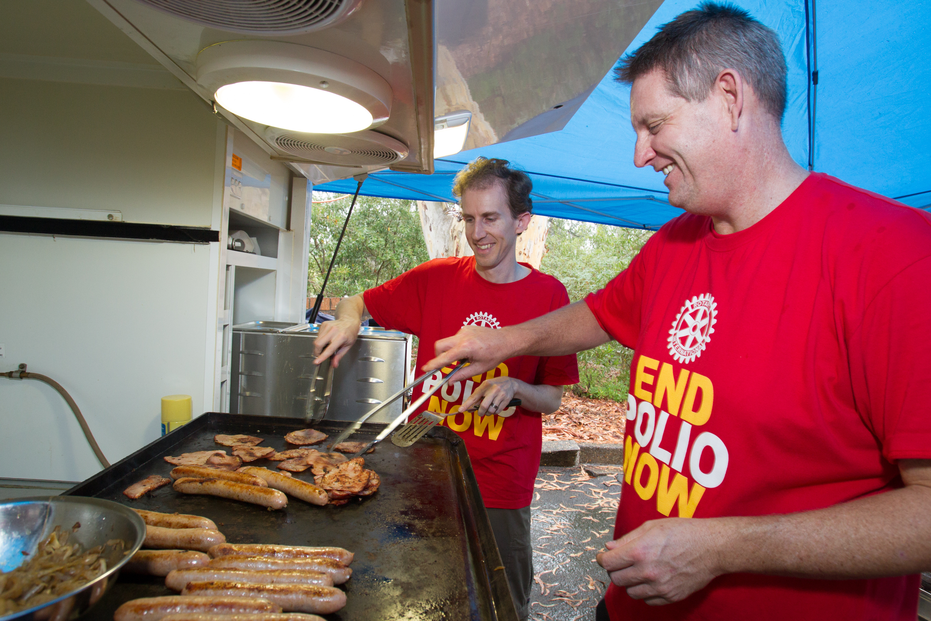
Service Projects
Notes:
11

Slide 12
Pages 4-6
District Grants
Notes:
12

Slide 13
Club Challenges Page 7
Membership
If your club is over 25 members:
Grow your club by 10 members
Or 10%
If your club is below 25 members:
Grow to 25 members
If you’re below 15 members, close the gap between where you are and 25 members by HALF
Notes:
13

Slide 14
Club Challenges Page 7
The Rotary Foundation
Annual Fund -- $175 per capita
If your club isn’t anywhere close to $175 per capita
Close the gap between where you are and $175 by half
If your club is over $175 per capita
Take the best of your past 5 years and beat it by $1.00
Notes:
14

Slide 15
Club Challenges Page 7
PolioPlus –
$50 per capita
If your club isn’t anywhere close to $50 per capita
Close the gap between where you are and $50 by half
If your club is over $50 per capita
Take the best of your past 5 years and beat it by $1.00
Notes:
15

Slide 16
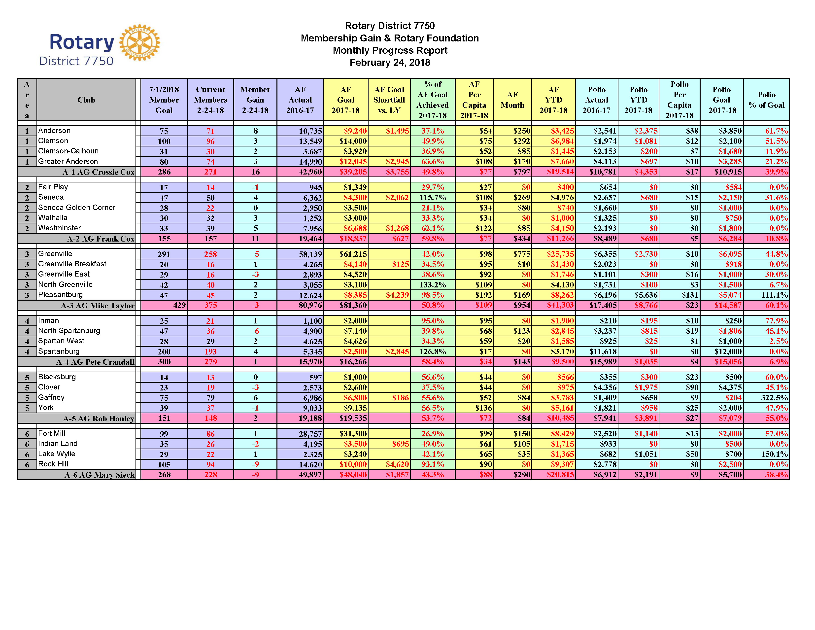
“Rainbow” Report LEFT POCKET
Notes:
16

Slide 17
Membership DG Ed Irick
Notes:
17

Slide 18
MEMBERSHIP
WHO
WHAT
WHEN
WHERE
WHY
Notes:
18

Slide 19
Needs Assessment Beth Padgett
D7750 Rotary Foundation Banquet
Notes:
19

Slide 20
NEEDS ASSESSMENT
Why do a Needs Assessment?
When was the last time you analyzed an existing project?
Maximize Club’s ability to make a meaningful impact
Get better understanding of community/stakeholders
Perhaps look at a lingering issue in a new way
Ensure you have buy-in for the project in your Club
Notes:
20

Slide 21
NEEDS ASSESSMENT
Your Existing Community Service Projects
What if we started first with WHY we are doing this project, then HOW & finally WHAT?
Is your project meeting a need?
Who & how many are benefiting?
What if we stopped doing this?
Has this project outlived its usefulness?
Notes:
21

Slide 22
NEEDS ASSESSMENT
Where do you go for Ideas?
— Community meeting
— Focus group
— Survey
— Interview
— Talk to community leaders
— Rotary Showcase
— District Governor’s Signature Project
Notes:
22

Slide 23
NEEDS ASSESSMENT
Good Measure of Rotary Relevance
— Peace and Conflict Prevention/Resolution
— Water and Sanitation
— Basic Education and Literacy
— Disease Prevention and Treatment
— Maternal and Child Health
— Economic and Community Health
Notes:
23

Slide 24
NEEDS ASSESSMENT
Example of a Project that Worked
Take iPDG Lance Young’s AED Project:
Had a WHY -- A purpose, a cause, a belief
Gave us the HOW -- Submit a matching grant and order from Altra Medical, price already negotiated
WHAT – 44 AEDS that will save lives are now in our communities
Notes:
24

Slide 25
The Rotary Foundation
PDG Lorraine Angelino
Notes:
25

Slide 26
THE ROTARY FOUNDATION
A Strong, Healthy, Vibrant Club
Gives to The Rotary Foundation
Notes:
26

Slide 27
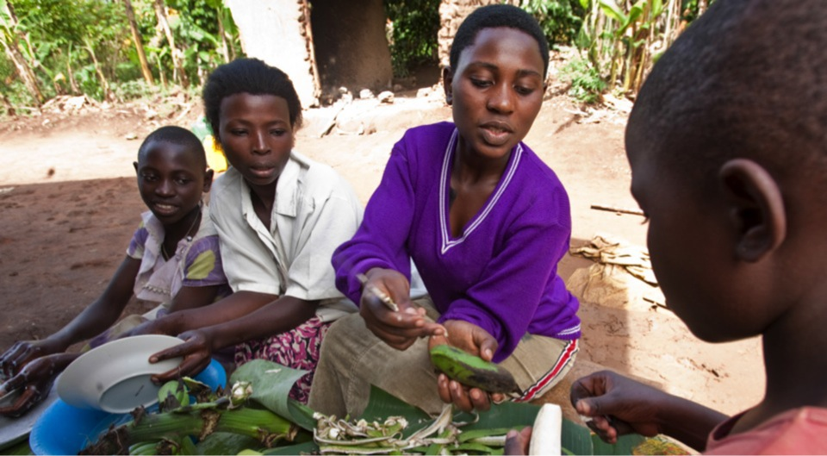
Why Give?
World Understanding • Goodwill • Peace
Notes:
27

Slide 28
THE ROTARY FOUNDATION
Dream the Possible Dream
Imagine a world in which:
No child goes to bed hungry
Every sick child gets medical attention
Every child has an opportunity to learn
Every child has a roof to sleep under and clothes to wear
Every child knows love and compassion
All young lives have hope and the chance for a better life
Notes:
28

Slide 29
THE ROTARY FOUNDATION
Be The Inspiration:
Set Goals – Think Big!
Apply for a District Grant
Assist with a Global Grant
Lead by example
Challenge club members
Promote the Foundation event
Notes:
29

Slide 30
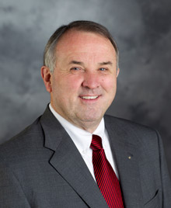
THE ROTARY FOUNDATION
District 7750 Foundation Event
Guest Speaker
Foundation Trustee Chair & PRIP
Ron D. Burton
Notes:
30

Slide 31
THE ROTARY FOUNDATION
District 7750 Foundation Event
Million Dollar Reception
Foundation Banquet
Tentative Date 11/29/2018
Notes:
31

Slide 32
Club Awards
Notes:
32

Slide 33
PETS Bag
ROTARY CITATION
Notes:
33

Slide 34
ROTARY CITATION
PETS Bag
Notes:
34

Slide 35
GOVERNOR’S AWARD
Pages 8-10
Notes:
35

Slide 36
GOVERNOR’S AWARD
Page 8
Notes:
36

Slide 37
GOVERNOR’S AWARD
Page 9
Notes:
37

Slide 38
GOVERNOR’S AWARD
Page 9
Notes:
38

Slide 39
GOVERNOR’S AWARD
Page 10
Notes:
39

Slide 40
Governor’s Leadership Society
Overachieving Club Award
Notes:
40

Slide 41
DISTRICT LEADERSHIP TEAM
Pages 11-12
Notes:
41

Slide 42
DISTRICT RESOURCES
Page 13
Notes:
42

Slide 43
WEB NAVIGATION Faith A. Line
-15
Pages 14-15
Notes:
43

Slide 44
Carolinas’ PETS 2018
Web Navigation

Slide 45
Carolinas’ PETS 2018

Slide 46
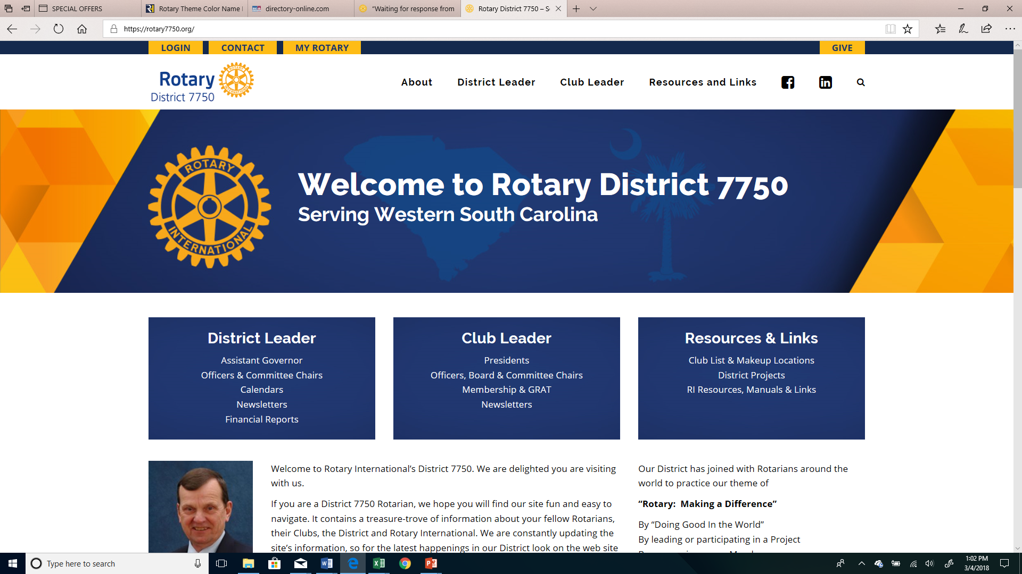
Carolinas’ PETS 2018
Notes:
The home page of the District Website has links to all kinds of information
We will take a brief look at::
Publications and Forms
Member Access – which takes you to the District and Club database – the restricted part of the District website
Rotary International Website
My Rotary – the restricted part of the Rotary International Website
Rotary Club Central – the RI database
-
46

Slide 47
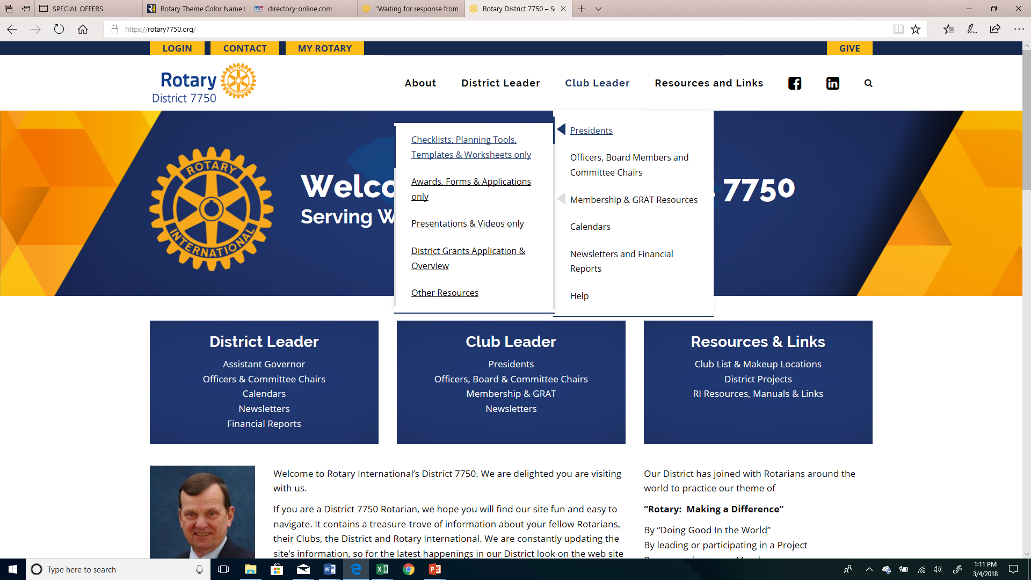
Carolinas’ PETS 2018
Notes:
Club Leader– open for anyone to see without being logged in
Note at top of the right hand column the Information Library for 2018-2019 Club Presidents
A very important page with links to dozens of documents you will use throughout the year
47

Slide 48
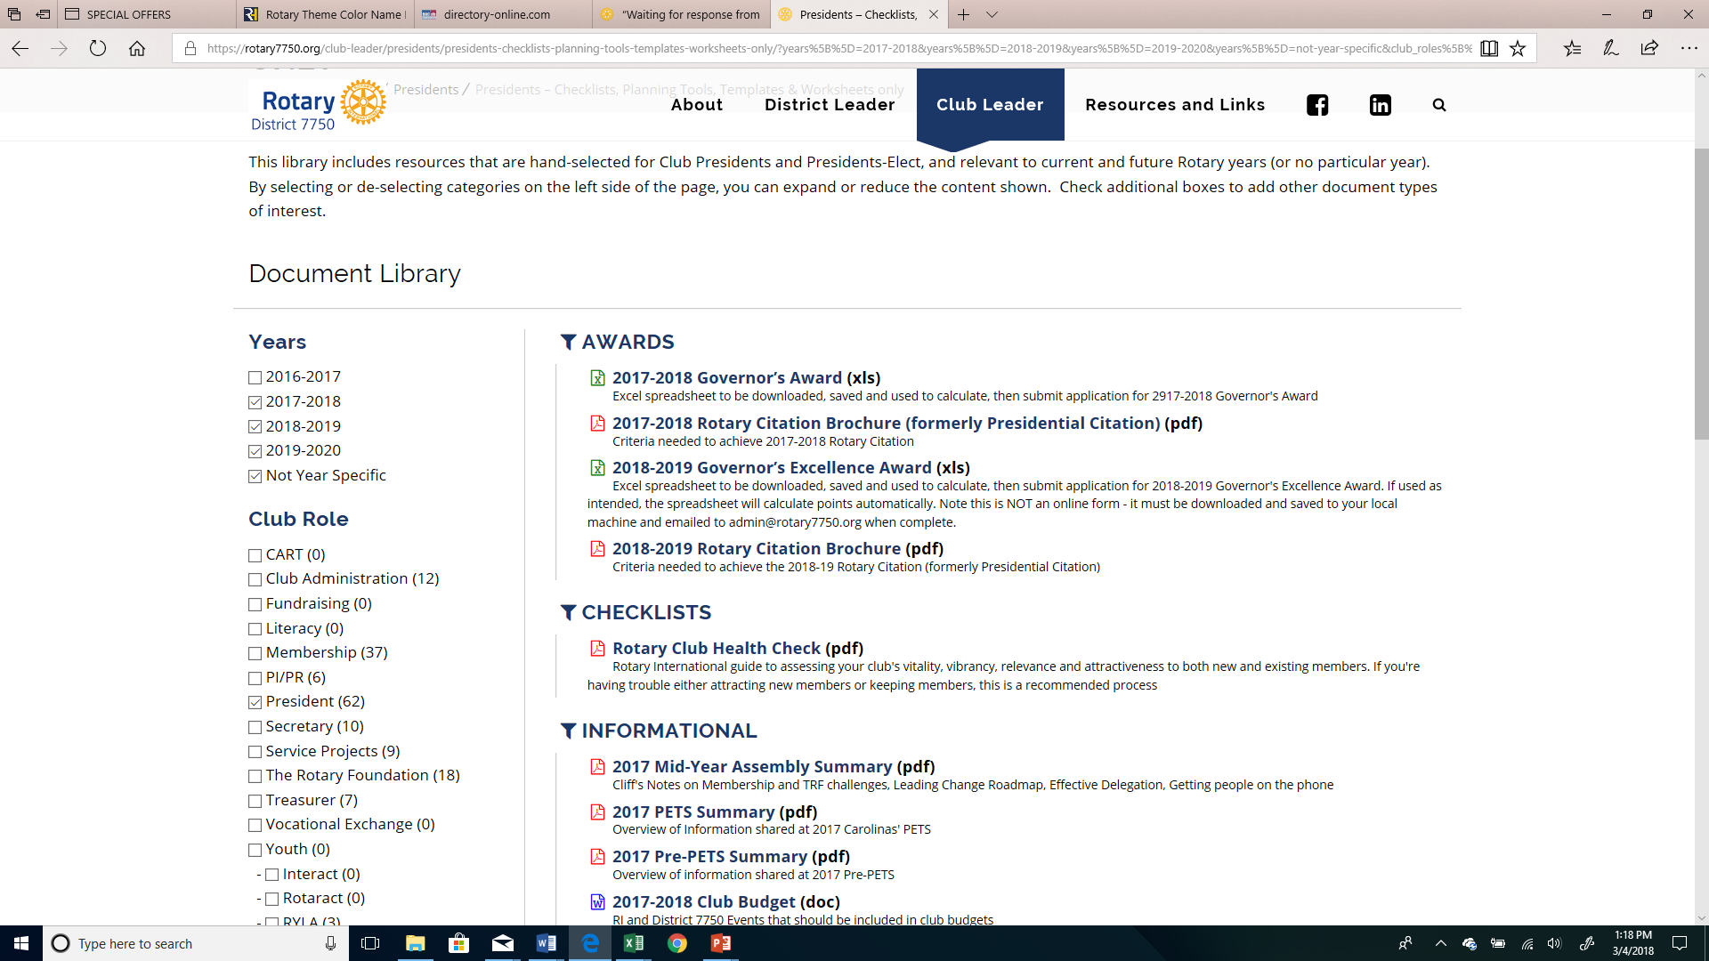
Carolinas’ PETS 2018
Notes:
All the forms and information in the District Resource Guide you received today and more is posted on the Information Library for 2016-2017 Presidents page.
Rotary Citation
Governor’s Award spreadsheet
Club Planning Guide
Membership ideas
Member Access – The District and Club data base = DACdb
48

Slide 49
Carolinas’ PETS 2018
Notes:
The home page of the District Website has links to all kinds of information
We will take a brief look at::
Publications and Forms
Member Access – which takes you to the District and Club database – the restricted part of the District website
Rotary International Website
My Rotary – the restricted part of the Rotary International Website
Rotary Club Central – the RI database
49

Slide 50
Carolinas’ PETS 2018
Easy to Log in & Easy to USE
Your EMAIL address
Your RI Member ID
Your Club Number

Slide 51
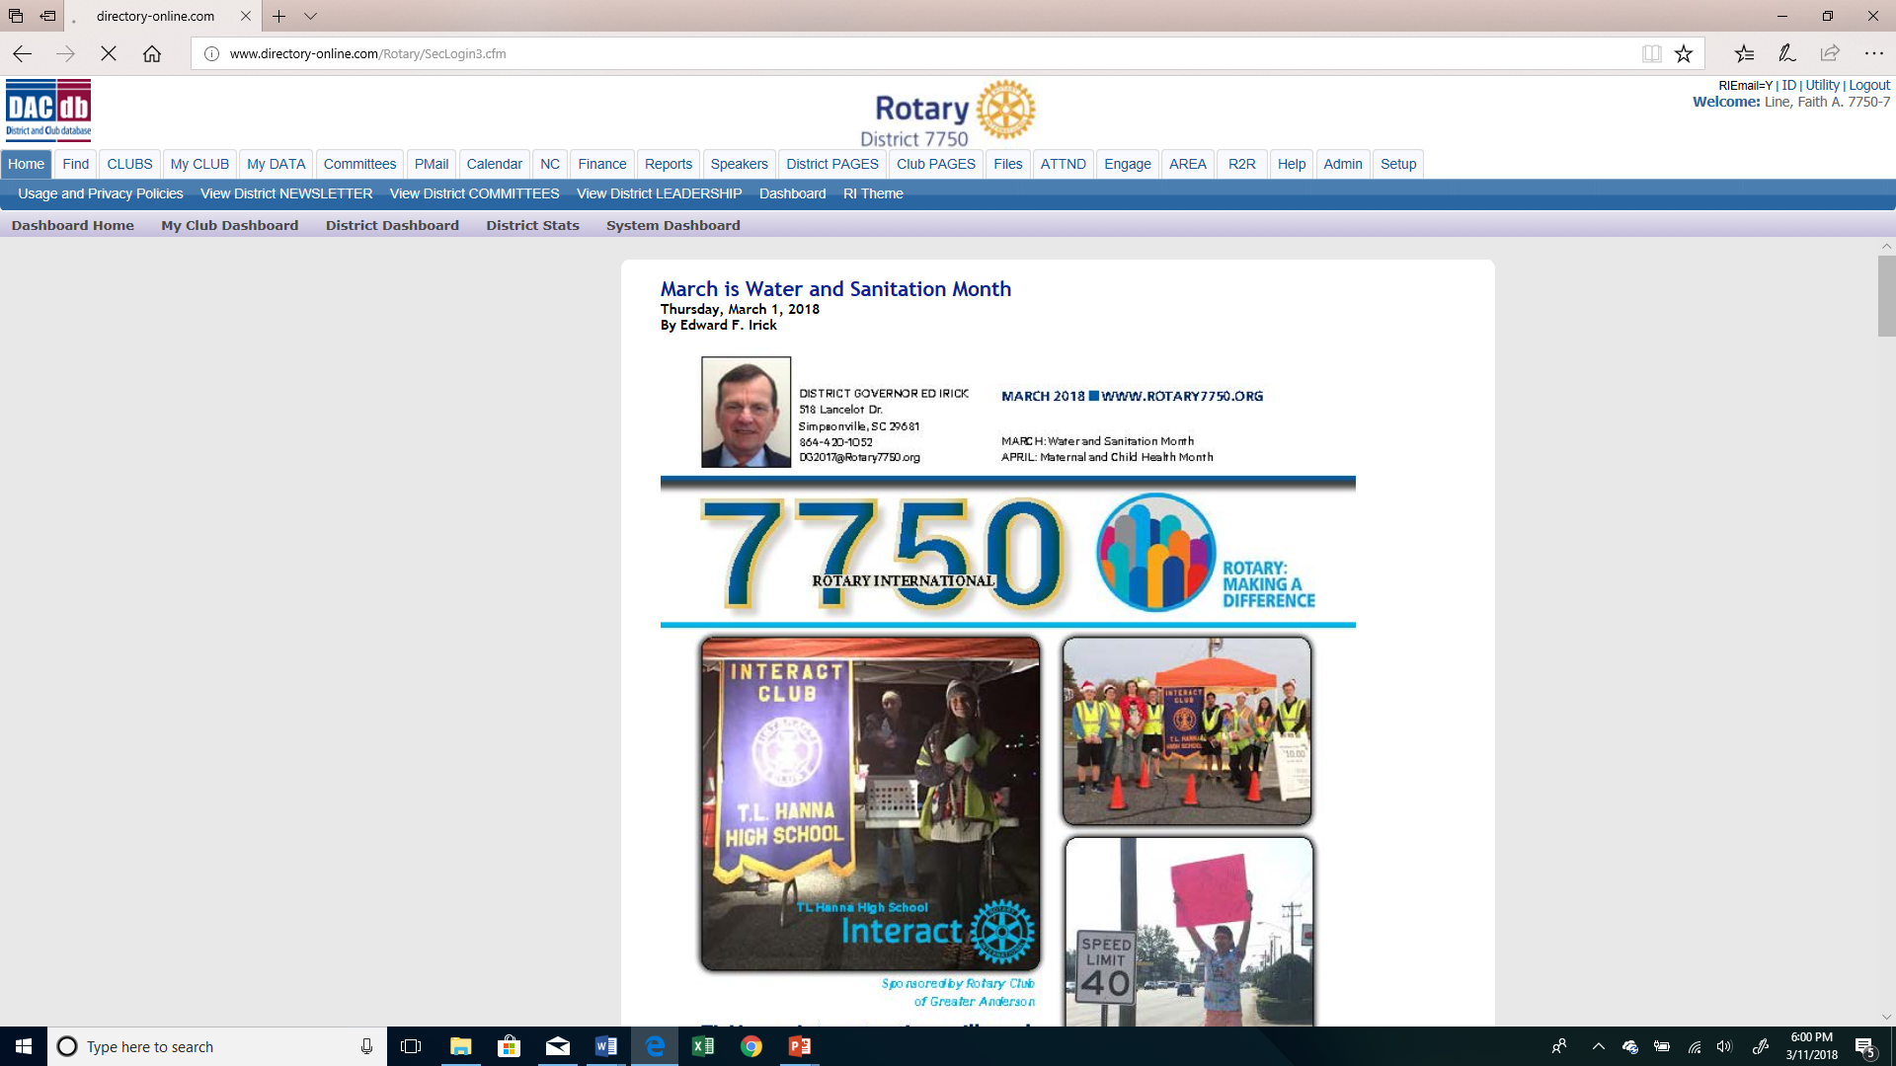
Carolinas’ PETS 2018
Notes:
Note the tabs in the white and blue bars:
Committees – lists all of the committee and resource chairs – the same people in your binder
Calendar – All district events are here –clubs encouraged to use it too so others can see what, when and where events are happening
51

Slide 52
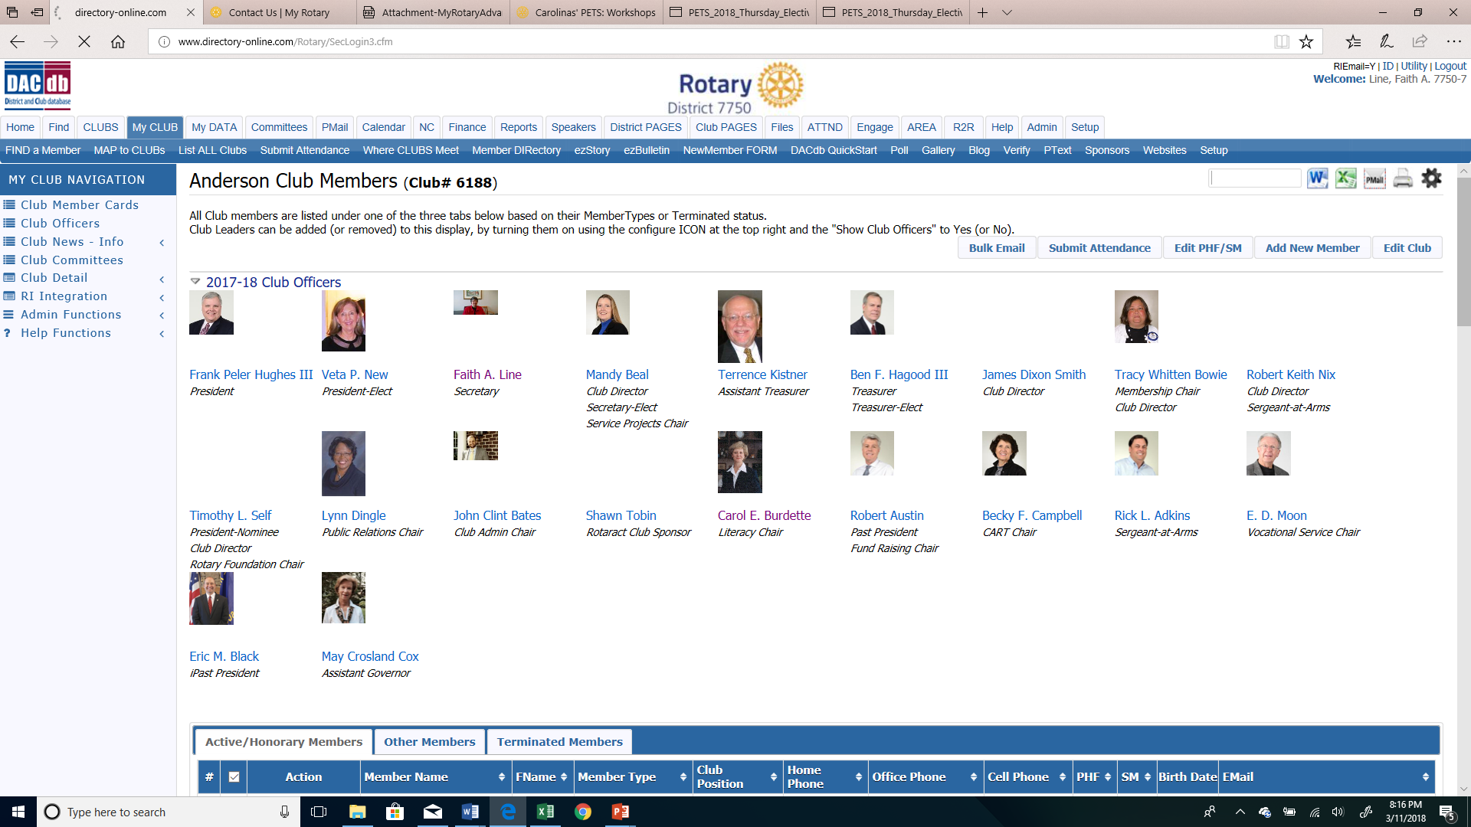
Carolinas’ PETS 2018
Notes:
You are all probably quite familiar with what your club page looks like. There are lots of important tools from this page.
PMail
Submit attendance
Member Compare – compares in real time who the district has on the books and who RI has on the books – important that they match!
The Calendar
52

Slide 53
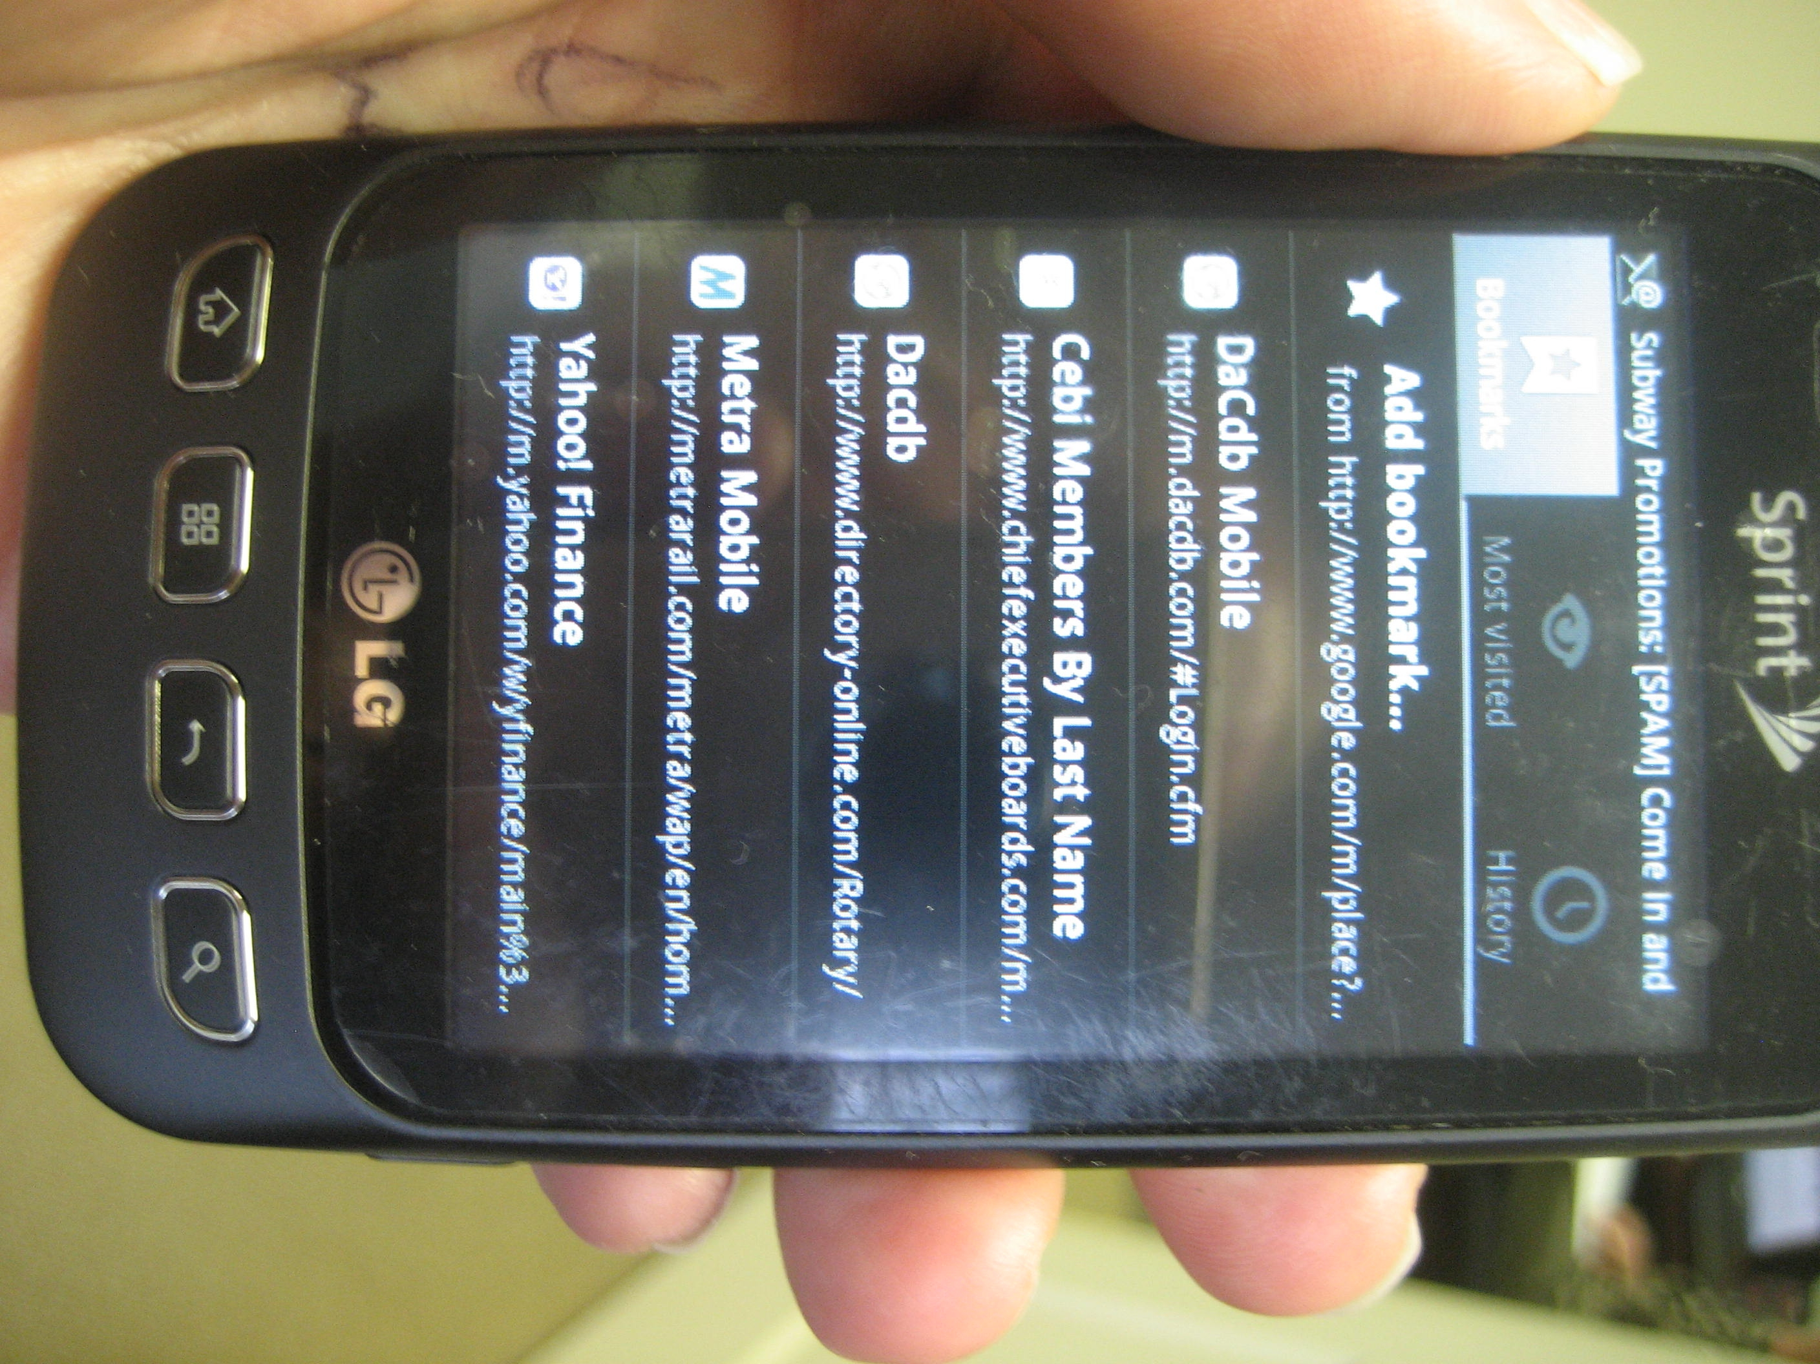
Carolinas’ PETS 2018
Mobile Access Bookmark: m.DaCdb.com in your mobile browser
Notes:
53

Slide 54
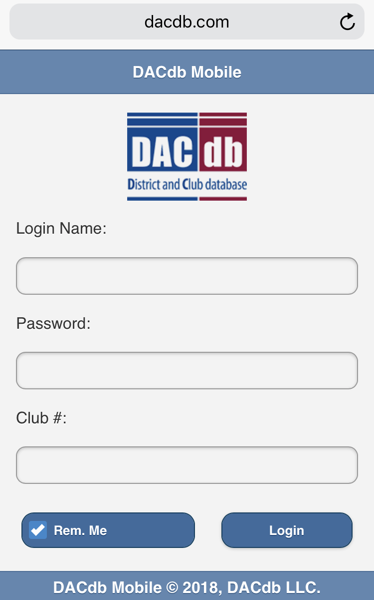
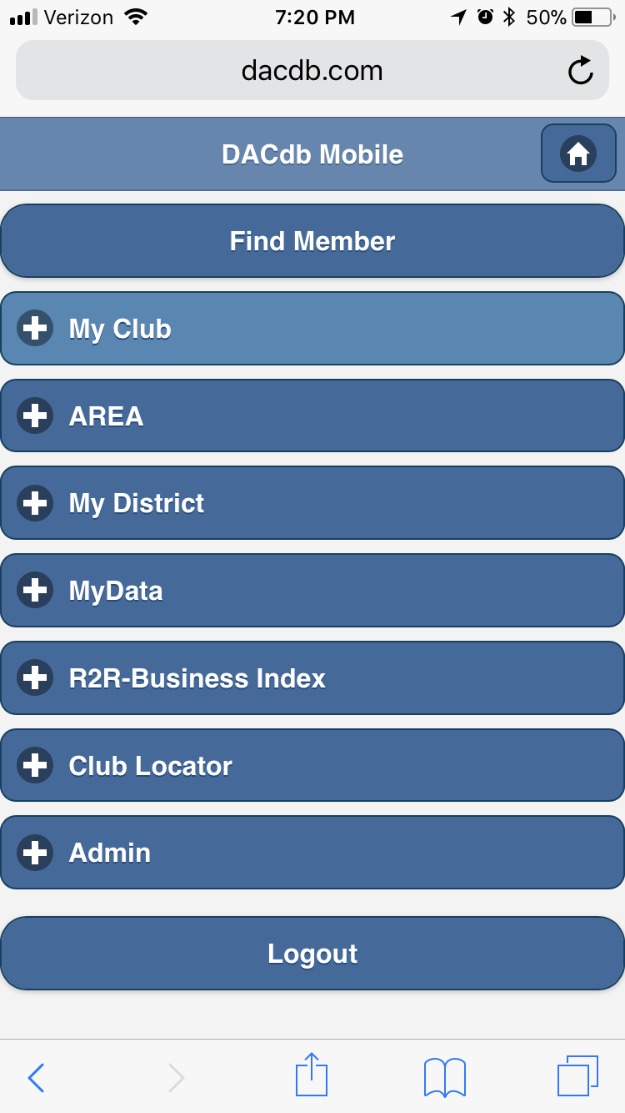
Carolinas’ PETS 2018

Slide 55
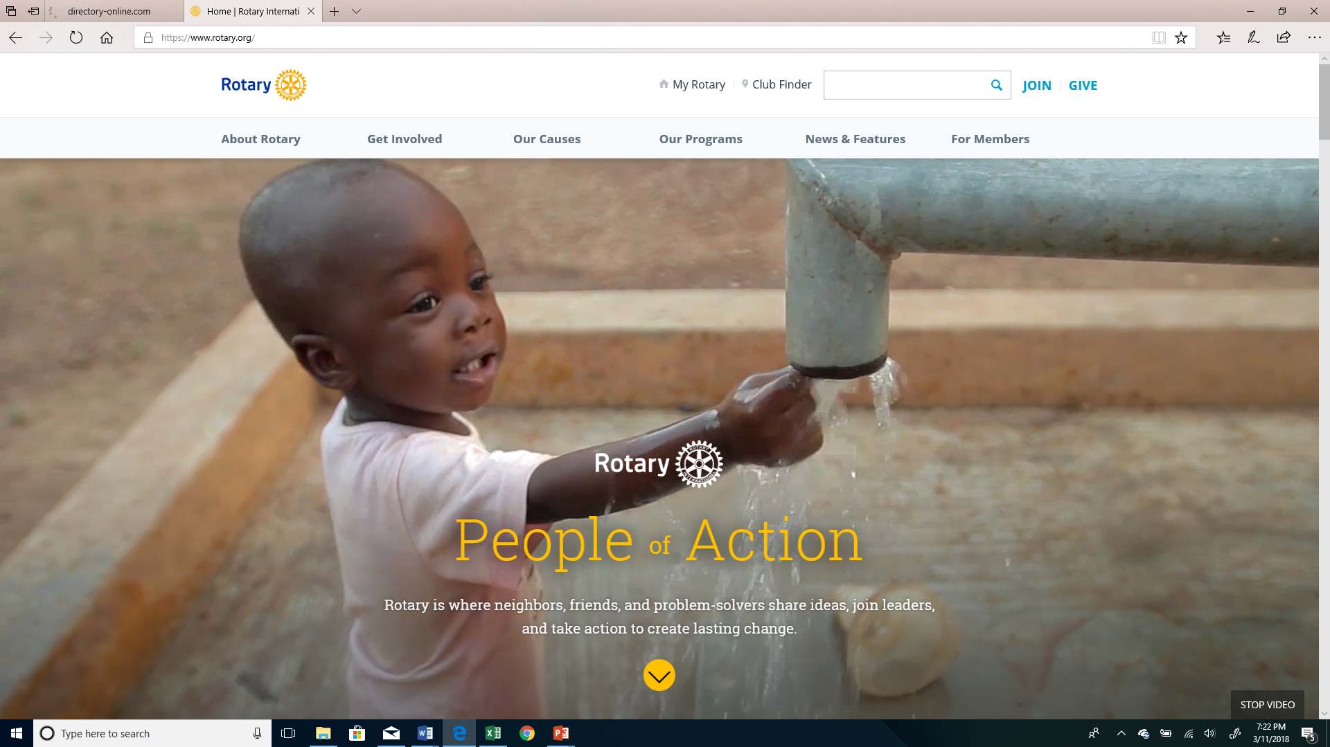
Carolinas’ PETS 2018
Notes:
This is the RI website that is open to the public – no log in required
Most of the real “meat” that you want is found in My Rotary
55

Slide 56
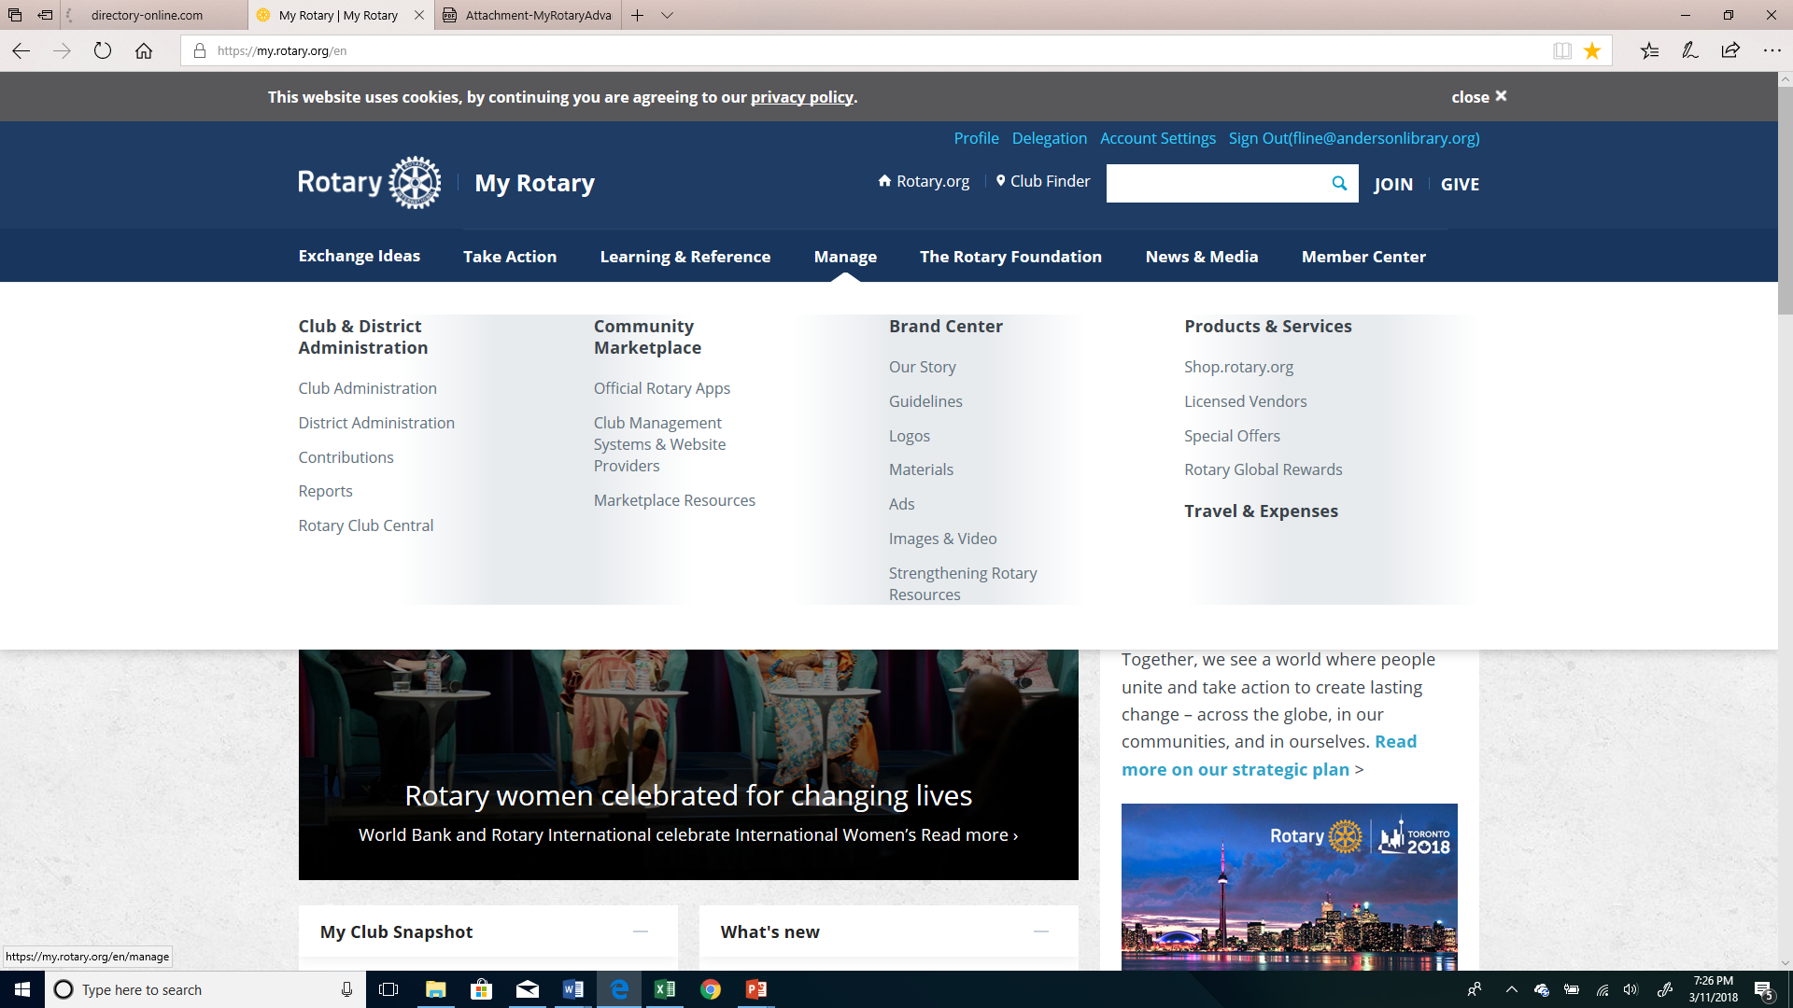
Carolinas’ PETS 2018

Slide 57
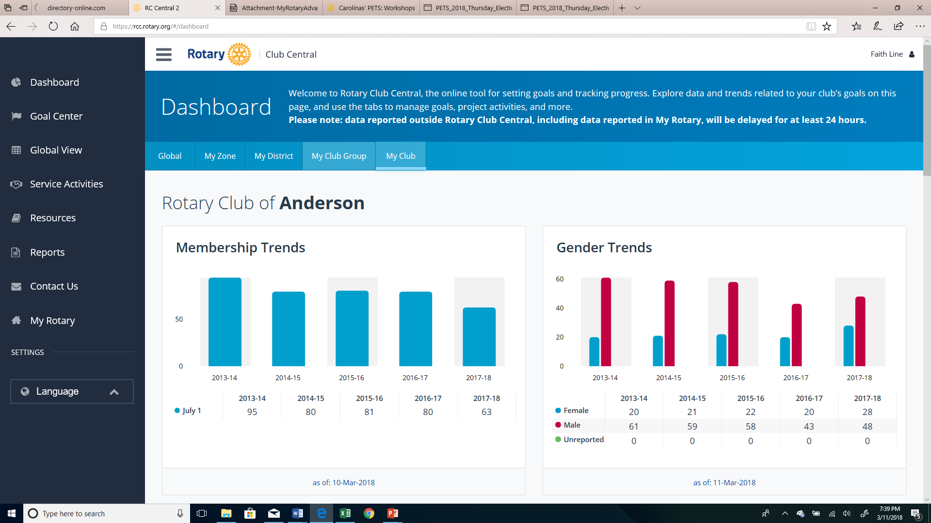
Carolinas’ PETS 2018
Notes:
It will open on the “Your Club” tab of your club.
That tab is mostly concerned with membership. When you scroll down you will see “trends”
Below that is where you enter your membership goals
The Foundation Tab will show your club’s trends for Foundation Giving
Scroll down to enter your goals for next year
The Service Tab covers just about everything else
This is where in addition to entering your service goals you will enter information for the Presidential Citation that isn’t automatically tracked by RI
Membership, TRF, Interact and Rotaract club sponsorships are automatically tracked however “mentoring 3 Interactors or Rotaractors” needs to be added
57

Slide 58
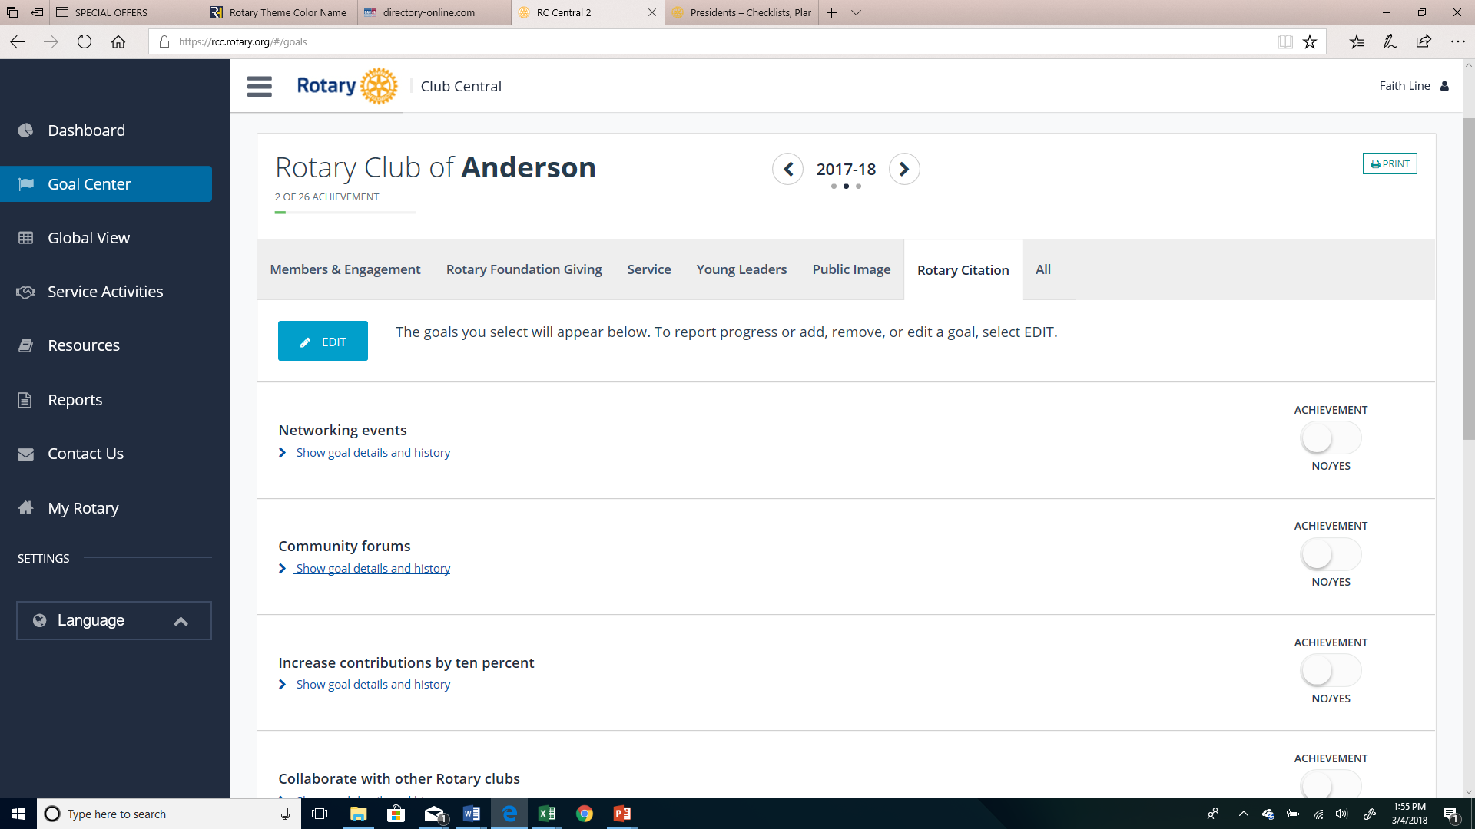
Carolinas’ PETS 2018
Notes:
Here is where you set goals
And where you indicate achievement – mostly yes and no answers
the pencil icon so you can edit
58

Slide 59
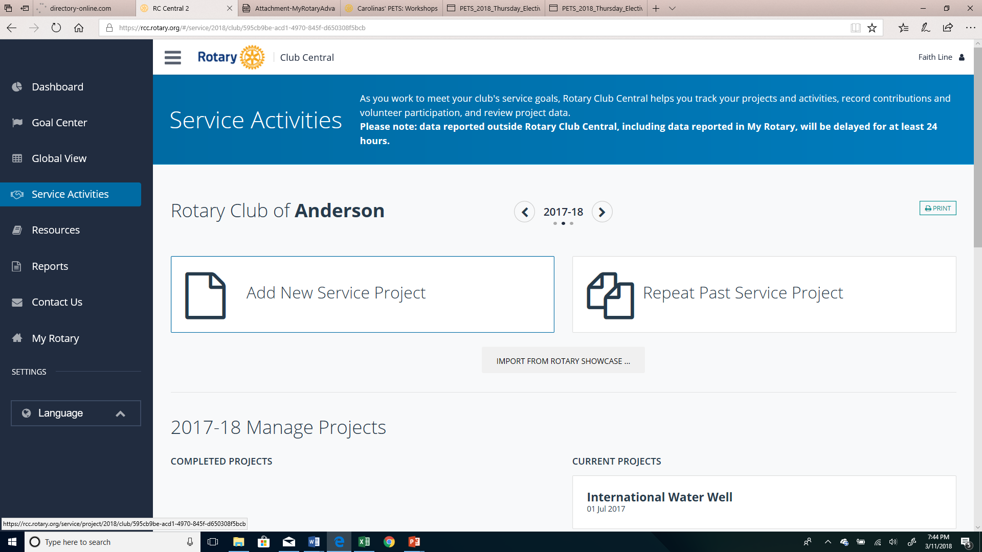
Carolinas’ PETS 2018

Slide 60
Carolinas’ PETS 2018
What if I Have a Problem
with DACdb?
E-mail: ITSupport@Rotary7750.org
What if I Have a Problem with the RI website? Click on “Contact Us”
at the bottom of the RI web page

Slide 61
DISTRICT CALENDAR
Page 16
Notes:
61

Slide 62
DISTRICT GOVERNOR’S OFFICIAL VISITS
Pages 18-19
Notes:
62

Slide 63
Leadership
Notes:
63

Slide 64
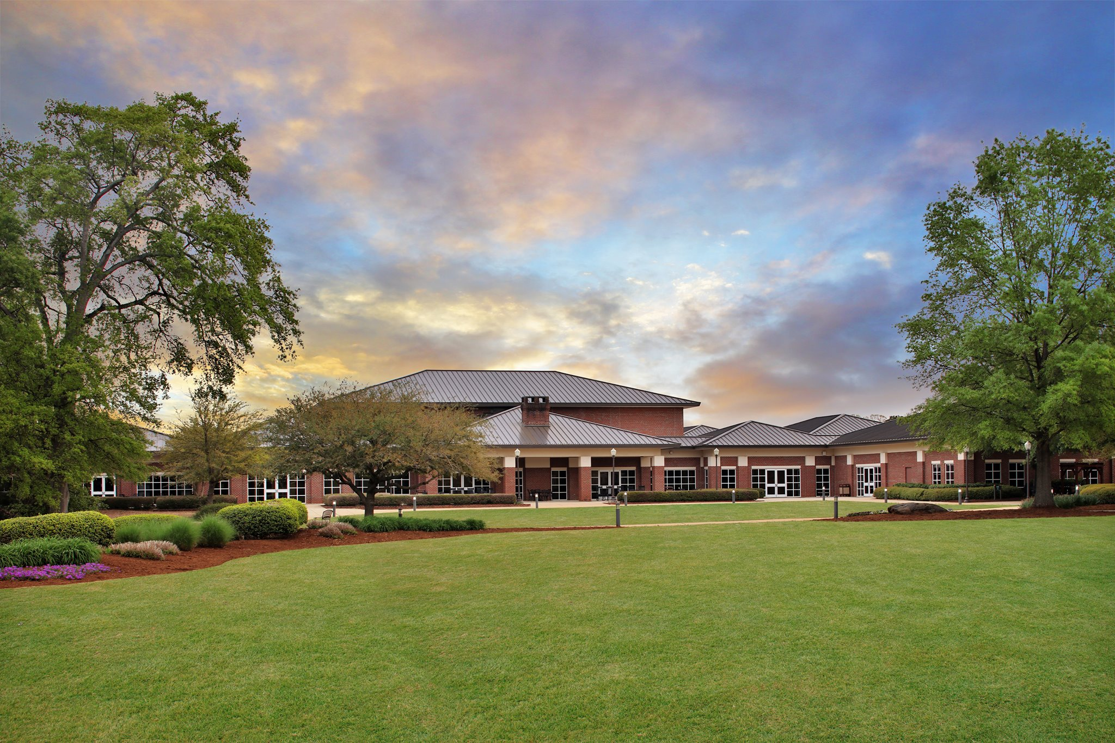
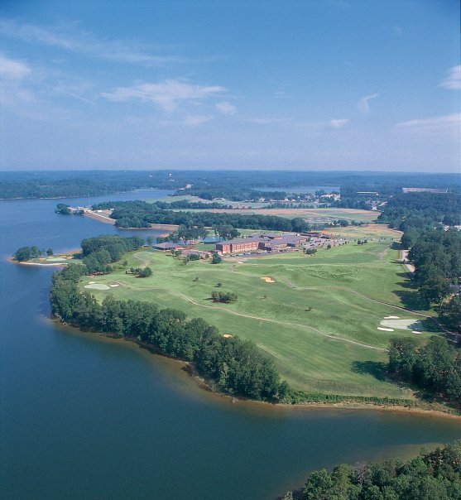
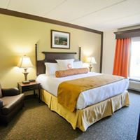
2019 Conference
Madren Center, Clemson
Notes:
64

Slide 65
Questions?
D7750 Rotary Foundation Banquet
Notes:
65

