Slide 1
Enhancing Your Club’s Public Image
TITLE
A Hands-on Workshop for Building Membership and Financial Support

Slide 2
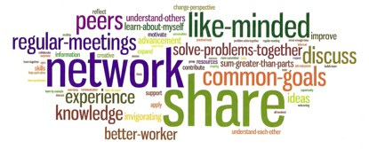
The Rotary Idea
Notes:
We joined rotary because as business and professional leaders it is by coming together that allows us to achieve the goals we have for our community.
We are going to review today how the club as a whole can leverage social media and communication to achieve our goals.
***ITS ALL ABOUT TELLING A STORY***
Goals are: Visibility of the club projects and mission, Support for our community projects, Membership which ultimately supports the first two goals.

Slide 3
Why enhance your club’s public image?
Each Rotary Club in District 7750 exists to impact their communities (and the larger world in which they live) in positive ways
If their community knows more about Rotary and what that club is doing
More members
+ More community (financial) support
= Greater impact

Slide 4
The work of Rotary begins in the community, and every community has its own unique needs and concerns.
Notes:
Communications / Public Image / Public Relations / Marketing – many different terms that all accomplish the same goals for our club.
But often all of these things seem separate from or different from why we became a Rotarian.
It also seems like something that someone very techy gets to do or worse it is a role someone is stuck with – the PI Chair!

Slide 5
Why enhance your club’s public image?
PI is about communication
Communication and PI affect EVERY role in the organization.
Strategic Initiatives
Build a network of communication contacts within the District
Active Committee Members
Advisory Committee Members
Build a resource portal to enable easy of use.

Slide 6
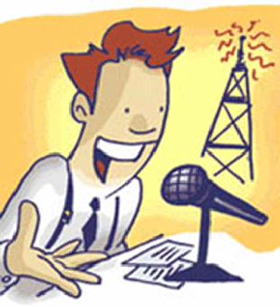
Mass Media Communication

Slide 7
Mass Media Best Practices
Newspapers/Magazines – letters to the editor, community interest pages (photos make everything more interesting), community activities calendars
Magazines – longer lead times, but also a longer shelf-life
Radio/TV – live interview on some radio stations’ Community Interest editorial, or posted on community activities calendars

Slide 8
Mass Media Best Practices
Most broadcast stations and print media now want all media release provided online – You make their job easier and have a greater chance of story coverage with this approach.
News coverage is based on newsworthiness – Work on the idea to make it interesting to the community.

Slide 9
Mass Media Best Practices
News Media Releases – Always provide a quote from someone in the club, it gives credibility to the story.
Templates available
Use cases:
New Members
Guest Speakers
Service Project / Event
Global emphasis days / events

Slide 10
New Rotary Logo

Slide 11
The new Rotary logo is customizable.
Notes:
*** CUSTOMIZE FOR THE CLUB YOU’RE SPEAKING WITH ***

Slide 12
Let’s take a live look at how to make it work
Project Overview
PI’s role is to get the ball rolling
Press Release, Blog/Web/LinkedIn post
Initial FB, Twitter, LinkedIn message
Promote the post – small budgets go a long way
But who looks at them???
Visibility – like, comment, share, click
Tag the organizations being supported
Twitter too – Link, Tag, Re-tweet,
Notes:
Facebook:
Everyone take out phones – like the page!
Keep your phones out
We are going to demonstrate how we can use social media to have very dramatic effect.
Notice that this page doesn’t exactly have many visitors – your Rotary club FB page may not either. That is not a problem.
Why are fewer people seeing my Page posts?
Fewer people may be seeing your Page posts because of a decline in organic reach, which is happening as the amount of content being shared on Facebook grows faster than people's ability to see it. To help people have a good experience on Facebook, we try to show them the most relevant stories in their News Feeds. This means that as the amount of content shared on Facebook continues to grow, your Page posts will be competing with more stories to appear in News Feed.
You can help your Page posts have a better chance of being shown in News Feed by creating high-quality posts and engaging with your audience.
PI Chair – made a post, linked to an article, blog or page. But who is looking at it. Facebook works based on special algorithms that only show posts based on relevance and likelihood others are interested. That relevance is managed by many things, but can be greatly improved by our own actions – linking, tagging, liking, commenting and sharing. So let’s walk through a few of these and see how we make that happen. And everyone here is going to do that with me – we are going to make this a live example of what can happen.
Start by liking the post – that’s easy, everyone go ahead and do that. There – 1 second down – do that every meeting.
Commenting is helpful and if you are a frequent user of fb, go ahead and do that – but you may want to save a comment for sharing which we will go over in a moment.
Follow the link – it only takes a moment, but it boosts the post and the destination page (yes, you may know what is there, but do it anyway – FB doesn’t know you know.)

Slide 13
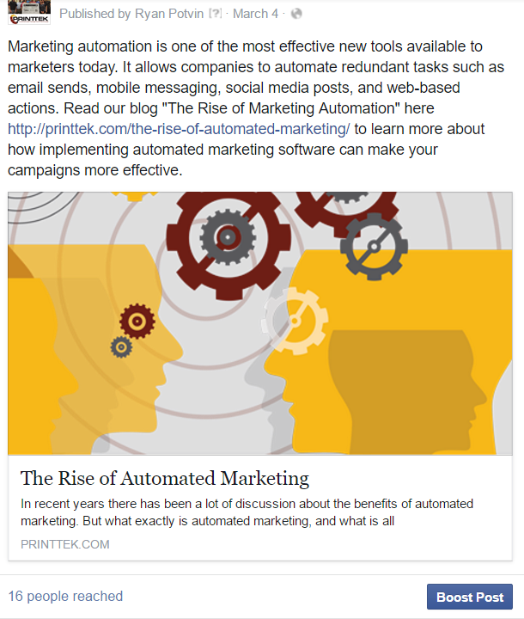
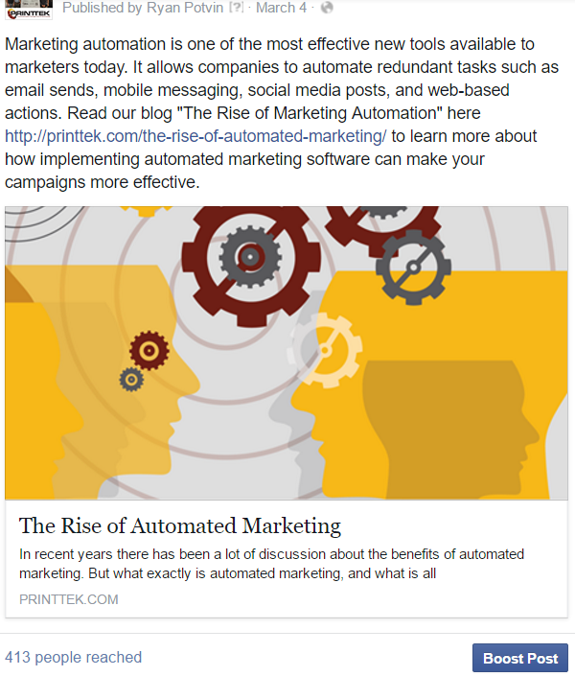
Notes:
Sharing – This one is extremely powerful. See the Reach number here on FB – we won’t see it go up dynamically, but it will grow exponentially as we share.
Two ways to share – instant, with commenting. Sharing is quick – do it often. Commenting is powerful, because now we can combine sharing with tagging. Here is how it works.
Rotary 7750 Group / City / Project organization – link them, link names (Scott), link communities (City), link organizations (project for…). When we share, this is not only going to have a greater likelihood of showing up on our friends feed, but it can show up on the feed of every one you just linked. Plus, it boosted the relevancy of the original post, so now it will show up on more people’s feed. And then as people like those shares, it also boosts the relevance of both posts and suddenly we have a HUGE audience.
Now let’s do the same thing with Twitter… I’m sure there are a lot less people here using twitter. So why do it… because other people out there are using it. But no one is going to see my ‘tweet’ – I have like 2 followers. Ah, but that is the power of tagging.
Navigate to the twitter account – See, there is a tweet. Let’s go ahead and retweet it, but let’s also tag someone… (City / Project Organization). Now we have just made this tweet visible and it links back to our original content.
Now let’s do the same thing with LinkedIn… To show you how to share a project on LinkedIn, I’m going to have Lindsey Stemann come up who works at

Slide 14
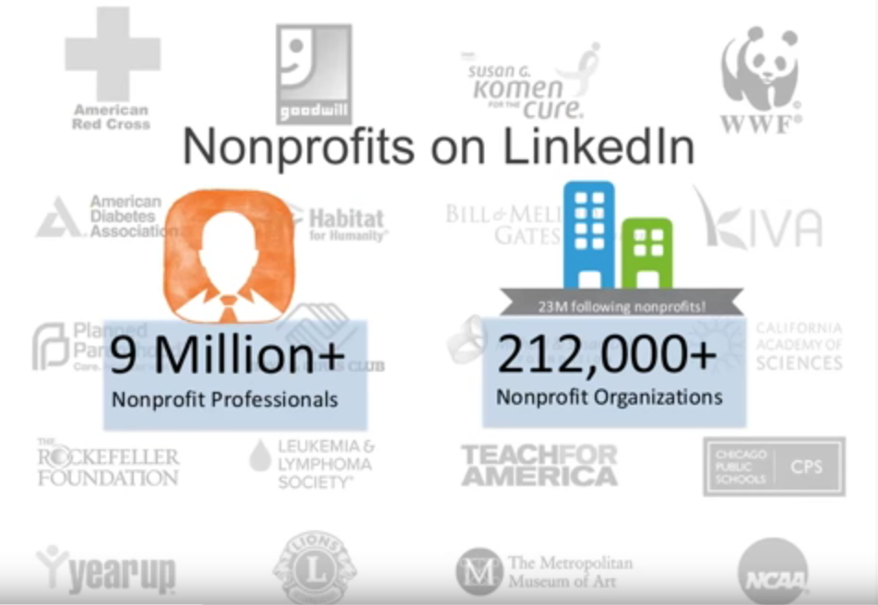
Your Rotary Club & LinkedIn

Slide 15
Your Rotary Club & LinkedIn
Update your Profile
Join Groups
Share relevant news, projects and events with your network and in Groups

Slide 16
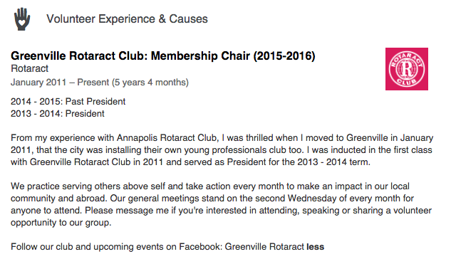
Include on Your LinkedIn Profile

Slide 17
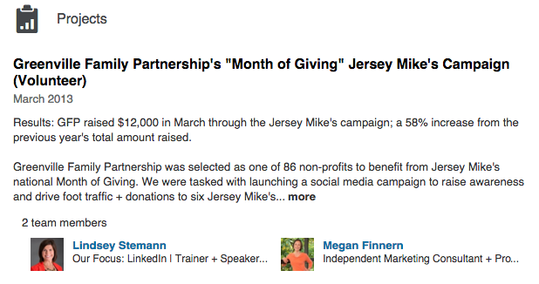
Include on Your LinkedIn Profile

Slide 18
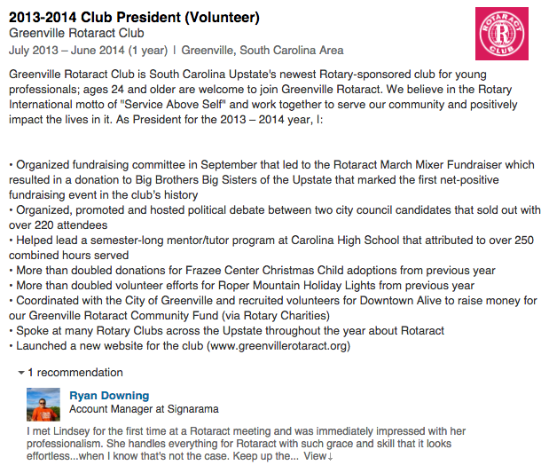
Include on Your LinkedIn Profile

Slide 19
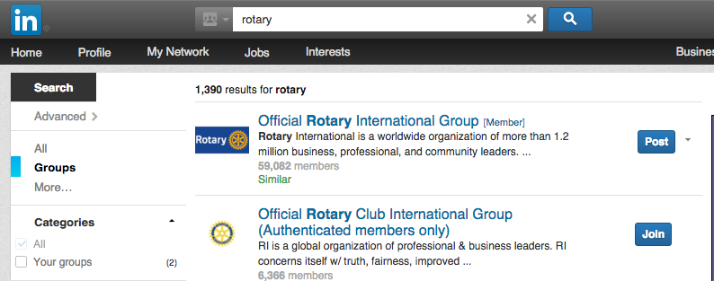
Join Rotary Group(s)

Slide 20
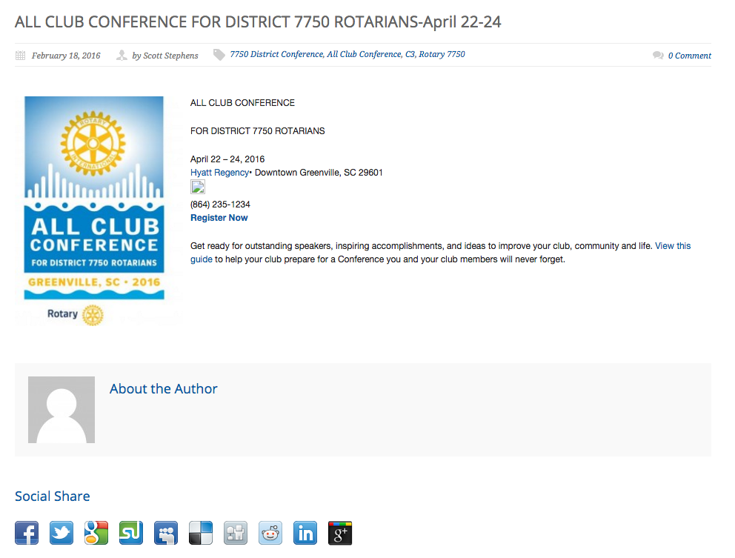
Share news, projects and events with your network (from website)
http://greenvillerotary.org/all-club-conference-for-district-7750-rotarians-april-22-24/

Slide 21
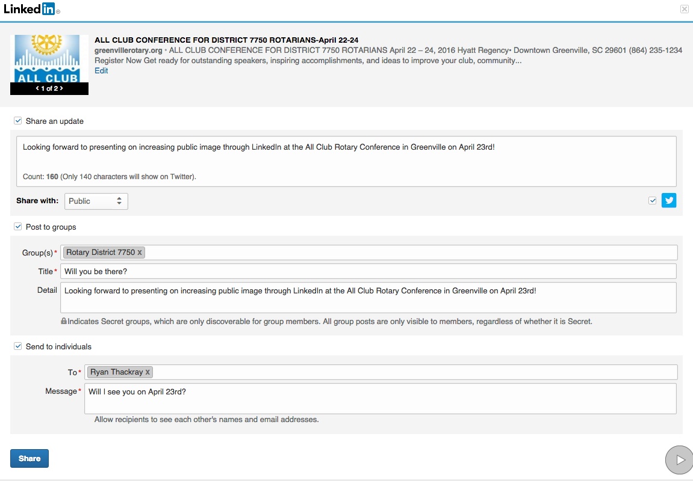
Share news, projects and events with your network (from website)

Slide 22
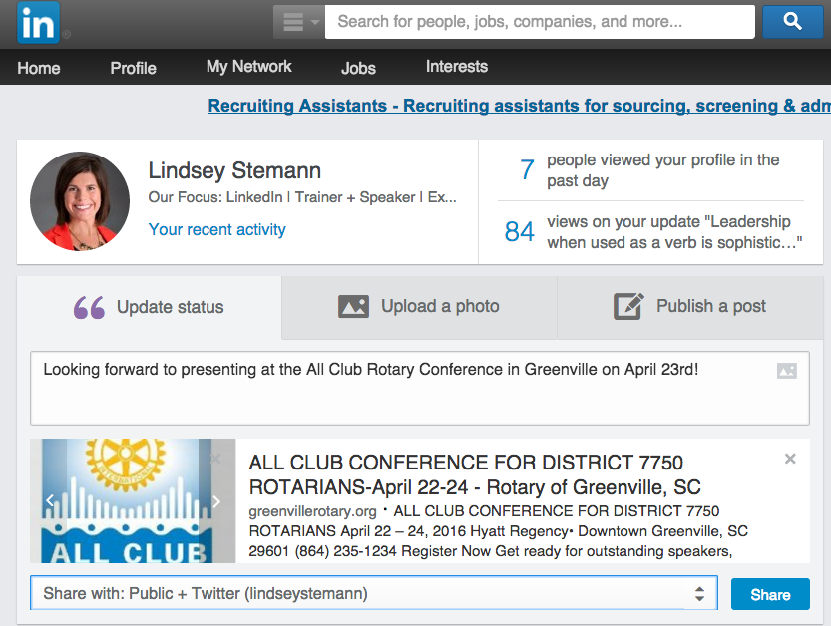
Share news, projects and events with your network (or post in LinkedIn)

Slide 23
Making it easy / Getting everyone involved
Rotary Goals
Serve our communities: projects are not about us, but those we support. Gaining support from others helps us achieve our goals.
Visibility drives membership: Membership supports our club through direct and financial support – which ultimately achieves the Rotary goals.
Everyone in Rotary is involved in PI.
Make it easy, Expand our reach, Achieve our goals.

Slide 24
Closing Remarks
A LOT of information?
Incoming PI Chairs: Useful tools
Practice these new techniques you’ve learned
Remember: There are a lot of communication tools at your disposal, use them!
Use a variety of tools for maximizing awareness of your Rotary Club

Slide 25
Closing Remarks - Resources
District 7750 Resource library
http://www.rotary7750.org/Club_Resources.asp
https://drive.google.com/folderview?id=0B3Z7iXhu1s96aW1iZWxVWmRWRGM&usp=drive_web
www.brandcenter.rotary.org
Logos
Guidelines
Advertising
Videos
Other materials (like this PowerPoint)
rpic33.org (PDG Sue Poss)

Slide 26
Closing Remarks
Don’t feel you have to do it alone:
Club Public Image is everyone’s responsibility
We are also here to help:
Adam Dost, 2016/17 District 7750 PI Chair
adam@printtek.com, 717.514.5248 Mobile
Remember: Always use the new Rotary logo!

