Slide 1
DELEGATION, ACCOUNTABILITY and COACHING
Notes:
1

Slide 2
WHY ORGANIZATIONS FAIL TO PERFORM
They Don’t Get It They don’t understand why it’s important
They Don’t Care Or care enough to make a difference
Winning Hearts & Minds
Leading Change
Leadership & Inspiration
Notes:
2

Slide 3
WHY ORGANIZATIONS FAIL TO PERFORM
They Don’t Get It They don’t understand why it’s important
They Don’t Care Or care enough to make a difference
Winning Hearts & Minds
Leading Change
Leadership & Inspiration
Training & Coaching
They Don’t Know How
Selection
Training
Coaching
Notes:
3

Slide 4
WHY ORGANIZATIONS FAIL TO PERFORM
They Don’t Get It They don’t understand why it’s important
They Don’t Care Or care enough to make a difference
Winning Hearts & Minds
Leading Change
Leadership & Inspiration
Training & Coaching
They Don’t Know How
Selection
Training
Coaching
Notes:
4

Slide 5
REASONS FOR NON-PERFORMANCE
They don't get it -- They don't understand what's important and why
They don't care -- Or care enough to make a difference
They don't know how -- They don't have the skills or strategies needed to make a difference
This applies also to Delegation, holding volunteers accountable, and coaching volunteer leaders
Notes:
5

Slide 6
DELEGATION FAILURES
“I told him to do it”
“I sent her an email”
“I don't know what happened”
“He hasn't done anything”
Notes:
6

Slide 7
DELEGATION FAILURES
“I told him to do it”
“I sent her an email”
“He hasn't done anything”
“I don't know what happened”
Delegation is not Abdication
Notes:
7

Slide 8
EVERYTHING HAS A LEARNING CURVE
People want to succeed
Adults hesitate to say “I don’t know how”
Wanting + Lack of Know-how = Frustration
What do they need?
A COACH
Show them how (or find them someone who can)
Ask for intentional strategies, actions and behaviors
Help set goals and agreed-upon results
Watch them do it
Provide feedback and encouragement
Notes:
8

Slide 9
EVERYTHING HAS A LEARNING CURVE
Notes:
9

Slide 10
EVERYTHING HAS A LEARNING CURVE
Notes:
10

Slide 11
EVERYTHING HAS A LEARNING CURVE
Notes:
11

Slide 12
EVERYTHING HAS A LEARNING CURVE
Notes:
12

Slide 13
EVERYTHING HAS A LEARNING CURVE
Most Managers
Notes:
13

Slide 14
COACHING = THE “BEFORE and “AFTER” of DELEGATION
Notes:
14

Slide 15
EFFECTIVE DELEGATION
Starts with clear-cut expectations
What is the Vision?
What does “Good” look like?
What do I expect you to do?
“What do you need?”
Establishes Metrics
How will we know we’re making progress?
The Contract
“Can you see yourself doing this?”
“Can I count on you?”
Notes:
15

Slide 16
MAKE THE TIME
Decide what you want
Write it down
Make an appointment – best in person
Explain everything – don’t minimize expectations
Confirm you have an agreement
Make the “ask”
If it’s worth asking, it’s worth getting it right
Notes:
16

Slide 17
How does this role sound to you?
Is this something you can get passionate about?
Can you see yourself leading this for me?
Can I count on you to lead this part of my team?

Slide 18
PLAN YOUR FOLLOWUP
Ask for progress reports (at appropriate times)
Sit in on committee meetings (as appropriate)
“You can EXPECT what you INSPECT”
Remember, they want to be successful, and so do you
Help them stay on track
Help keep them accountable to themselves
Notes:
18

Slide 19
WORK SESSION
Write up one Committee Chair Expectation on your worksheet (5 min.)
Make the “ask” of your coaching partner
Partners – Ask questions (or give excuses) as if you’re the prospective committee chair ( 5 min.)
Reverse roles ( 5 min.)
Notes:
19

Slide 20
GETTING PEOPLE ON THE PHONE or: THE KEYS OUT OF VOICE MAIL HELL
Notes:
20

Slide 21
GETTING PEOPLE ON THE PHONE
This will change your life if you employ it regularly
Notes:
21

Slide 22
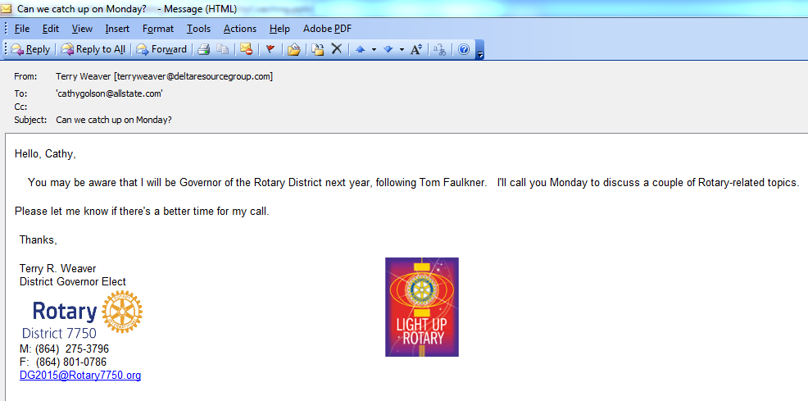
BEFORE YOU CALL (a day or two)
Send an email – 3 sentences:
I have something I need to talk with you about
I’ll call you on Tuesday to explain
Please let me know if there’s a better time
Subject: Can we catch up on Tuesday?
Notes:
22

Slide 23
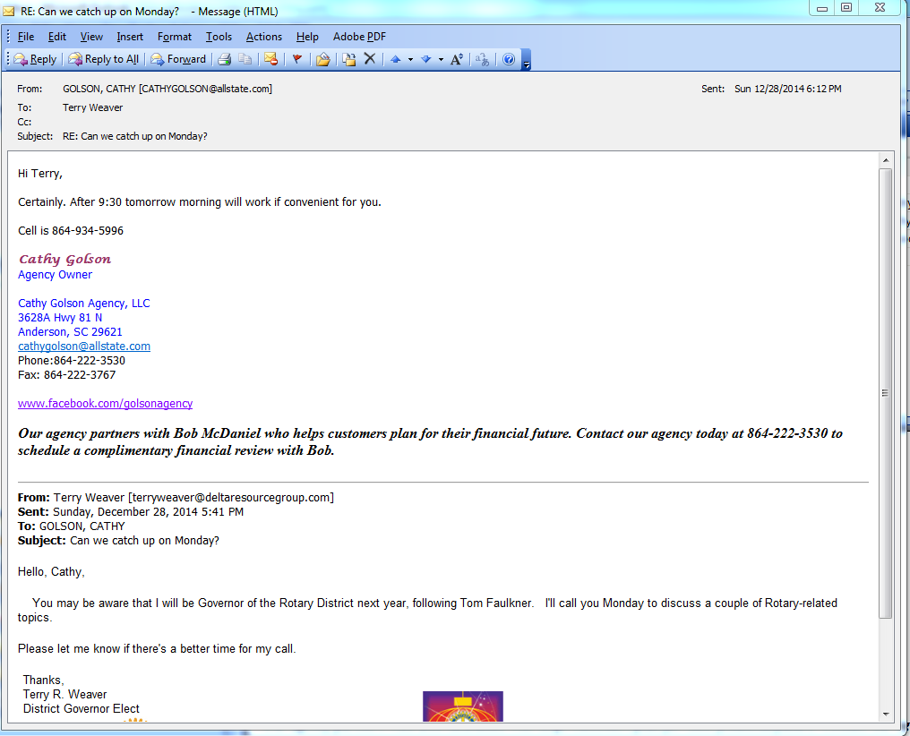
NEXT…
Notes:
23

Slide 24
OR:
Make the call – If they answer, say, “Is this an OK time? You’re not tied up with something, are you?”
If you get voicemail:
“Hello, ____, this is _____. Sorry I missed you today
“I wanted to talk about……
“I’ll call you on Wednesday to fill you in
“Please let me know if there’s a better time
“If you can call me back, it’s 864 275-3796”
Notes:
24

Slide 25
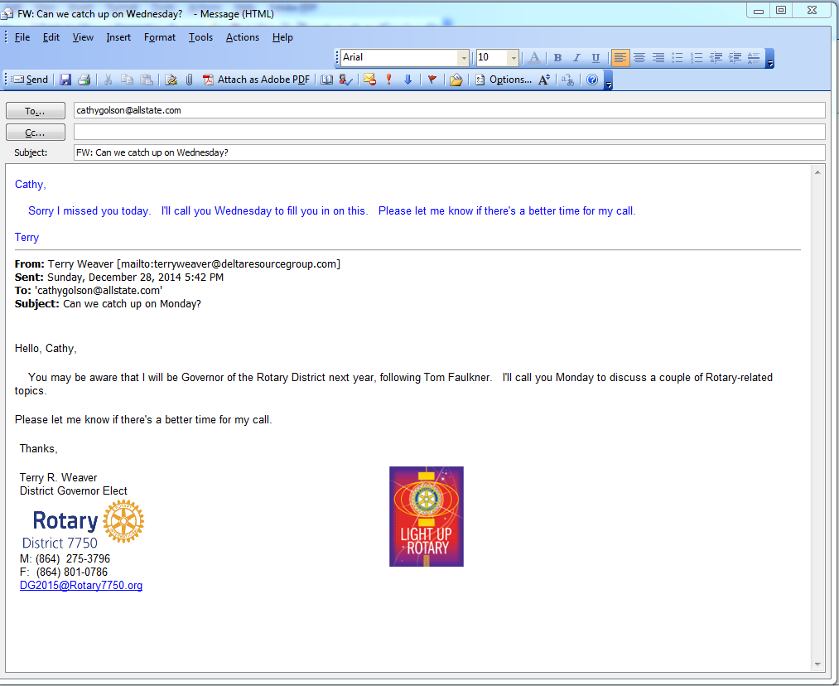
THEN:
Notes:
25

Slide 26
ON WEDNESDAY:
Make the call – If they answer, say, “Is this an OK time? You’re not tied up with something, are you?”
Make the call – if you get voicemail:
“Hello, ____, this is _____. Sorry I missed you today
“I wanted to talk about……
“I’ll call you on Thursday to fill you in
“Please let me know if there’s a better time
“If you can call me back, it’s 864 275-3796”
Notes:
26

Slide 27
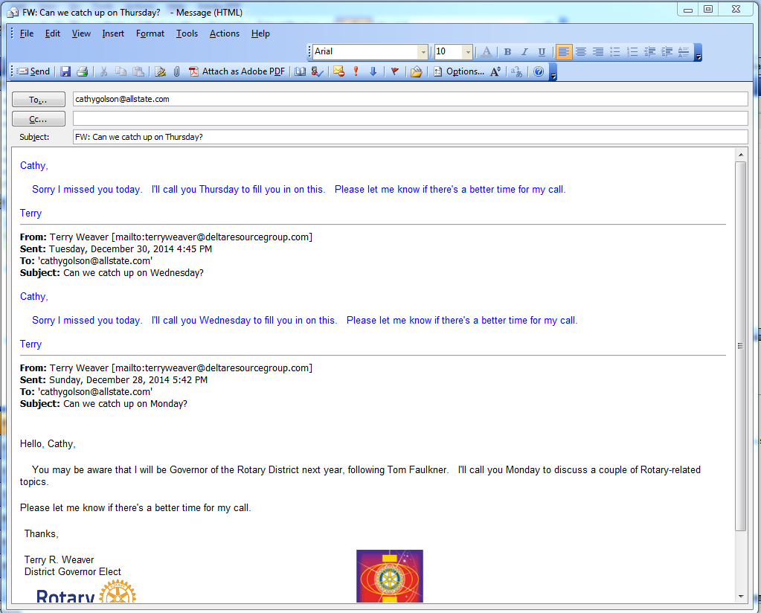
THEN:
Notes:
27

Slide 28
WHY THIS WORKS
While the ball’s in their court, you’re doing the work – asking very little of them
They can easily respond with an alternate date
On vacation, out of the country, swamped with work, company in town, etc.
Politely persistent
“I’m serious about talking with you
“I have a reason to do so
“I’m respectful of your time
“I’m willing to do all the work from my end.”
Notes:
28

Slide 29
CLUB PLANNING PROCESS
Notes:
29

